Slide 1
Fabric
A Platform for
Secure Distributed Computation and Storage
Jed Liu Xin Qi | Michael D. George Lucas Waye | K. Vikram Andrew C. Myers
Department of Computer Science Cornell University 22nd ACM SIGOPS Symposium on Operating Systems Principles 14 October 2009

Slide 2







The Web is Not Enough
The Web: decentralized information-sharing
Limitations for integrating information
  Medicine, finance, government, military, …
  Need security and consistency
Is there a principled way to build federated applications while guaranteeing security and consistency?

Slide 3
Fabric: A System and a Language
Decentralized system for securely sharing information and computation
All information looks like an ordinary program object
Objects refer to each other with references
  Any object can be referenced uniformly from anywhere
  References can cross nodes and trust domains
  All references look like ordinary object pointers
node1
n
child:
node2
Compiler and runtime enforce security and consistency despite distrust
value: 42
n.child.value++

Slide 4





Fabric Enables Federated Sharing
Different
HIPAA-compliant
policy
HIPAA-compliant
policy
General
Practitioner
(GP)
Psychiatrist

Slide 5

Fabric Enables Federated Sharing
General
Practitioner
(GP)
Psychiatrist

Slide 6
Fabric Enables Federated Sharing
Different
HIPAA-compliant
policy
HIPAA-compliant
policy
General
Practitioner
(GP)
Psychiatrist

Slide 7






Example: Filling a Prescription
Order medication
Check for conflicts
Pharmacist
Verify prescription
Get current medications
Psychiatrist
General Practitioner

Slide 8


Example: Filling a Prescription
Security issues
Pharmacist shouldn’t see entire record
Psychiatrist doesn’t fully trust pharmacist with update
  Need secure distributed computation
Consistency issues
Need atomicity
Doctors might be accessing medical record concurrently
Fill order
Pharmacist
Update inventory
Mark prescription as filled
Must be done by pharmacist
Psychiatrist
Must be done by psychiatrist

Slide 9
Pharmacy Example in Fabric
Order orderMed(PatRec psyRec, PatRec gpRec, Prescription p) {
if (!psyRec.hasPrescription(p)) return Order.invalid;
if (isDangerous(p, gpRec.getMeds())) return Order.danger;
}
Check for conflicts
Get prescriptions
Get current
medications

Slide 10
Pharmacy Example in Fabric
Order orderMed(PatRec psyRec, PatRec gpRec, Prescription p) {
atomic {
if (!psyRec.hasPrescription(p)) return Order.invalid;
if (isDangerous(p, gpRec.getMeds())) return Order.danger;
Worker psy = psyRec.getWorker();
psyRec.markFilled@psy(p);
updateInventory(p);
return Order.fill(p);
}
}
Fill order
Update
inventory
Mark prescription as filled

Slide 11
A High-Level Language
Order orderMed(PatRec psyRec, PatRec gpRec, Prescription p) {
atomic {
if (!psyRec.hasPrescription(p)) return Order.invalid;
if (isDangerous(p, gpRec.getMeds())) return Order.danger;
Worker psy = psyRec.getWorker();
psyRec.markFilled@psy(p);
updateInventory(p);
return Order.fill(p);
}
}
Java with:
Remote calls
Nested transactions (atomic blocks)
Label annotations for security (elided)

Slide 12
A High-Level Language
Order orderMed(PatRec psyRec, PatRec gpRec, Prescription p) {
atomic {
if (!psyRec.hasPrescription(p)) return Order.invalid;
if (isDangerous(p, gpRec.getMeds())) return Order.danger;
Worker psy = psyRec.getWorker();
psyRec.markFilled@psy(p);
updateInventory(p);
return Order.fill(p);
}
}
All objects accessed uniformly regardless of location
Objects fetched as needed
Remote calls are explicit
Run-time system requirement:
Secure transparent data shipping

Slide 13
Remote Calls
Order orderMed(PatRec psyRec, PatRec gpRec, Prescription p) {
atomic {
if (!psyRec.hasPrescription(p)) return Order.invalid;
if (isDangerous(p, gpRec.getMeds())) return Order.danger;
Worker psy = psyRec.getWorker();
psyRec.markFilled@psy(p);
updateInventory(p);
return Order.fill(p);
}
}
Remote call — pharmacist runs method at psychiatrist’s node
Run-time system requirements:
Secure transparent data shipping
Secure remote calls

Slide 14
Federated Transactions
Order orderMed(PatRec psyRec, PatRec gpRec, Prescription p) {
atomic {
if (!psyRec.hasPrescription(p)) return Order.invalid;
if (isDangerous(p, gpRec.getMeds())) return Order.danger;
Worker psy = psyRec.getWorker();
psyRec.markFilled@psy(p);
updateInventory(p);
return Order.fill(p);
}
}
Federated transaction — spans multiple nodes & trust domains
Remote call — pharmacist runs method at psychiatrist’s node
Run-time system requirements:
Secure transparent data shipping
Secure remote calls
Secure federated transactions

Slide 15
Fabric Security Model
Decentralized system – anyone can join
What security guarantees can we provide?
Decentralized security principle:
Need notion of “you” and “trust” in system and language
  Principals and acts-for
You can’t be hurt by what you don’t trust

Slide 16

Principals and Trust in Fabric
Principals represent users, nodes, groups, roles
Trust delegated via acts-for
  “Alice acts-for Bob” means “Bob trusts Alice”
  Like “speaks-for” [LABW91]
  Generates a principal hierarchy
acts for
acts for
A_{pharm}
A_{doc}

Slide 17
Trust Management
Fabric principals are objects
Explicit trust delegation via method calls
  Compiler and run-time ensure that caller has proper authority
Determines whether
p acts for this principal
class Principal {
boolean delegatesTo(principal p);
void addDelegatesTo(principal p) where caller (this);
…
}
Caller must have authority of this principal
// Adds “Alice acts-for Bob” to principal hierarchy
bob.addDelegatesTo(alice)

Slide 18
Security Labels in Fabric
Based on Jif programming language [M99]
Decentralized label model [ML98]
  Labels specify security policies to be enforced
Compiler and run-time system ensure that policies are satisfied
Confidentiality: | Alice Bob | Alice permits Bob to read
Integrity: | Alice Bob | Alice permits Bob to write
class Prescription {
Drug{Psy A_{pharm}; Psy Psy} drug;
Dosage{Psy A_{pharm}; Psy Psy} dosage;
… }

Slide 19
Security Labels in Fabric
Based on Jif programming language [M99]
Decentralized label model [ML98]
  Labels specify security policies to be enforced
Compiler and run-time system ensure that policies are satisfied
Confidentiality: | Alice Bob | Alice permits Bob to read
Integrity: | Alice Bob | Alice permits Bob to write
class Prescription {
Drug{Psy A_{pharm}; Psy Psy} drug;
Dosage{Psy A_{pharm}; Psy Psy} dosage;
… }
Run-time system requirements:
Secure transparent data shipping
Secure remote calls
Secure federated transactions
Enforcement of security labels

Slide 20
Contributions
Language combining:
  Remote calls
  Nested transactions
  Security annotations
System with:
  Secure transparent data shipping
  Secure remote calls
  Secure federated transactions
  Enforcement of security labels
Challenge: How to provide all these in the same system?

Slide 21
Fabric Run-Time System
Decentralized platform for secure, consistent sharing of information and computation
  Nodes join freely
  No central control over security
Nodes are principals
  Root of trust
  Authentication: X.509 certificates bind hostnames to principal objects

Slide 22

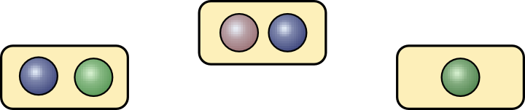
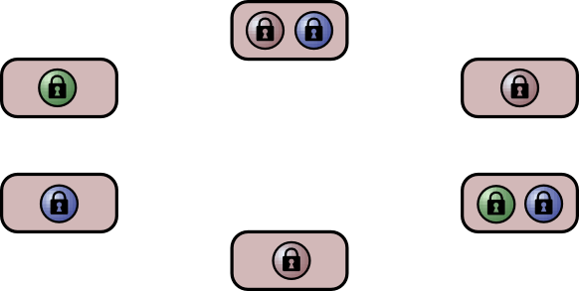
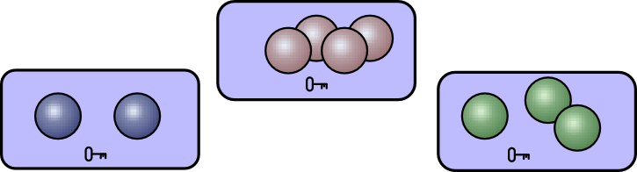
Fabric Architecture
transaction
Worker nodes
(Workers)
remote
call
Dissemination nodes
Storage nodes
(Stores)

Slide 23
Fabric Architecture
transaction
Worker nodes
(Workers)
remote
call
Dissemination nodes
Storage nodes securely store persistent objects
Each object specifies its own security policy, enforced by store

Slide 24


Fabric Architecture
transaction
Worker nodes
(Workers)
remote
call
Dissemination nodes cache signed, encrypted objects in peer-to-peer distribution network for high availability
disseminate
Storage nodes securely store persistent objects
Each object specifies its own security policy, enforced by store

Slide 25


Fabric Architecture
transaction
Worker nodes compute on cached objects
Computation may be distributed across workers in federated transactions
remote
call
write
read
Dissemination nodes cache signed, encrypted objects in peer-to-peer distribution network for high availability
disseminate
Storage nodes securely store persistent objects
Each object specifies its own security policy, enforced by store

Slide 26


Secure Transparent Data Shipping
Illusion of access to arbitrarily large object graph
  Workers cache objects
  Objects fetched as pointers are followed out of cache
Stores enforce security policies on objects
  Worker can read (write) object only if it’s trusted to enforce confidentiality (integrity)
Worker node: y = x.f
Fabric object graph (distributed)
object cache
proxy
x
x
y

Slide 27
Secure Transparent Data Shipping
Illusion of access to arbitrarily large object graph
  Workers cache objects
  Objects fetched as pointers are followed out of cache
Stores enforce security policies on objects
  Worker can read (write) object only if it’s trusted to enforce confidentiality (integrity)
Worker node: y = x.f
Fabric object graph (distributed)
object cache
proxy
x
x
y
Run-time system requirements:
Secure transparent data shipping
Secure remote calls
Secure federated transactions
Enforcement of security labels

Slide 28
Secure Remote Calls
Is callee trusted to see call?
Call itself might reveal private information
Method arguments might be private
Is caller trusted to make call?
Caller might not have sufficient authority to make call
Method arguments might have been tampered with by caller
Confidentiality
Integrity
Static checks
Dynamic checks
caller
Integrity
Confidentiality
callee
Is callee trusted to execute call?
Call result might have been tampered with by callee
Is caller trusted to see result?
Call result might reveal private information

Slide 29
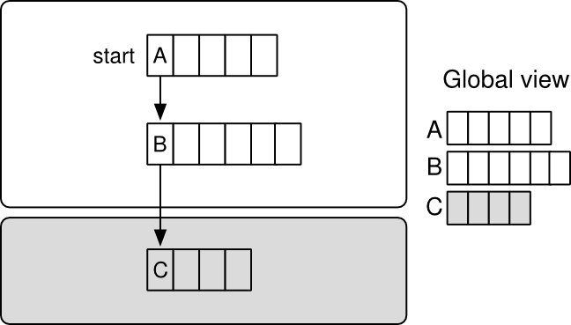
Secure Federated Transactions
Transactions can span multiple workers, cross trust domains
  No single node trusted for entire
  log: distributed log structure
Object updates propagated transparently and securely in multi-worker transactions
Pharmacist
Mark prescription as filled
Pharmacist not trusted to log update
Psychiatrist

Slide 30
Also in the Paper...
Dissemination of encrypted object groups
  Key management to support this
Writer maps for secure propagation of updates
Hierarchical two-phase commit for federated transactions
Interactions of transaction abort and information flow control
Automatic ‘push’ of updated objects to dissemination layer
In-memory caching of object groups at store
Caching acts-for relationships at workers

Slide 31
Implementation
Fabric prototype implemented in Java and Fabric
  Total: 35 kLOC
  Compiler translates Fabric into Java
    15 k-line extension to Jif compiler
    Polyglot [NCM03] compiler extension
  Dissemination layer: 1.5k-line extension to FreePastry
    Popularity-based replication (à la Beehive [RS04])
  Store uses BDB as backing store

Slide 32
Overheads in Fabric
Extra overhead on object accesses at worker
  Run-time label checking
  Logging reads and writes
  Cache management (introduces indirection)
  Transaction commit
Overhead at store for reads and commits
Ported non-trivial web app to evaluate performance

Slide 33
Cornell CMS Experiment
Used at Cornell since 2004
  Over 2000 students in over 40 courses
Two prior implementations:
  J2EE/EJB2.0
    54k-line web app with hand-written SQL
    Oracle database
  Hilda [YGG+07]
    High-level language for
    data-driven web apps
Fabric implementation
app
server
DB
server
app server
(worker)
CMS
store

Slide 34
Performance Results

Slide 35
Scalability Results
Language integration: easy to replicate app servers
Reasonable speed-up with strong consistency
  Work offloaded from store onto workers
app server
(worker)
CMS
store
 | 3 workers | 5 workers
Course overview | 2.18 x | 2.49 x
Student info | 2.45 x | 2.94 x

Slide 36
Related Work
Category | Examples | What Fabric Adds
Federated object store | OceanStore/Pond | Transactions Security policies
Secure distributed storage systems | Boxwood, CFS, Past | Fine-grained security High-level programming
Distributed object systems | Gemstone, Mneme, ObjectStore, Sinfonia, Thor | Security enforcement Multi-worker transactions with distrust
Distributed computation/RPC | Argus, Avalon, CORBA, Emerald, Live Objects, Network Objects | Single-system view of persistent data Strong security enforcement
Distributed information flow systems | DStar, Jif/Split, Swift | Transactions on persistent data
Fabric is the first to combine information-flow security, remote calls, and transactions in a decentralized system.

Slide 37
Summary
Fabric is a platform for secure and consistent federated sharing
Prototype implementation
Contributions:
  High-level language integrating information flow, transactions, distributed computation
  Transparent data shipping and remote calls while enforcing secure information flow
  New techniques for secure federated transactions: hierarchical commits, writer maps

Slide 38
Fabric
A Platform for
Secure Distributed Computation and Storage
Jed Liu Xin Qi | Michael D. George Lucas Waye | K. Vikram Andrew C. Myers
Department of Computer Science Cornell University 22nd ACM SIGOPS Symposium on Operating Systems Principles 14 October 2009

