Slide 1

A File is Not a File:
Understanding the I/O Behavior of Apple Desktop Applications
Tyler Harter, Chris Dragga, Michael Vaughn,
Andrea C. Arpaci-Dusseau, Remzi H. Arpaci-Dusseau
Department of Computer Sciences
University of Wisconsin-Madison

Slide 2
Why study desktop applications?
Measurement drives file-system design
  File systems must decide how to optimize
Great history - many past I/O studies
  SOSP ’81: M. Satyanarayanan. A Study of File Sizes and Functional Lifetimes.
  SOSP ’85:, Ousterhout et al. A Trace-Driven Analysis of Name and Attribute Caching in a Distributed System.
  SOSP ’91: M. Baker et al. Measurements of a Distributed System.
  SOSP ’99: W. Vogels. File system usage in Windows NT 4.0.
There is still uncharted territory
  Little focus on home users
  Little focus on individual applications
  More study can inform the design of the next generation of file systems

Slide 3
Outline
Why study desktop applications?
Case study: saving a document
  The big picture
  The DOC file
General findings
Conclusion

Slide 4
A case study: saving a document
Application: Pages 4.0.3
  From Apple’s iWork suite
  Document processor (like MS Word)
One simple task (from user’s perspective):
  Create a new document
  Insert 15 JPEG images (each ~2.5MB)
  Save to the Microsoft DOC format

Slide 5
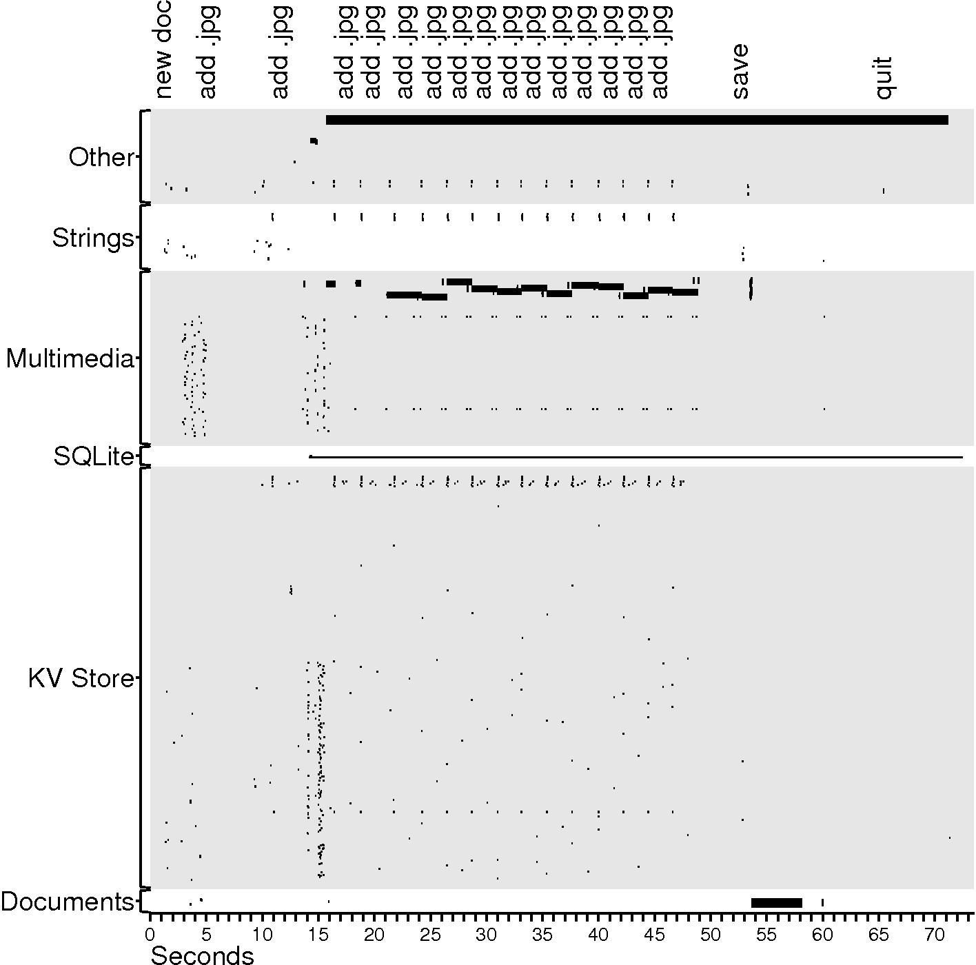
Files
small I/O
big I/O

Slide 6
Files
small I/O
big I/O

Slide 7
Files
small I/O
big I/O

Slide 8
Case study observations
Auxiliary files dominate
  Task’s purpose: create 1 file; observed I/O: 385 files are touched
  218 KV store files + 2 SQLite files:
    Personalized behavior (recently used lists, settings, etc)
  118 multimedia files:
    Rich graphical experience
  25 Strings files:
    Language localization
  17 Other files:
    Auto-save file and others

Slide 9
Files
small I/O
big I/O

Slide 10
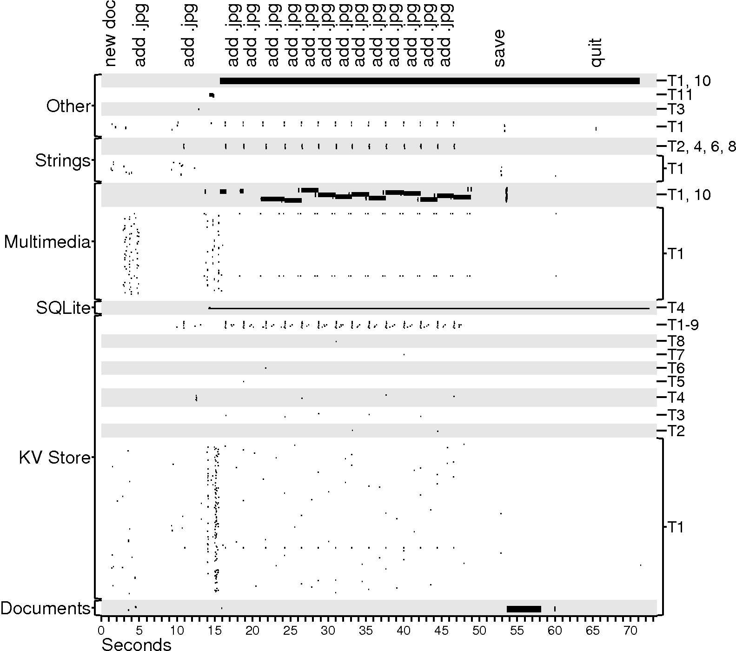
Files
Threads
small I/O
big I/O

Slide 11
Case study observations
Auxiliary files dominate
Multiple threads perform I/O
  Interactive programs must avoid blocking

Slide 12
Files
Threads
small I/O
big I/O

Slide 13
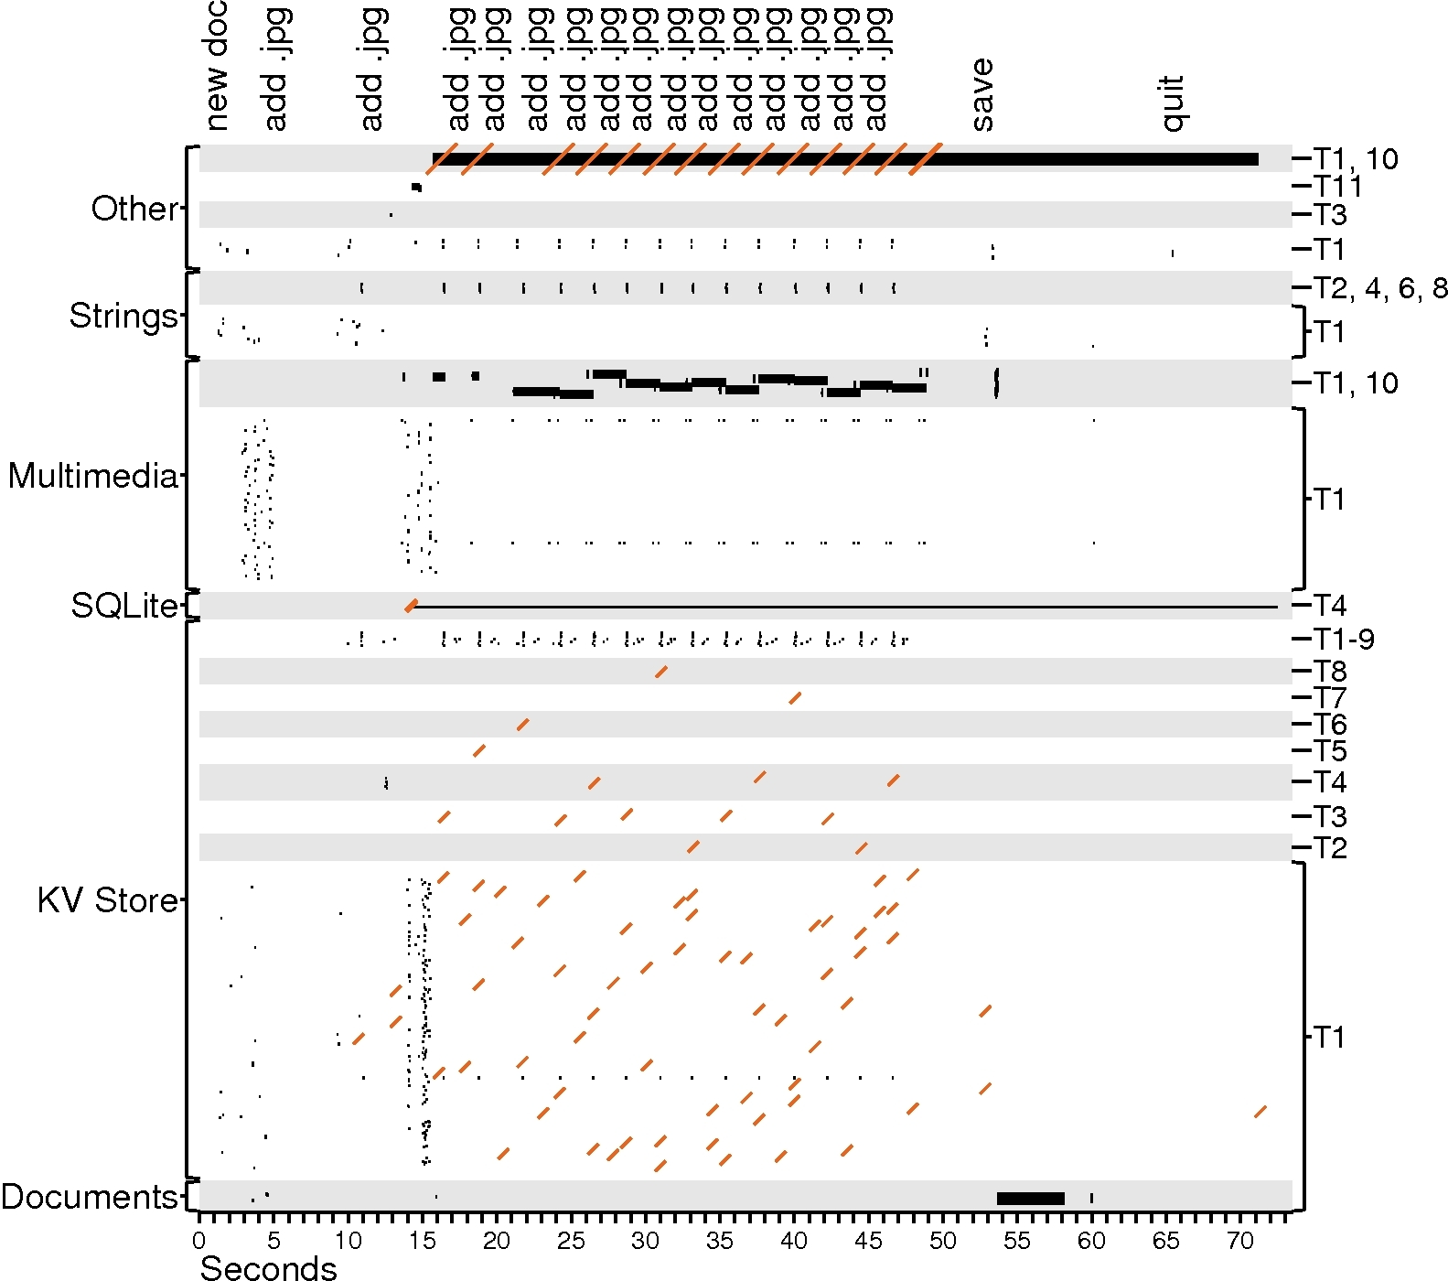
Files
Threads
small I/O
big I/O
fsync

Slide 14
Case study observations
Auxiliary files dominate
Multiple threads perform I/O
Writes are often forced
  KV-store + SQLite durability
  Auto-save file

Slide 15
Files
Threads
small I/O
big I/O
fsync

Slide 16
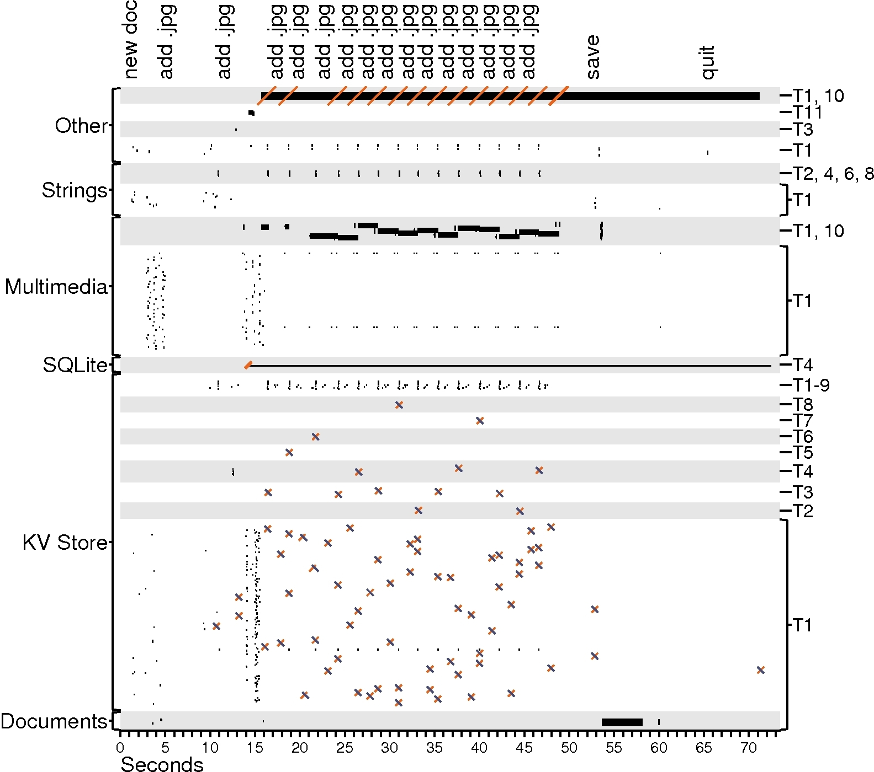
Files
Threads
small I/O
big I/O
fsync
rename

Slide 17
Case study observations
Auxiliary files dominate
Multiple threads perform I/O
Writes are often forced
Renaming is popular
  Often used for key-value store
  Makes updates atomic

Slide 18
Files
Threads
small I/O
big I/O
fsync
rename

Slide 19
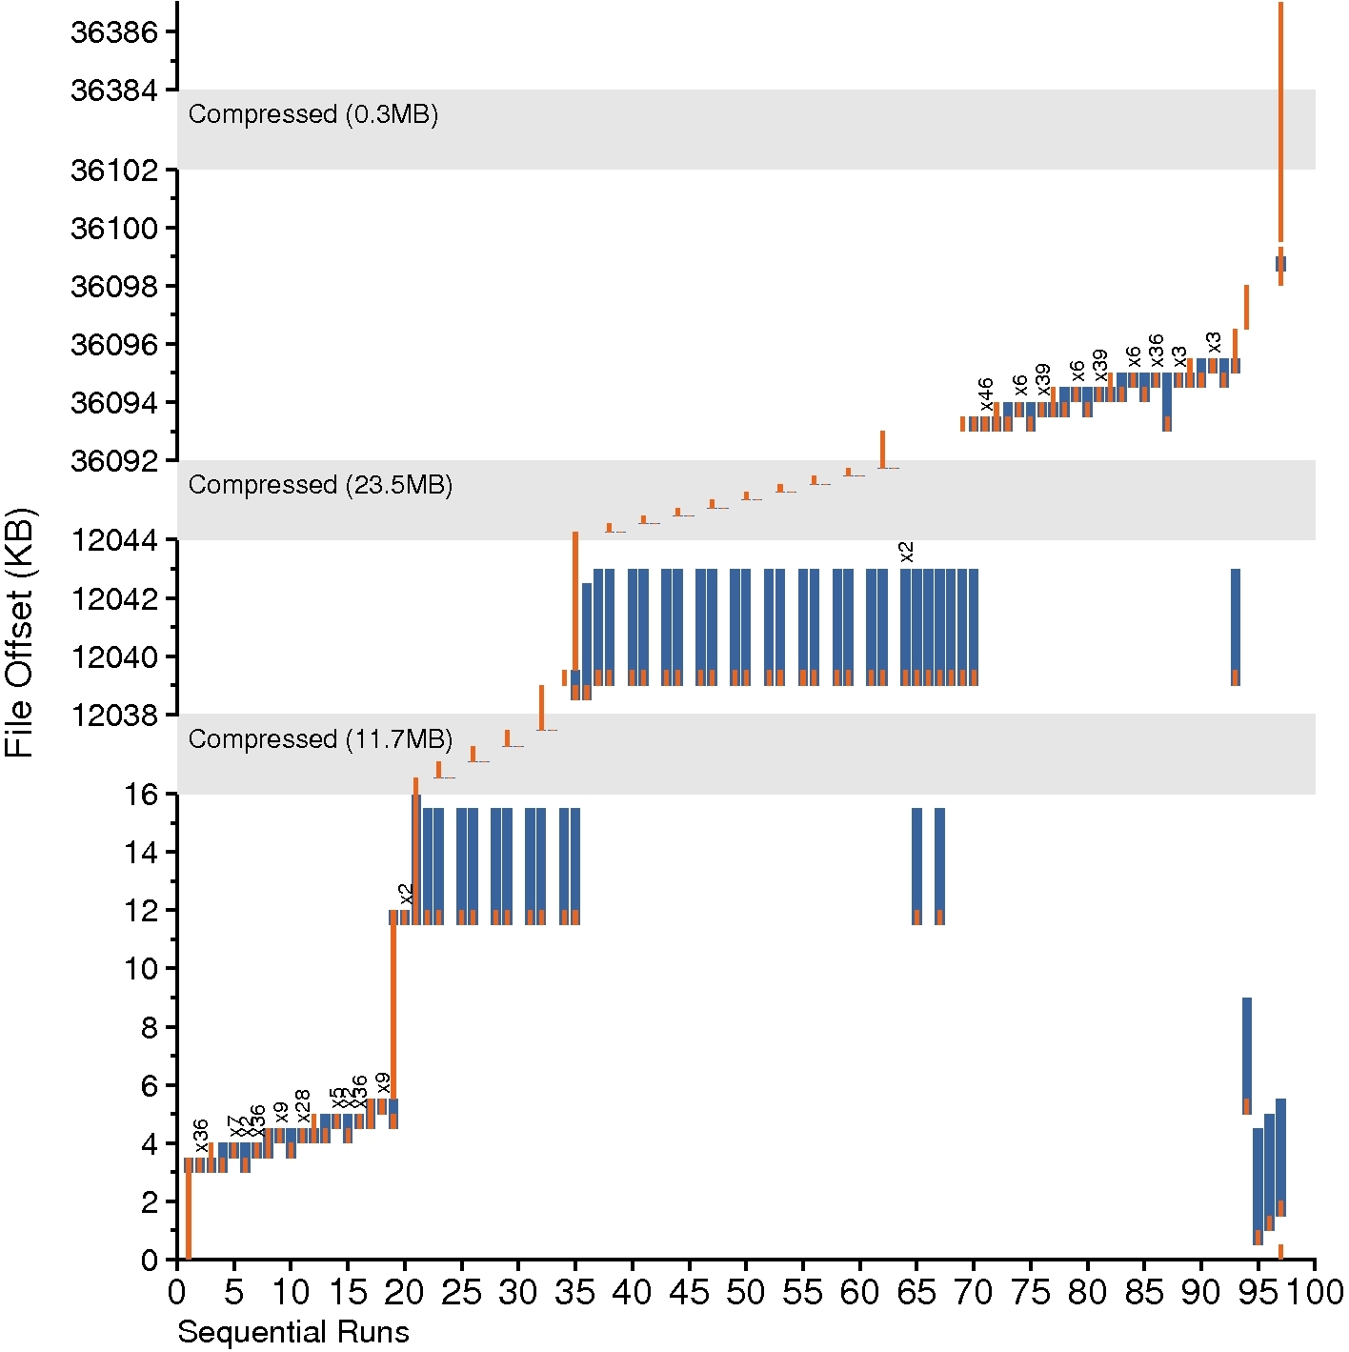
Writing the
DOC file
read
write

Slide 20
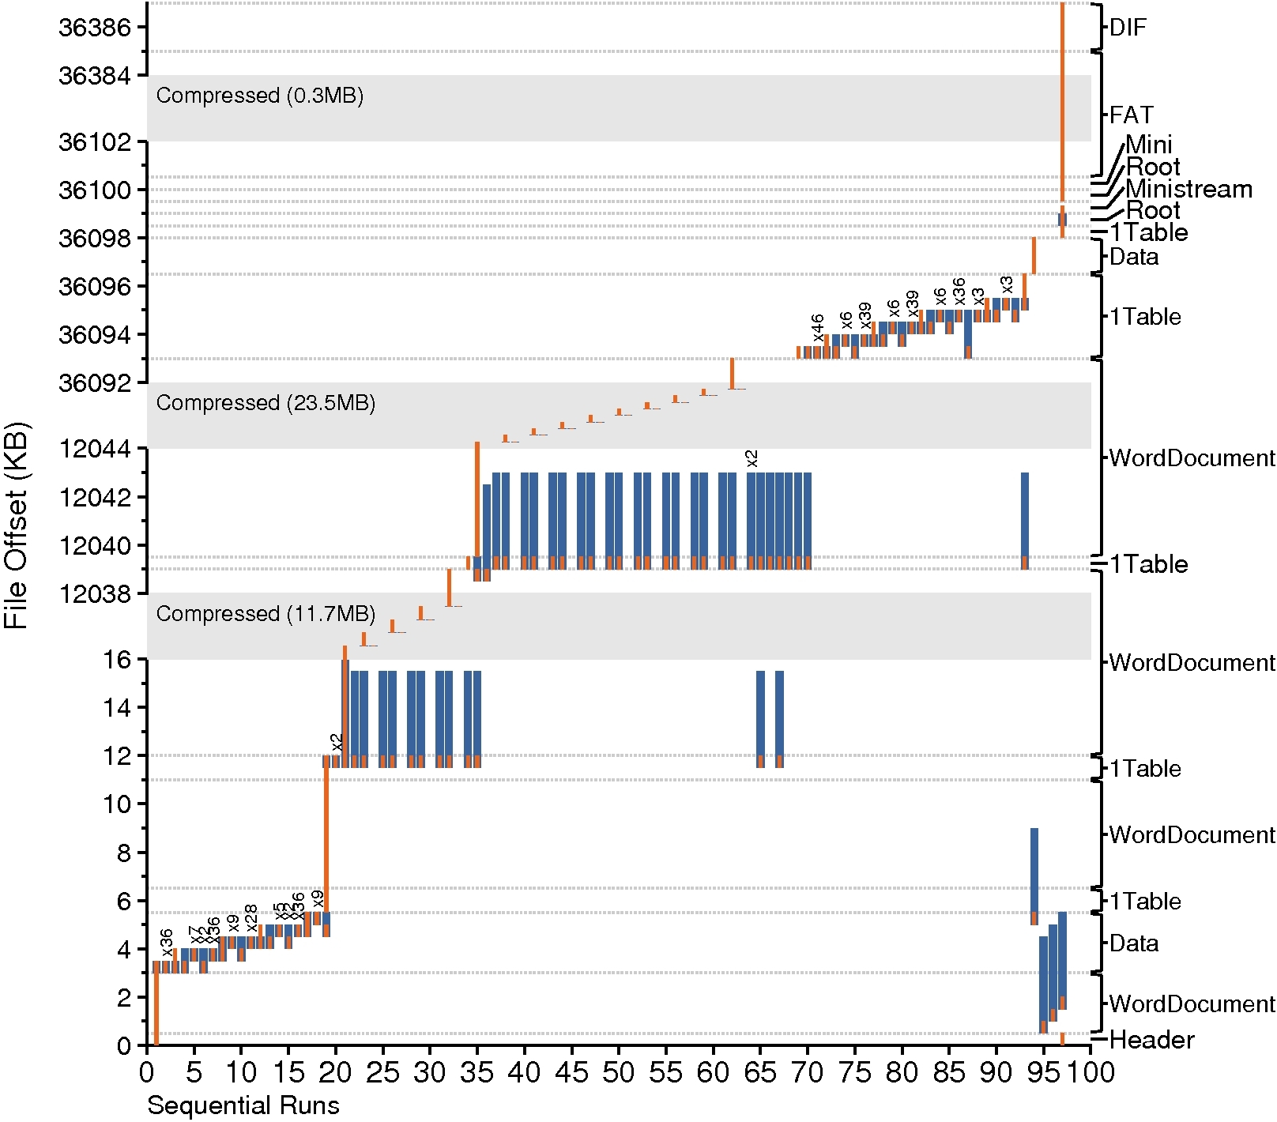
Writing the
DOC file
read
write

Slide 21
Case study observations
Auxiliary files dominate
Multiple threads perform I/O
Writes are often forced
Renaming is popular
A file is not a file
  DOC format is modeled after a FAT file system
    Multiple “sub-files”
    Application manages space allocation

Slide 22
Writing the
DOC file
read
write

Slide 23
Case study observations
Auxiliary files dominate
Multiple threads perform I/O
Writes are often forced
Renaming is popular
A file is not a file
Sequential access is not sequential
  Multiple sequential runs in a complex file => random accesses

Slide 24
Writing the
DOC file
read
write

Slide 26
Case study observations
Auxiliary files dominate
Multiple threads perform I/O
Writes are often forced
Renaming is popular
A file is not a file
Sequential access is not sequential
Frameworks influence I/O
  Example: update value in page function
  Cocoa, Carbon are a substantial part of application

Slide 27
Outline
Why study desktop applications?
Case study: saving a document
General analysis
  Introducing iBench
  Files
  Accesses
  Transactional demands
  Threads
Conclusion

Slide 28






iBench applications
Choose popular home-user applications
  iLife suite (multimedia)
    iPhoto 8.1.1
    iTunes 9.0.3
    iMovie 8.0.5
  iWork (like MS Office)
    Pages 4.0.3
    (Word)
    Numbers 2.0.3
    (Excel)
    Keynote 5.0.3
    (PowerPoint)

Slide 29
iBench Tasks
Automate 34 typical tasks (iBench task suite)
  Importing photos, playing songs, editing movies
  Typing documents, making charts, displaying a slideshow
Collect I/O traces
  Use DTrace to instrument kernel
  System-call level traces reveal application behavior
  Record I/O events: open, close, read, write, fsync, etc.
The iBench traces
  Available online: http://www.cs.wisc.edu/adsl/Traces/ibench/

Slide 30
iBench questions
What different types of files are accessed?
  Which types dominate?
What I/O patterns are used to access the files?
  Is I/O sequential or random?
What are the transactional properties?
  Are writes flushed with fsync or performed atomically?
How are threads used?
  How is I/O distributed across different threads?

Slide 31
iBench questions
What different types of files are accessed?
  Which types dominate?
What I/O patterns are used to access the files?
  Is I/O sequential or random?
What are the transactional properties?
  Are writes flushed with fsync or performed atomically?
How are threads used?
  How is I/O distributed across different threads?

Slide 32
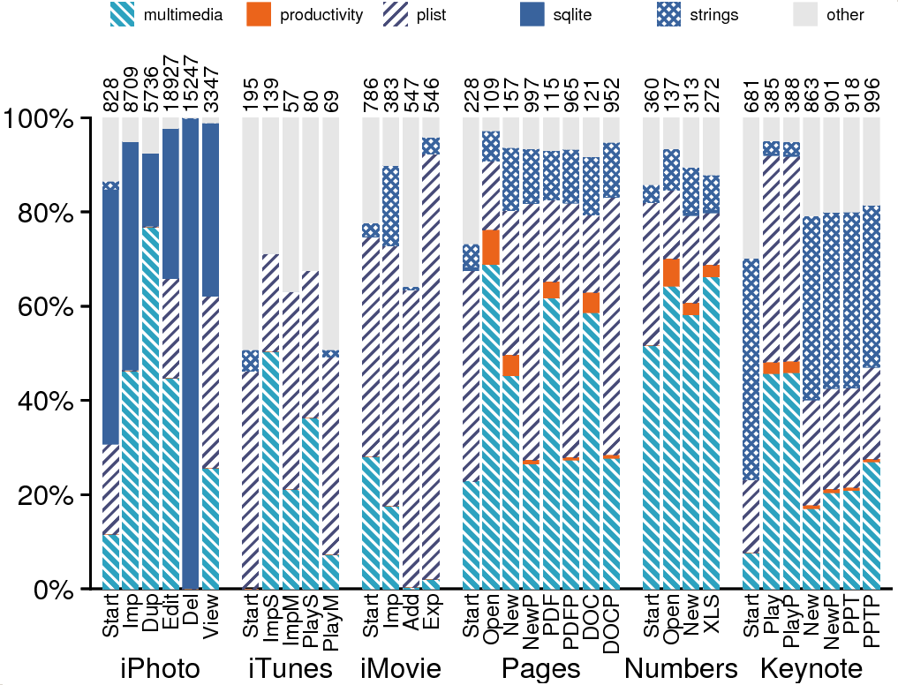
File type (weighted by accesses)
Files

Slide 33
Files

Slide 34
General observations
Auxiliary files dominate
  Lots of helper files
  With hundreds of helper files, how can we minimize disk seeks?

Slide 35
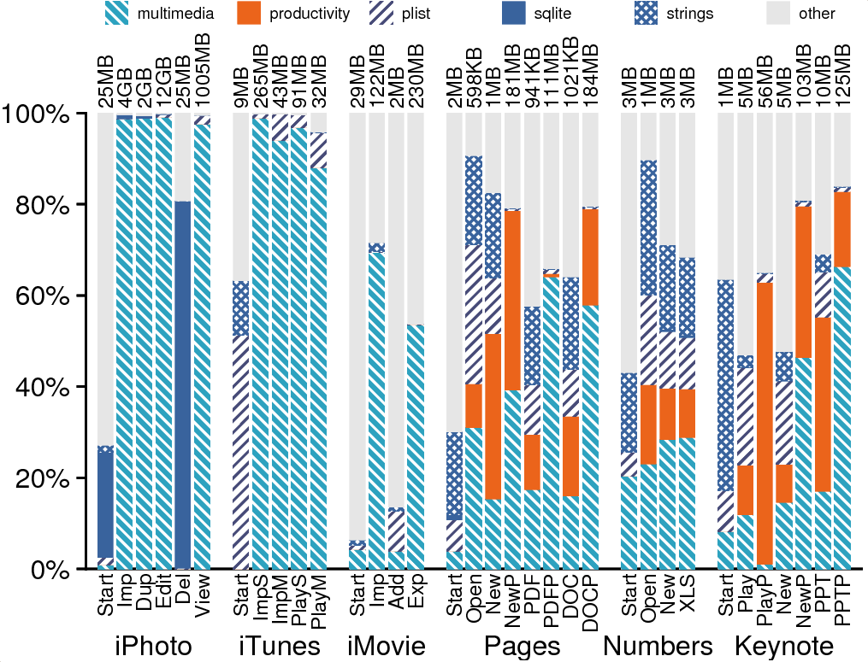
File type (weighted by I/O bytes)
Files, (weighted by I/O)

Slide 36
Mostly Complex
Files
Files, (weighted by I/O)

Slide 37
General observations
Auxiliary files dominate
A file is not a file
  Complex files have a significant presence
  How can we allocate space for sub files in complex files?

Slide 38
iBench questions
What different types of files are accessed?
  Which types dominate?
What I/O patterns are used to access the files?
  Is I/O sequential or random?
What are the transactional properties?
  Are writes flushed with fsync or performed atomically?
How are threads used?
  How is I/O distributed across different threads?

Slide 39
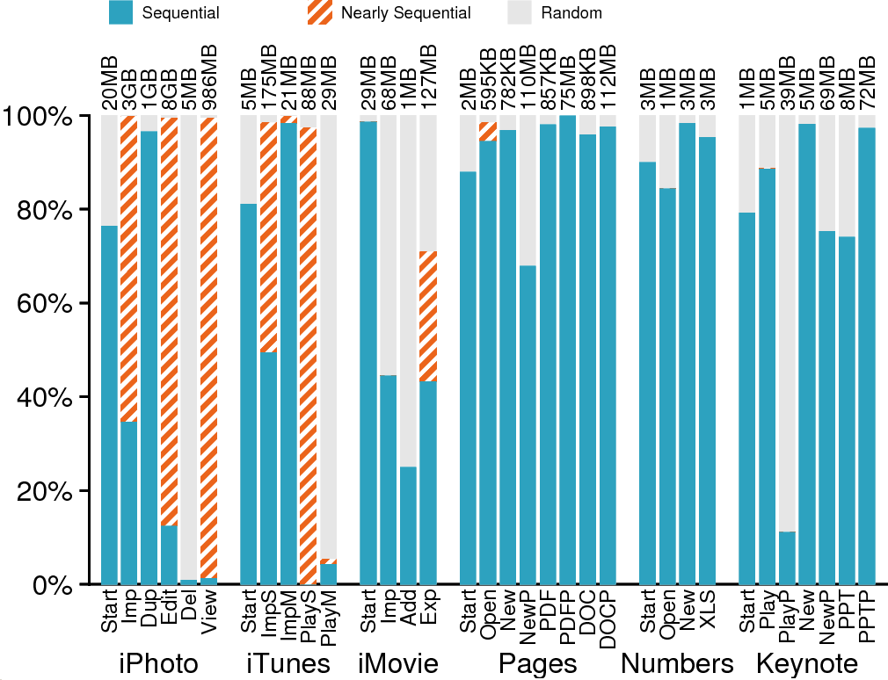
Read sequentiality
Read I/O bytes

Slide 40
Prefetching
Implications
Read I/O bytes

Slide 41
General observations
Auxiliary files dominate
A file is not a file
Sequential access is not sequential
  How can we prefetch intelligently based on patterns?

Slide 42
iBench questions
What different types of files are accessed?
  Which types dominate?
What I/O patterns are used to access the files?
  Is I/O sequential or random?
What are the transactional properties?
  Are writes flushed with fsync or performed atomically?
How are threads used?
  How is I/O distributed across different threads?

Slide 43
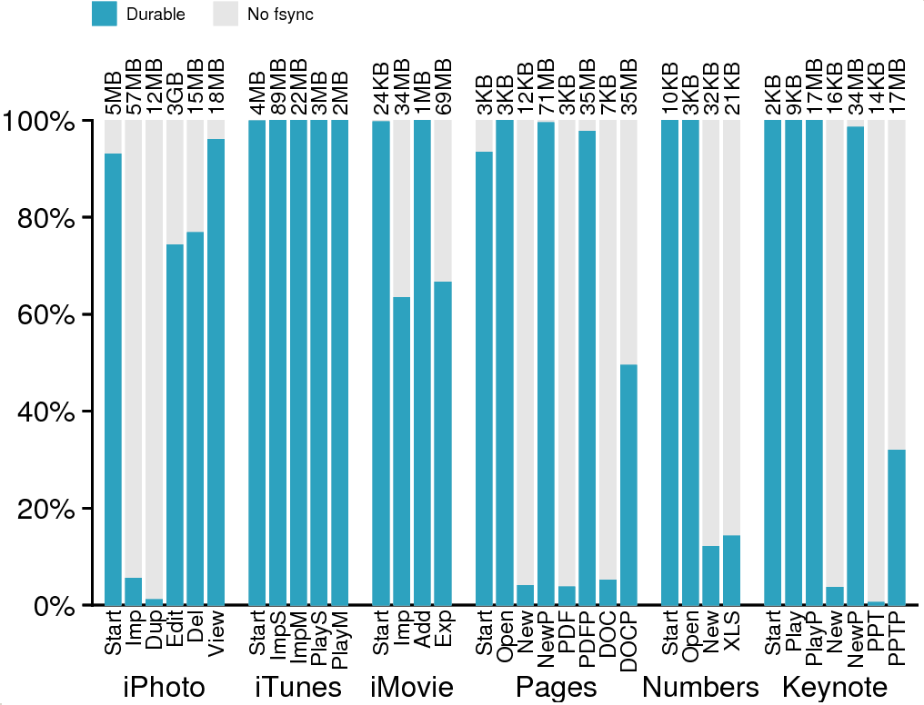
Fsync (durability)
Write I/O bytes

Slide 44
Write I/O bytes

Slide 45
General observations
Auxiliary files dominate
A file is not a file
Sequential access is not sequential
Writes are often forced
  Renders write buffering ineffective
  Can hardware help?
  What do applications need? Durability? Ordering?

Slide 46
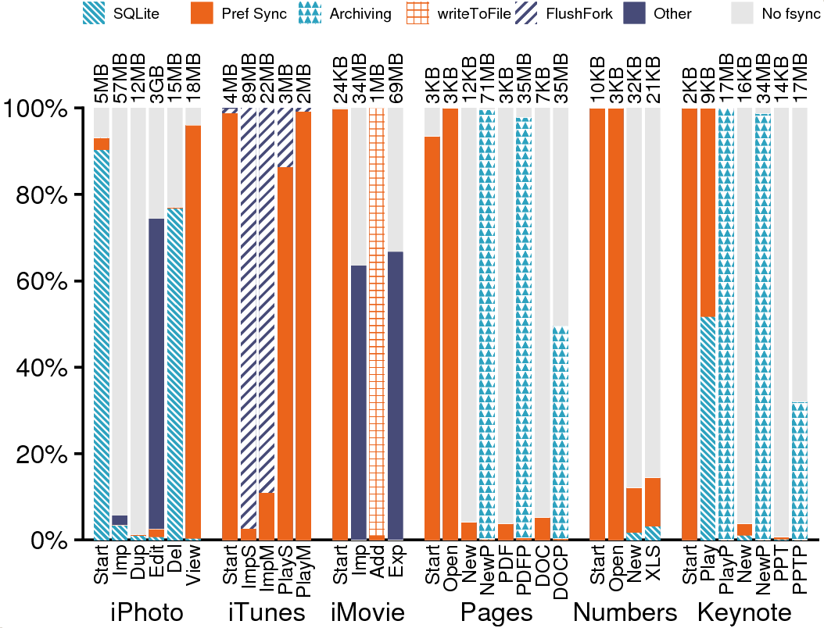
Fsync causes
Write I/O bytes

Slide 47
Explicit Case
Write I/O bytes

Slide 48
General observations
Auxiliary files dominate
A file is not a file
Sequential access is not sequential
Writes are often forced
Frameworks influence I/O
  Should there be greater integration between FS and frameworks?

Slide 49
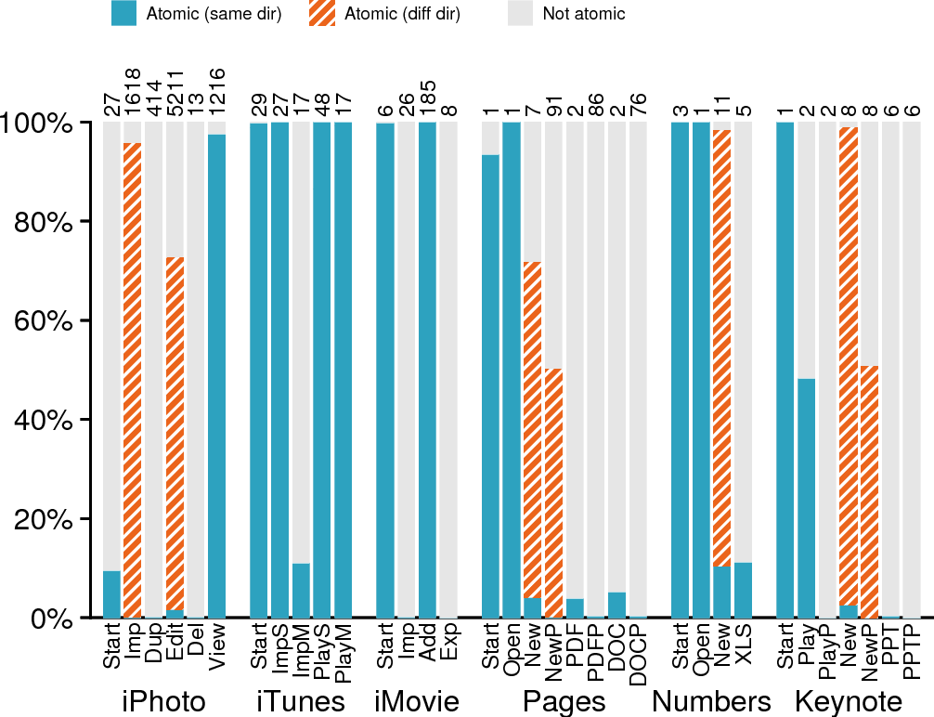
Rename and similar calls
Write I/O bytes

Slide 50
Locality
Implications
Write I/O bytes

Slide 51
General observations
Auxiliary files dominate
A file is not a file
Sequential access is not sequential
Writes are often forced
Frameworks influence I/O
Renaming is popular
  How should directory-locality heuristics adapt?
  Do we need atomicity APIs? Is copy-on-write always best?

Slide 52
iBench questions
What different types of files are accessed?
  Which types dominate?
What I/O patterns are used to access the files?
  Is I/O sequential or random?
What are the transactional properties?
  Are writes flushed with fsync or performed atomically?
How are threads used?
  How is I/O distributed across different threads?

Slide 53
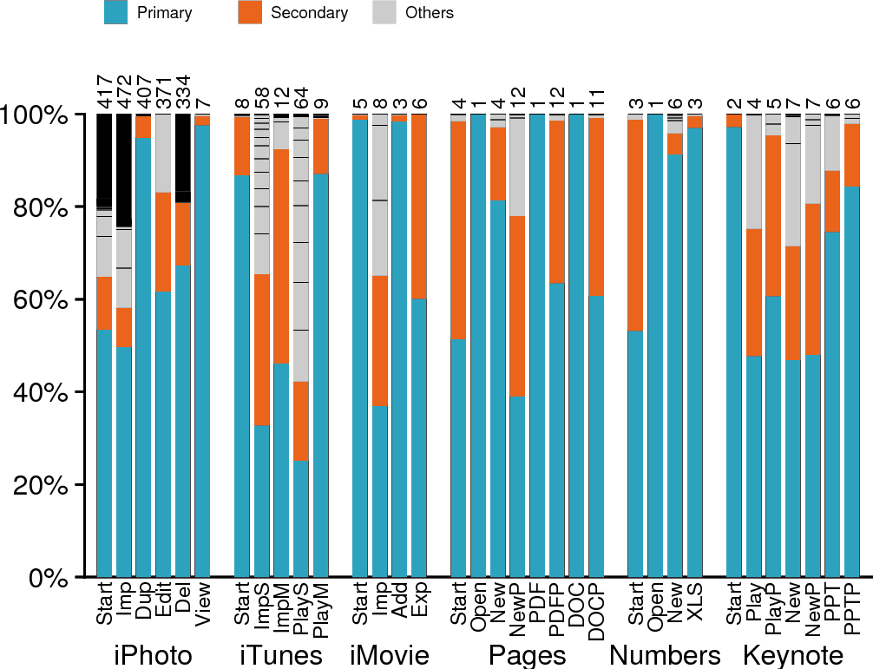
Thread I/O distribution
I/O bytes

Slide 54
I/O bytes

Slide 55
General observations
Auxiliary files dominate
A file is not a file
Sequential access is not sequential
Writes are often forced
Frameworks influence I/O
Renaming is popular
Multiple threads perform I/O
  Should file systems do thread-based locality (like ext file systems)?
  Should GUI threads receive special treatment?

Slide 56
Summary
The general findings agree with the case study findings:
  Auxiliary files dominate
  A file is not a file
  Sequential access is not sequential
  Writes are often forced
  Renaming is popular
  Multiple threads perform I/O
  Frameworks influence I/O

Slide 57
Conclusion: how has the world changed?

Slide 58
In 1974:
“No large ‘access method’ routines are required to insulate the programmer from the system calls; in fact, all user programs either call the system directly or use a small library program, only tens of instructions long…”
~ Ritchie and Thompson. The UNIX Time-Sharing System.

Slide 59
Conclusion: how has the world changed?
In the past, applications:
  Used the file-system API directly
  Performed simple tasks well
  Chained together for more complex actions
Application
File System

Slide 60
Conclusion: how has the world changed?
In the past, applications:
  Used the file-system API directly
  Performed simple tasks well
  Chained together for more complex actions
Today, we see:
  Applications are graphically rich,
  multifunctional monoliths
  “#include <Cocoa/Cocoa.h>
  reads 112,047 lines from 689 files”
  ~ Rob Pike ‘10
  They rely heavily on I/O libraries
Application
File System
Developer’s Code
Cocoa, Carbon,
and other frameworks
File System

Slide 61
Resources
  The iBench suite and the paper are available online:
  Traces: http://www.cs.wisc.edu/adsl/Traces/ibench/
  Paper: http://www.cs.wisc.edu/adsl/Publications/

