Slide 1




Atlantis: Robust, Extensible Execution Environments for Web Applications
James Mickens
Mohan Dhawan
Notes:
Hi! Today I’ll describe Atlantis, which is a new exokernel architecture for web browsers.

Slide 2

Your web browser

Slide 3

Our Claim
Our Solution
Web browsers are a horrifying platform!
  APIs are too complex
  Implementations are too brittle
  Writing robust apps is too hard
HTML
CSS
JavaScript
HTML
CSS
JavaScript
Monolithic browser
HTML/CSS parser
HTML/CSS parser
DOM tree
DOM tree
Layout/rendering
Layout/rendering
Scripting runtime
Scripting runtime
Atlantis
exokernel
Pages manage their own complexity!

Slide 4





Why Do We Need Another Browser?
Notes:
Now, you might be saying to yourself, why does the world need another web browser? After all, the web basically seems to work. Using our browser of choice, we can access all kinds of fantastic things, like:
-Farmville!
-Weird advertising!
-Internet dating!
-And THIS picture! (I don’t even care if it’s real. It’s real, or it *should* be real.)
Despite all of the amazing things that we can access from our web browsers, the web has a dirty secret, namely, that the aggregate web specification is a complete disaster.

Slide 5

The “Web Protocol”
HTTP
HTTPS
file://
DOM Storage
JSON
HTML
Web sockets
Web workers
Which version does the browser use?
Data URIs
CSS
<canvas> tag
<video> tag
PDF
Core JavaScript
Java
Silverlight
Flash
JavaScript DOM Bindings
Quicktime
Notes:
What exactly do I mean by the “web specification”? Well, it includes things like the HTTP network protocol for delivering content to your browser. It includes HTML and CSS, which describe the structure and the presentation of that content. To add client-side scripting abilities, we have to include the JavaScript specification, both the one that defines core built-in objects like regular expressions, and the additional bindings that allow JavaScript to interact with the browser and manipulate HTML content. Don’t forget that some pages still use Java applets, too, so we need to add the Java specification to the web protocol. And as long as we’ve done that, don’t forget plugin protocols like Flash, Silverlight, and PDF. And don’t forget new proposals for audiovisual content like the video and the canvas tags. I mean, how much time do you have? And don’t forget that for most of these protocols, there are multiple versions that have wide deployment on different kinds of browsers. So, as you can see, the aggregate web protocol is huge and messy. This has two practical implications.

Slide 6
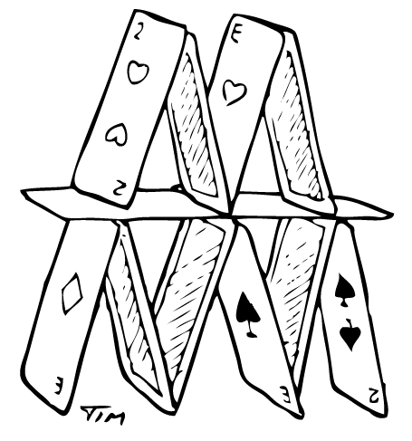

No Single Browser Will Ever Get It Right
Theory
Practice
Notes:
The first implication is that no single browser will ever implement the web protocol in a completely satisfactory way. In theory, standards are supposed to provide order, but in practice, there are so many standards, and they’re so complex, that all browsers have a variety of implementation deficiencies.

Slide 7




Each Browser Will Fail In Different Ways
Firefox
IE
Monster
Other Monster
Notes:
The second problem is that each browser will fail in a different way. If you want to deploy your application on two different browsers, you have to deal with two sets of quirks, and two sets of implementation deficiencies.

Slide 8
Outline
The Adversarial Web Browser: Case Studies
Atlantis: Design and Implementation
Evaluation
Related Work
Notes:
So, here’s an outline for the rest of the talk. First, I’ll give you some concrete examples of the implementation issues that make it difficult to create robust web applications. These case studies will hope motivate the design of Atlantis, our new exokernel web browser. After describing the design, I’ll evaluate its performance and its extensibility. Finally, I’ll discuss some related work before concluding.

Slide 9


Let Me Teach You About Life
Web browsers are
terrible and buggy.
Bah! I use JS libraries like
jQuery to hide the complexity.
You are foolish and hysterical.
Notes:
Now, let me teach you a little bit about life. A lot of times, I’ll go up to professors and say, “web browsers are terrible and buggy, and it’s hard to develop sophisticated apps on them.” The professor will often laugh like a James Bond villain, and say, “Bah! When I make web pages, I use JavaScript libraries like jQuery to hide all of the complexity that you’re talking about. You’re foolish and hysterical and like a child.”
http://www.befunky.com/create/#/home

Slide 10

What You Think
Your Web App
Nice, browser-neutral interface
jQuery
Largely tolerable browser APIs
Browsers
Notes:
A lot of people think like this. They think, yes, browsers are a bit cantankerous, but they’re ultimately lovable and endearing, kind of like an old couple that lives in your apartment building. In this mental model, jQuery takes a bunch of moderately tolerable browser APIs and then spits out a nice, browser-neutral interface to your web app.

Slide 11

What You Think
What Is
Your Web App
Nice, browser-neutral interface
jQuery
Largely tolerable browser APIs
Browsers
Notes:
That’s what you think. Here’s what’s really going on: it’s a clowndown. It’s horrible. These web browsers are like vicious gang members

Slide 12
What Is
Your Web App
Partially browser-neutral interface
jQuery
Flaky, semi-consistent APIs
Browsers
Notes:
These browsers actually export a series of flaky, semi-consistent APIs, and then jQuery ends up exporting an interface which is actually nicer than the ones provided by the underlying browsers. However, this interface in only partially browser-neutral since it can’t hide all of the quirks of each browser. I’m going to give you some concrete example of this. Take my hand, if you will, as we go on a little journey that I like to call . . .

Slide 13

Why the Suicide Rate for Web Developers
is 89%

Slide 14


James Mickens vs. Browsers:
Event Handling
Ok!
<html>
<div>
<button>
Click me!
</button>
</div>
</html>
I’d like support for the official three-phase model.
Ok!
9
I WILL NOT SUPPORT
THE CAPTURE PHASE. Lolz.
8-
<html>
“Official” event model
1) Capture phase
2) Target phase
3) Bubble phase
Event
captureHandler(evt)
<div>
bubbleHandler(evt)
<button>
targetHandler(evt)

Slide 15



Problem: Different browsers have different DOM tree implementations!
Notes:
The problem is that different browsers have different DOM tree implementations. Some browsers implement the complete DOM tree specification and provide some additional, useful functionality that isn’t strictly requires by the spec. Other browsers implement a more minimalistic version of the spec, but they respect the spirit of the DOM tree specification, if not the exact letter. Other browsers which shall not be named have a DOM tree that is lacking in breadth, depth, and many other tree like characteristics.

Slide 16


James Mickens vs. Browsers:
Event Handling, Part 2
Ok!
I’d like you to fire a blur event when the input focus changes.
Sometimes I’ll fire the event, but sometimes I won’t. Rofl.
Focus!
Blur!
Enter your name:
j
a
m
e
s
I’ll generate multiple events for each blur.

Slide 17
!=

Slide 18

James Mickens vs. Browsers:
Layout and Rendering
I’d like to specify an element’s size as a percentage of the enclosing element.
<html>
<div width=“49.5%”>
</div>
<div width=“50.5%”>
</div>
</html>

Slide 19

James Mickens vs. Browsers:
Layout and Rendering
I’d like to specify an element’s size as a percentage of the enclosing element.
<html>
<div width=“49.5%”>
</div>
<div width=“50.5%”>
</div>
</html>

Slide 20
Problem: HTML/CSS parsing and layout engine are completely opaque to the web page!
<html>
?
HTML
<head>
<body>
<title>
<div>
<div>
CSS
Markup parser +
layout engine

Slide 21

James Mickens vs. Browsers:
Extending the JavaScript Runtime
I’d like to introspect/extend objects without the crippling fear that I’ll wedge my browser.
Help me help myself.
//Application code
obj.f = function(){return 42;};
//Third-party diagnostic code
//[e.g., Mugshot@NSDI 2010] might
//do something like this . . .
oldF = obj.f;
obj.f = function(){
mugshot.logCall(oldF);
return oldF();
};
This “should” “work”. Except when it won’t.
Also, I’m dating your mom.
Notes:
Here’s a final example of how browsers screw you over. JavaScript supports a rich interface for object reflection. This can be extremely handy if you want to dynamically extend the application. So, suppose that you had some JavaScript code which defines an object and a simple method for that object. You might want to add some third-party diagnostic code to that object. For example, the Mugshot library from last year’s NSDI will essentially look for interesting objects in your application and shim their functions so that diagnostic code runs, and then invokes the original application-defined function. Very handy. So, what I want is just the ability to introspect and extend JavaScript objects without the crippling fear that I’ll destroy my browser. After all, this is what the JavaScript language is ostensibly telling me that I can do. Unfortunately, this does not work consistently. And, by the way, the browsers are dating your mom. WHAT JUST HAPPENED QUESTION STATEMENT.

Slide 22
Problem: Opaque dependencies between C++ objects in browser and reflected versions in JavaScript!
Unfathomable
browser
DOMnode
function addEventListener(eName,
callback){
nativeInvoke([“__addListener”,
evtName,
callback]);
}
__addListener(e,c){
//C++ code
}
JavaScript
(“user” layer)
C++
(“kernel” layer)

Slide 23
Problem: Opaque dependencies between C++ objects in browser and reflected versions in JavaScript!
Unfathomable
browser
DOMnode
function addEventListener(eName,
callback){
nativeInvoke([“__addListener”,
evtName,
callback]);
}
__addListener(e,c){
//C++ code
}
JavaScript
(“user” layer)
C++
(“kernel” layer)
Notes:
The reason this happens is because there are opaque dependencies between C++ objects in the browser and their reflected versions in JavaScript land. For example, all of the DOM nodes in JavaScript land define a method called addEventListener(). This function essentially makes trap into the browser. You can think of the JavaScript code as being at the quote-unquote “user” layer, and the underlying C++ of the browser being in the kernel layer. So, this function that you can access at the user layer essentially has a pointer which you can’t see to the kernel layer. Now, since the browser is unfathomable, it has a bunch of references to state at JavaScript layer, but you as the web developer can’t see those references. All that you can see is the one reference in red. So, sometimes when you try to introspect or shim objects at the JavaScript layer, you unknowingly perturb these kernel pointers in ways that break the browser.

Slide 24
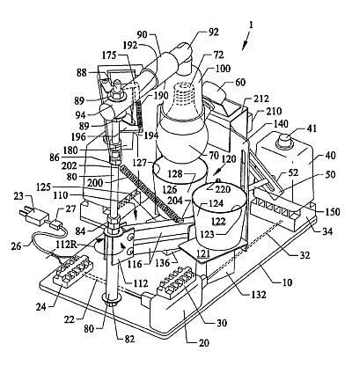
How do we fix all of this?
Notes:
The obvious question is: how do we fix all of this?

Slide 25
Outline
The Adversarial Web Browser: Case Studies
Atlantis: Design and Implementation
Evaluation
Related Work
Notes:
And that question takes us to the design of the Atlantis browser.

Slide 26
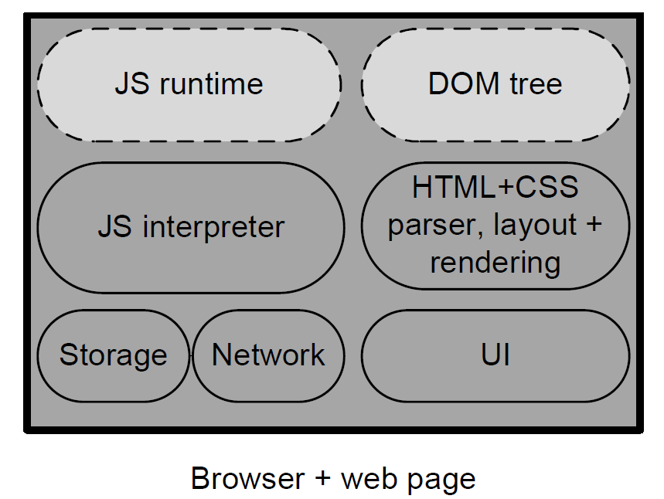
Monolithic Browser
Notes:
But before we can understand Atlantis’ architecture, we have to consider what’s come before. Here we see the architecture of a standard monolithic browser. Each web page essentially gets a process with a bunch of software modules in it. These modules do things like parse the HTML, implement the DOM tree, and so on. All of the code is black-box to the web page itself, with the exception of the JS runtime and the DOM tree, which are partially introspectable (in a *brittle* way) using JavaScript’s reflection facilities.

Slide 27
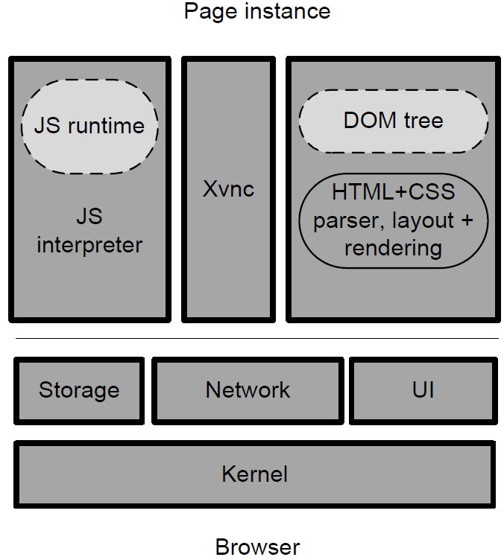
OP (Oakland 08)
No change in extensibility
Rhino
KHTML
Notes:
Here we see the architecture of OP, which is a prior microkernel browser. OP strongly isolates components like the JS interpreter and the HTML engine, and makes them communicate using a message-passing mechanism. This strong isolation results in much stronger security, but note that OP uses standard, off-the-shelf components for the JavaScript interpreter and the HTML engine and so on. This means that there is no change in the extensibility of the runtime.

Slide 28
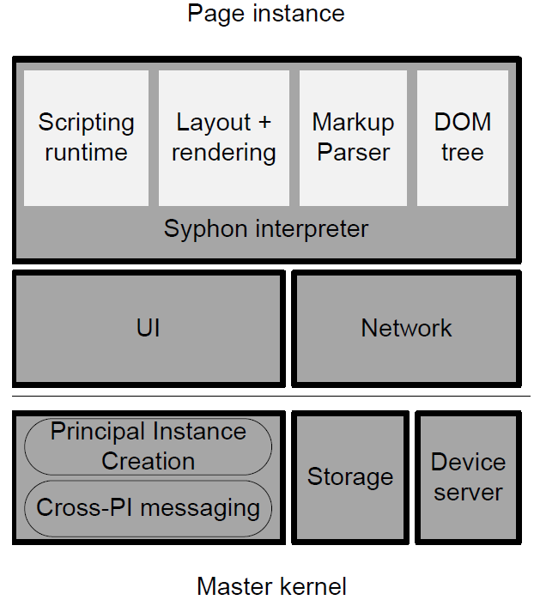
Atlantis
Defined by web page!
1 process w/
3 C# AppDomains
Executes Syphon code
Per-instance kernel
Notes:
Here’s what Atlantis looks like. At the bottom, we have the master kernel. This kernel is responsible for creating new pages, passing messages between various components, and so on. At the higher level, we have a page instance. The page instance consists of one process with three C# AppDomains. We coded all of Atlantis in C#, and an AppDomain is a C# mechanism for providing strong memory isolation to code running within the same process. This basically allows you to have threads that live in the same process but can’t directly poke at each other’s state. So, there are three AppDomains. Two of them belong to what we call the per-instance kernel. One AppDomain handles the page’s UI stuff, and another handles network connection for the page. The third AppDomain contains the Syphon interpreter. Syphon is the name for our new scripting language. It sort of looks like JavaScript, but there are some key differences, but I’ll defer you to the paper for a description. So, there’s a script interpreter, and the web page defines its own HTML parser, DOM tree, and so on, by presenting the relevant code to that interpreter for execution.

Slide 29

Atlantis: Defining the Web Stack
It shall be done.
Load foo.html.
HTML
Notes:
Let’s explore that process in more detail.

Slide 30

Atlantis: Defining the Web Stack
It shall be done.
Load foo.html.
HTML

Slide 31
Atlantis: Defining the Web Stack
<environment>
<compiler=‘http://foo/compiler.syp’>
<markupParser=‘http://bar/mParser.js’>
<runtime=‘http://baz/runtime.js’>
</environment>
High-level application runtime
Layout and
Rendering
mParser.js
DOM tree
AJAX library
  Atlantis kernel
  Bitmap rendering
  Frame creation and destruction
  Cross-frame messaging
  Low-level GUI events
  Blocking/non-blocking
  HTTP sockets
compiler.syp
mParser.syp
runtime.syp
Syphon Interpreter

Slide 32

Atlantis: Defining the Web Stack
By default, thy gets a backwards-compatible stack.
<html>
.
.
.
</html>
I cannot findeth an
<environment> tag.
JScompiler.syp
HTML+CSSparser.syp
DOM.syp
Syphon Interpreter
Notes:
Now, let’s say that Atlantis parses the page’s markup and doesn’t find an environment tag at the top. In this case, Atlantis will give the web page a default web stack that implements the standard web API and JavaScript environment. So, there will be an HTML parser, a CSS parser, a DOM tree, and so on. This is how we support legacy web pages that aren’t Atlantis aware.

Slide 33

Atlantis: Defining the Web Stack
By default, thy gets a backwards compatible stack.
It’s all made of JavaScript!
<html>
.
.
.
</html>
JScompiler.syp
HTML+CSSparser.syp
DOM.syp
Syphon Interpreter
Notes:
What’s nice about this default environment is that, from the web page’s perspective, the entire high-level runtime is made entirely of JavaScript. For example, the DOM tree does not have any shadow state inside the Atlantis kernel---the DOM tree implementation is totally at the application-layer, and the application can introspect that tree in whatever way it pleases.

Slide 34
Common case: You don’t write the (extensible!) web stack

Slide 35

jQuery
Microsoft
Facebook

Slide 36
Outline
The Adversarial Web Browser: Case Studies
Atlantis: Design and Implementation
Evaluation
Related Work

Slide 37

Extensibility
DOM nodes have an innerHTML property
  Assign a string to dynamically update DOM tree
  Allows for cross-site scripting attacks!
Want: Ability to shim innerHTML and automatically install a sanitizer
var comment = document.getElementById(“commentBox”);
var contentParent = document.getElementById(“parent”);
contentParent.innerHtml = comment.value; //What if this is
//JavaScript source?

Slide 38

DON’T WORRY ATLANTIS CAN HELP YOU

Slide 39
Extensibility
In Atlantis, to change the DOM tree implementation:
  YOU JUST DO IT
  The entire implementation belongs to you!
  Don’t have to wait on browser vendors!

Slide 40
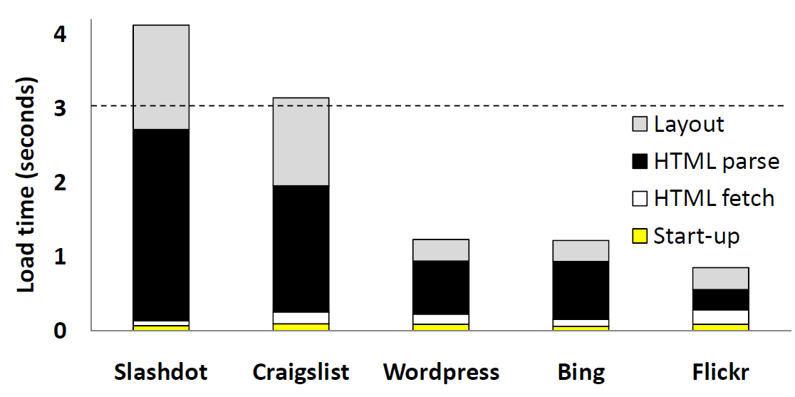
Page Load Times
Notes:
Here, we show you the load times for several pages on Atlantis, just to show you that we actually built something. The dotted line shows the three second load barrier at which point users begin to get frustrated. We see that in three case, we’re well below that line, in one case, we’re at the line, and in another case, we’re about a second over. As you can see, the HTML parsing is taking a lot of time, and we discuss in the paper how we plan to improve this in the next version of the browser. Basically, function call overhead in our Atlantis prototype is not as efficient as it could be, and HTML parsing involves a ton of small function calls. I’ll refer you to the paper for a fuller discussion of this issue.

Slide 41
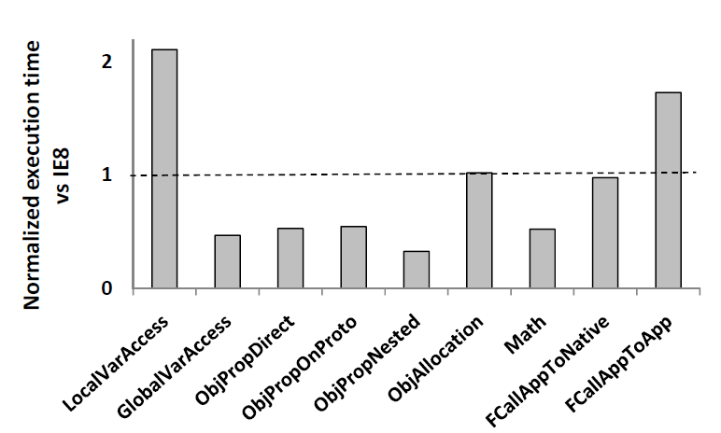
Microbenchmarks

Slide 42
Outline
The Adversarial Web Browser: Case Studies
Atlantis: Design and Implementation
Evaluation
Related Work

Slide 43

Related Work
Microkernel browsers: OP, Gazelle, ServiceOS
  Isolate commodity JS engines, HTML renderers, etc.
  Better security . . .
  . . . but same extensibility, robustness
Notes:
Microkernel browsers like OP, Gazelle, and ServiceOS strongly isolate the software components of a commodity browser. As I mentioned earlier, this does lead to better security properties, but it does not change the extensibility and robustness problems that Atlantis does address.

Slide 44
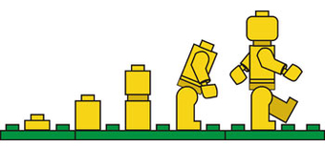
Related Work
JavaScript abstraction frameworks
  JavaScript libraries: jQuery, mooTools, Prototype
  Compile-to-JavaScript: GWT, Script#
Extremely useful!
However, they can’t . . .
  Hide all browser quirks
  Make black-box components introspectable
Notes:
Earlier I mentioned jQuery, which is a JavaScript library that tries to hide browser quirks and present a nice interface to developers. There are other such libraries like mooTools and Prototype. There are also some compile-to-JavaScript frameworks that have similar goals. For example, the Google Web Toolkit compiles Java to JavaScript, and Script# performs a similar service for C#. Make no mistake, these libraries are extremely useful, and they do make it easier to write web applications. However, as I’ve shown, they can’t hide all browser quirks, and furthermore, they can’t make black-box components like the HTML parser introspectable by web apps.

Slide 45

Conclusions
Web browsers have a lot of potential . . .
Notes:
So, in conclusion, we think that web browsers have a lot of potential. Of course, whenever someone says that you have a lot of potential, it actually means that you’re doing it wrong right now. We think that web browsers need to be fundamentally restructured so that they can become better platforms for supporting robust web applications. The reason that browsers need to change is because they’ve been given an impossible task.

Slide 46
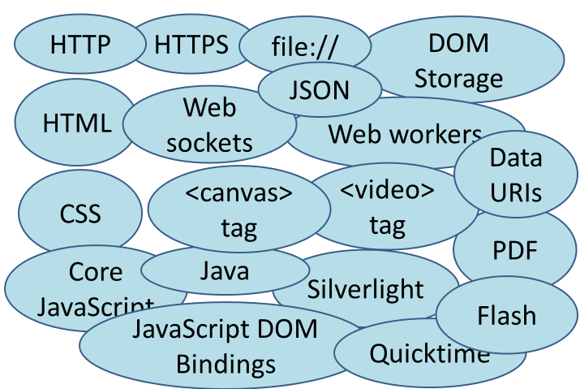

Conclusions
The aggregate “web protocol” is big and complex!
  No individual browser can get it all right
  Different browsers will fail in different ways
Notes:
The aggregate “web protocol” is so big and so complex that no individual browser can ever hope to implement the entire spec in a completely consistent way. Even worse, different browsers will have different quirks and different failure modes, meaning that if you want your web app to run on multiple browsers, you have to waste a lot of time devising hacks to deal with painful corner cases. And, as I’ve discussed earlier, there are some browser quirks that can’t be hacked around at all.

Slide 47

Conclusions
Atlantis: an exokernel browser
  Kernel handles low-level networking, GUI events, bitmap rendering
  Application defines higher-level abstractions
Advantages
  Strong security
  Powerful extensibility
Notes:
In this talk, I’ve described Atlantis, which is a new exokernel browser. The Atlantis kernel provides low-level services like collecting basic GUI events and drawing bitmaps to the screen. However, the web page itself is completely free to define higher-level abstractions like the DOM tree, the markup parser, and so on. Like prior microkernel browsers, Atlantis provides strong isolation between components (and thus strong security). However, Atlantis also supports a powerful extensibility model. This allows web developers to spend much less time worrying about the vagaries of the underlying browser; now, developers can spend more time thinking about Internet buzzwords, why people like this post photos of themselves on Facebook, and, of course, pictures like this. Thank you!

Slide 48



Slide 49
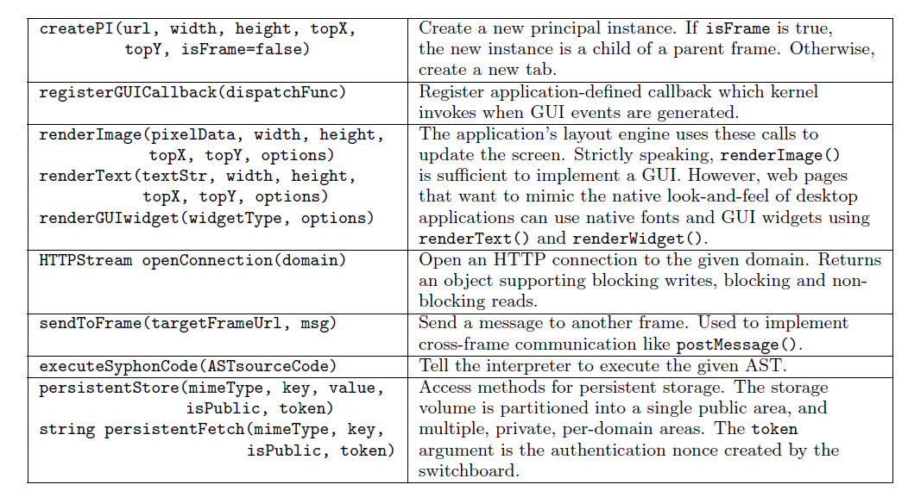
Primary Atlantis Kernel Calls

Slide 50
Atlantis: Advantages over Gazelle
Security
  Atlantis provides better isolation w/per-instance kernels
  Atlantis isolates intra-domain components
Extensibility
  Gazelle uses IE to provide a web stack; default Atlantis stack written in pure JavaScript
  Atlantis lets pages dynamically define new runtimes without user intervention
  Syphon interpreter provides new isolation abstractions

Slide 51
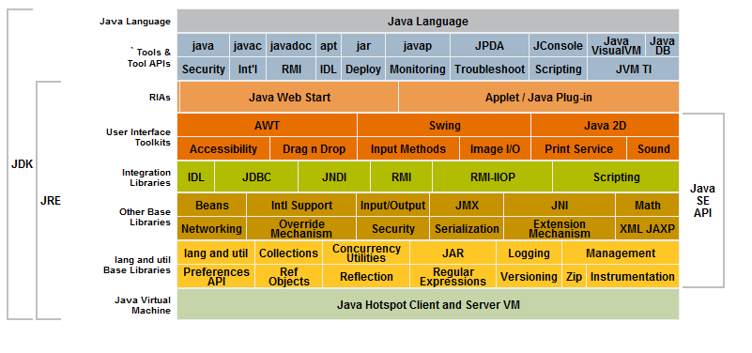
Let’s Just Use Java And Wash Our Hands of the Entire Sordid Affair™
Notes:
The JVM provides the wrong interface. For example, the JVM specification is far too wide, providing full-blown access to things like databases, printers, the underlying file system, and so on. We think that a web browser should specify a much narrower interface. Java also has a much more complicated security model. For example, Java makes programmers reason about extremely fine-grained security policies for network access, access to GUI inputs, and so on. Java also has these confusing rules about how to determine the security permissions of a thread that executes code in multiple protection domains. In contrast, Atlantis offers a much simpler model based around the same-origin policy and some commonsense rules like a principal can only draw bits to its own frame. Thus, we think that the Atlantis interface is better in terms of minimality and simplicity. It's true that the Java interface is more general, but we don't think that “general” is always “better.”
Now, you may disagree with some of the design decisions that we made when we created our particular narrow interface. However, the larger point of the Atlantis work is that the current “web spec” is far too large, and we need to replace it with something that has a reasonable hope of being implemented in a robust way. So, if browsers in five years are using an exokernel architecture, but it isn’t our specific one, we’d been overjoyed. However, I don’t think that the JVM is the exokernel interface that you’re looking for.

Slide 52



DISASTER

Slide 53



