Slide 1
Transactional storage for geo-replicated systems
Yair Sovran, Russell Power,
Marcos K. Aguilera, Jinyang Li
NYU and MSR SVC

Slide 2







Life in a web startup

Slide 3

Web apps need geo-replicated storage
Geo-replicated transactional storage

Slide 4

Consistency vs. performance: existing tradeoffs
Maximize multi-site performance
Have few anomalies
More coordination
Fewer anomalies
Less coordination
More anomalies
Serializability
Eventual Consistency
Snapshot Isolation

Slide 5
Our contribution
New semantics: Parallel Snapshot Isolation (PSI)
Walter: implementing PSI efficiently
  Preferred site
  Counting set
Application experience

Slide 6
Snapshot isolation
T1
Read-X
Write-X
Commit
T2
Read-Y
Write-Y
Commit
Timeline of storage state
Snapshot isolation’s guarantees
  Read snapshots from global timeline
  Prohibit write-write conflict
  Preserve causality

Slide 7
PSI avoids global transaction ordering
T1
Read-X
Write-X
Commit
Site1
Site1 timeline
T2
Read-Y
Write-Y
Commit
Site2
Site2 timeline
A transaction commits locally first, then propagates to remote sites.
Parallel
Snapshot isolation’s guarantees
  Read snapshots from global timeline
  Prohibit write-write conflict
  Preserve causality
Per-site
Walter achieves
this efficiently

Slide 8
PSI has few anomalies
Anomaly | Serializ-ability | Snapshot Isolation | PSI | Eventual
dirty read | No | No | No | Yes
non-repeatable read | No | No | No | Yes
lost update | No | No | No | Yes
short fork | No | Yes | Yes | Yes
long fork | No | No | Yes | Yes
conflicting fork | No | No | No | Yes

Slide 9
PSI’s anomaly
T1
Short fork
(allowed by
snapshot isolation)
T1 commits
T2
T2 commits
T1 commits
T1 and T2 propagate to both sites
T1
Long fork
(disallowed by
snapshot isolation)
T2
T2 commits

Slide 10
Walter overview
C
C
C
C
C
C
Start_TX
Commit_TX
Read
Write
Replicate data
Coordinate for PSI
Site1
Site2
Main challenge: avoid write-write conflict across sites
Walter’s solution
  Preferred site
  Counting set

Slide 11
Technique #1: preferred site
Alice
C
Bob
C
Write
Write (fast commit)
Bob’s
photos
Bob’s photos
slow
commit
Alice’s photos
Alice’s photos
Site1
Site2
Associate each user’s data with a preferred site
Common case: write at preferred site → fast commit
  Rare case: write at non-preferred site→ cross-site 2-phase commit
Notes:
Observation: most writes to an object occur in one site

Slide 12
Technique #2: counting set
Be-friend Eve
Be-friend Eve
Alice
Bob
C
C
write
write
Eve’s
friendlist
Eve’s
friendlist
Site 1
Site 2
Problem: some objects are modified from many sites
Counting set: a data type free of write-write conflict

Slide 13
Technique #2: counting set
Be-friend Eve
Be-friend Eve
Alice
C
C
Bob
add(“Alice”)
add(“Bob”)
add
Eve’s friendlist
Eve’s friendlist
add
Alice → 1
Bob→ 1
Bob→ 1
Alice → 1
Site1
Site2
Add/del operations commute → no need to check for write-write conflict
Caveat: application developers must deal with counts

Slide 14
Site failure
Two options to handle a site failure
  Conservative: block writes whose preferred site failed
  Aggressive: re-assign preferred site elsewhere
Warning: Committed but not-yet-replicated transactions may be lost

Slide 15
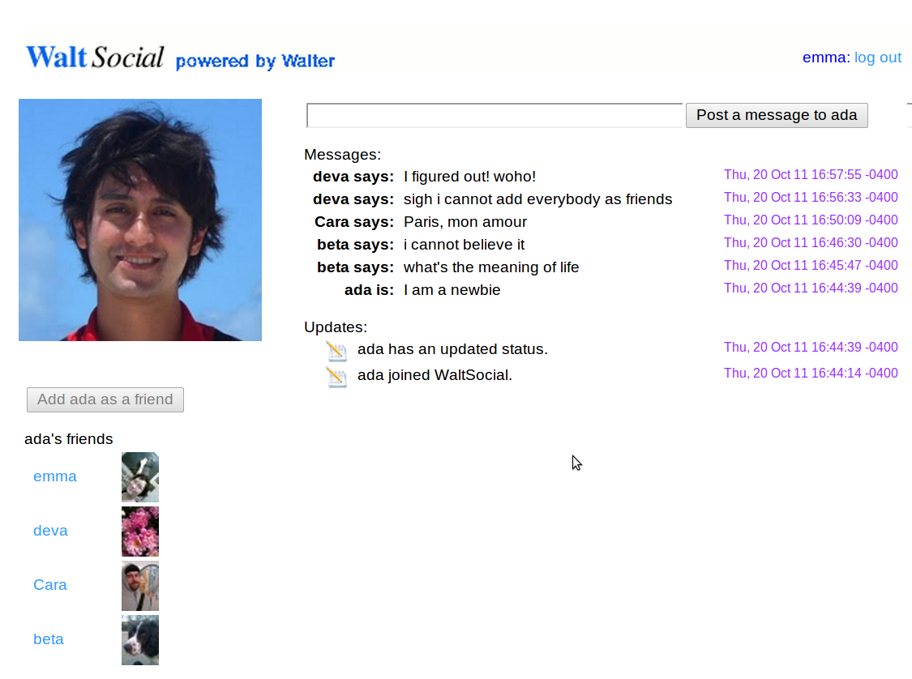

Application #1: WaltSocial
Meow says: Meow Meow Meow
Bob-cat says: I saw a mouse
Bob-cat says: I saw a mouse
Peanut says: awldaiwdliawd
Meow says: I think I ate too much catnip last night. Meow.
Befriend transaction
A ← read Alice’s profile
B ← read Bob’s profile
Add A.uid to B.friendlist
Add B.uid to A.friendlist
Add “Alice is now friends with Bob” to A.wall
Add “Bob is now friends with Alice” to B.wall
Wall and Friendlist are
counting sets

Slide 16
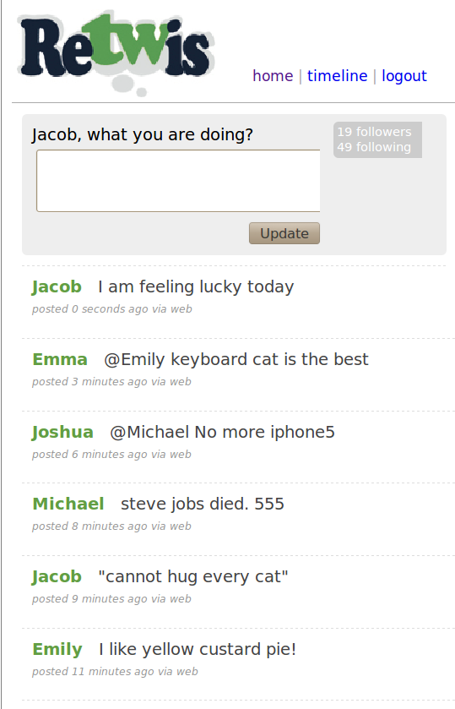
Applications #2: Twitter clone
Third party app in PHP
Our port: switch storage
backend from Redis to Walter
Post-status transaction
write status to new object O
foreach f in user’s followers
add O to f’s timeline_cset
Each user’s timeline is a counting set

Slide 17
Evaluation
Walter prototype
  Implemented in C++ with PHP binding
  Custom RPC library with Protocol Buffers
Testbed: Amazon EC2
  Extra-large instance
  Up to 4-sites (Virginia, California, Ireland, Singapore)
    Full replication across sites

Slide 18
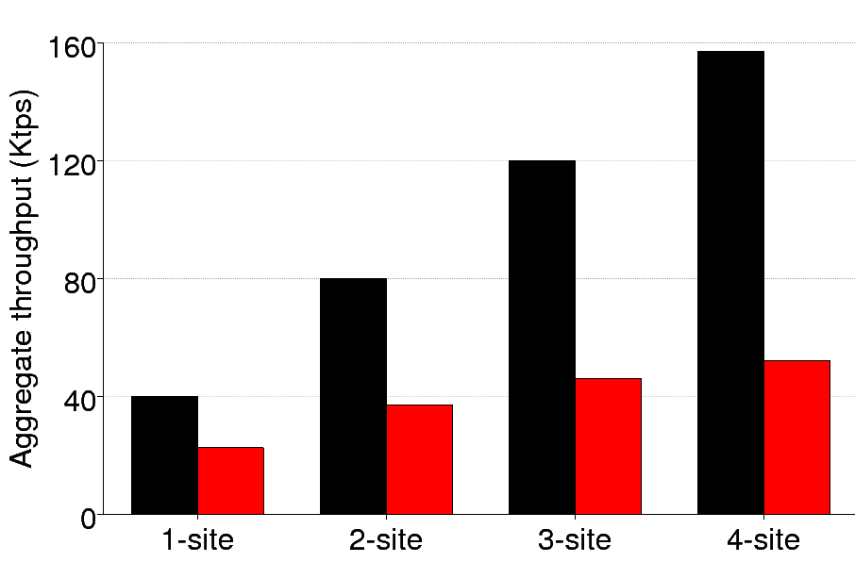
Walter scales
Read
Write
Read/write a 100-byte object
Reads’ working set fits in memory

Slide 19
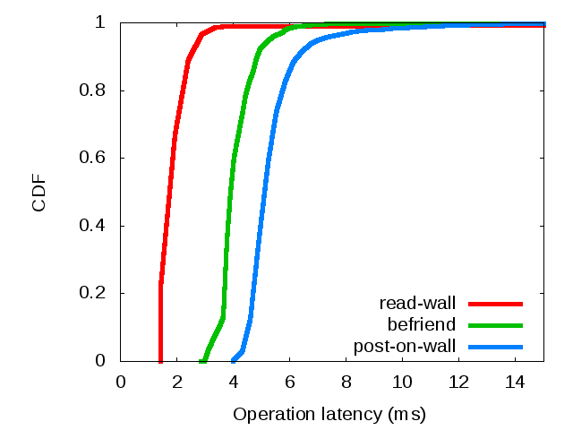
WaltSocial achieves low latency
A post-on-wall transaction
reads 2 objects, writes 2 objects, updates 2 counting sets

Slide 20
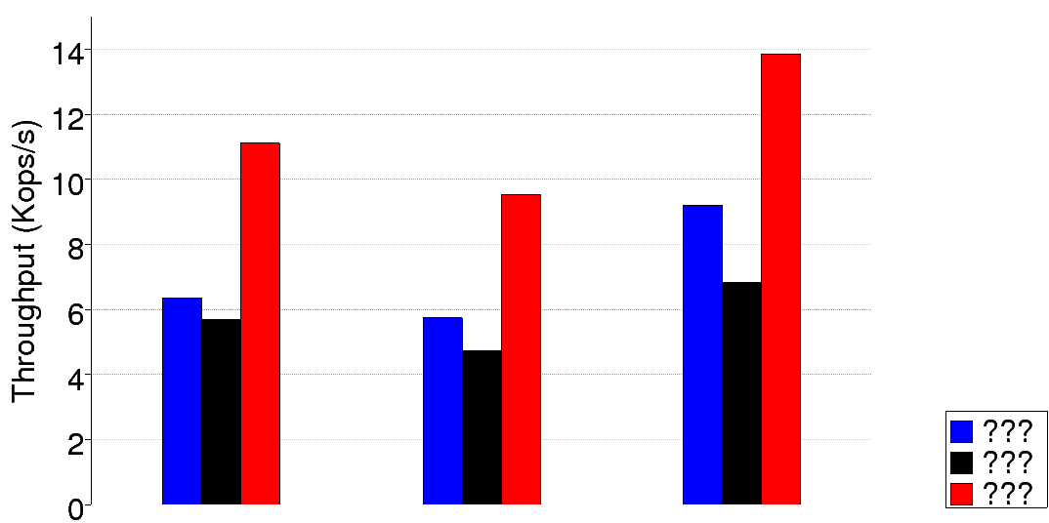
Walter lets ReTwis scale to >1 sites
Redis
Walter (1-site)
Walter (2-site)
Read Timeline
Post status
Follow user

Slide 21
Related work
Cloud storage systems
  Single-site: Bigtable, Sinfonia, Percolator
  No/limited transaction: Dynamo, COPS, PNUTS
  Synchronous replication: Megastore, Scatter
Replicated database systems
  Eager vs. lazy replication
  Escrow transactions: for numeric data
Conflict-free replicated data types
  Inspired counting sets

Slide 22
Conclusion
PSI is a good tradeoff for geo-replicated storage
  Allows fast commit with asynchronous replication
  Prohibits write-write conflict and preserves causality
Walter realizes PSI efficiently
  Preferred site
  Conflict-free counting set

