Slide 1

Batching with End-to-End Performance Estimation
Avidan Borisov†, Nadav Amit†, Dan Tsafrir†
†Technion

Slide 2
Background: batching
per-object cost
per-batch cost
without batching
object
expensive operation
object
expensive operation
object
expensive operation
with batching
object
object
object
expensive operation
batch

Slide 3
Background: batching in networking
per-byte cost
per-batch cost
without batching
bytes
expensive operation
bytes
expensive operation
bytes
expensive operation
with batching
bytes
bytes
bytes
expensive operation
batch

Slide 4
Background: batching in networking
per-byte cost
per-batch cost
without batching
bytes
expensive operation
bytes
expensive operation
bytes
expensive operation
with batching
bytes
bytes
bytes
expensive operation
batch
“Batching trades-off latency for throughput”

Slide 5
Seemingly “ideal” batching
Assume batching never waits for more objects
  Batching is only done in presence of congestion
  IX [OSDI’14] calls this “adaptive batching”

Slide 6

Seemingly “ideal” batching
Assume batching never waits for more objects
  Batching is only done in presence of congestion
  IX [OSDI’14] calls this “adaptive batching”
3 requests have arrived together to the server
  Should the server process them as one batch?

Slide 7
To batch or not to batch?
avg. latency = 14
throughput = 3/20
without batching
per-response cost
client
1
1
1
server
2
4
2
4
2
4
time
per-request cost
per-batch cost
0
5
10
15
20
25
=3/26
=3/24

Slide 8
To batch or not to batch?
avg. latency = 13
throughput = 3/14
with batching
client
1
1
1
server
2
2
2
4
time
0
5
10
15
20
25
avg. latency = 14
throughput = 3/20
without batching
client
1
1
1
server
2
4
2
4
2
4
time
0
5
10
15
20
25
=3/26
=3/24

Slide 9
To batch or not to batch?
avg. latency = 21
throughput = 3/26
with batching
client
5
5
5
server
2
2
2
4
time
0
5
10
15
20
25
avg. latency = 18
throughput = 3/24
without batching
client
5
5
5
server
2
4
2
4
2
4
time
0
5
10
15
20
25
=3/26
=3/24

Slide 10
To batch or not to batch?
avg. latency = 17
throughput = 3/20
with batching
client
3
3
3
server
2
2
2
4
time
0
5
10
15
20
25
avg. latency = 16
throughput = 3/22
without batching
client
3
3
3
server
2
4
2
4
2
4
time
0
5
10
15
20
25
=3/26
=3/24

Slide 11
To batch or not to batch?
Same server-side activity
Completely different results
client-side cost | latency | throughput
1 | better | better
5 | worse | worse
3 | worse | better

Slide 12
Not just in theory
nagle=off
nagle=on
(a) client CPU [%]
(b) server CPU [%]
(c) latency [μs]
120
120
240
100
100
200
Redis at 20K req/s
80
80
160
nagle=off
60
60
120
nagle=on
40
40
80
20
20
40
0
0
0
baremetal
VM
baremetal
VM
baremetal
VM

Slide 13

Not just in theory
nagle=off
nagle=on
(a) client CPU [%]
(b) server CPU [%]
(c) latency [μs]
120
120
240
Without end-to-end performance metrics, any batching decision can be wrong!
100
100
200
Redis at 20K req/s
80
80
160
nagle=off
60
60
120
nagle=on
40
40
80
20
20
40
0
0
0
baremetal
VM
baremetal
VM
baremetal
VM

Slide 14
What does the literature say?
State-of-the-practice (Linux)
  Nagle
  Auto-corking
  TSO
  xmit_more
  …
State-of-the-art
  Netmap [ATC’12]
  MegaPipe [OSDI’12]
  IX [OSDI’14]
  mTCP [NSDI’14]
  Stackmap [ATC’16]
  ZygOS [SOSP’17]
  …
None utilize end-to-end performance

Slide 15
What does the literature say?
State-of-the-practice (Linux)
  Nagle
  Auto-corking
  TSO
  xmit_more
  …
State-of-the-art
  Netmap [ATC’12]
  MegaPipe [OSDI’12]
  IX [OSDI’14]
  mTCP [NSDI’14]
  Stackmap [ATC’16]
  ZygOS [SOSP’17]
  …
None utilize end-to-end performance
  Hypothesis: all may benefit

Slide 16
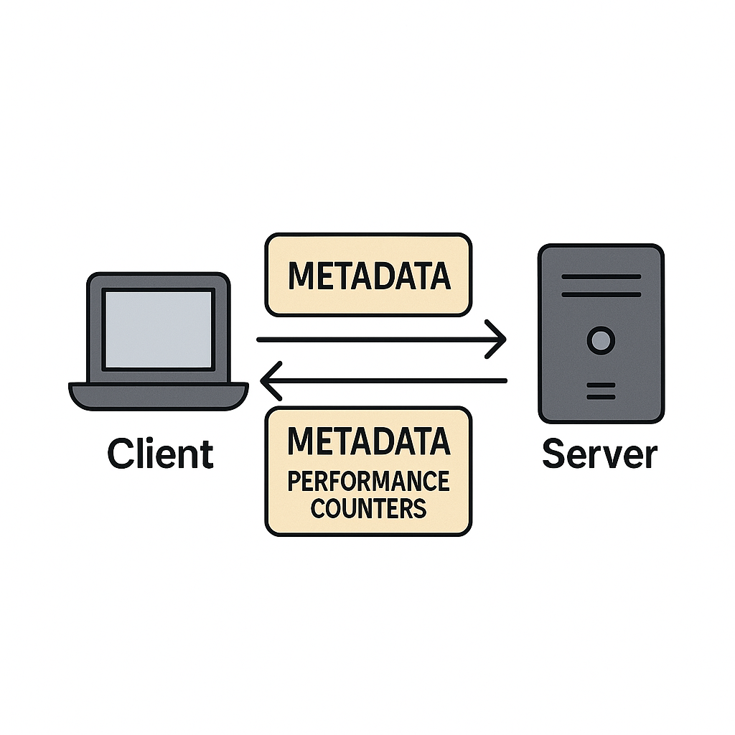
End-to-end latency is unknown
RTT?

Slide 17
End-to-end latency is unknown

Slide 18











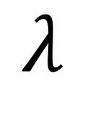
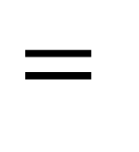
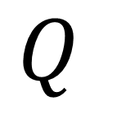
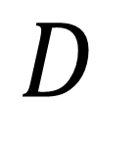
Little’s law
$$Q$$
$$=$$
$$λ$$
$$×$$
$$D$$
average
occupancy
average
rate
average
delay
Sun
Mon
Tue
Wed
Thu

Slide 19

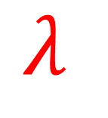
Little’s law
$$Q$$
$$=$$
$$λ$$
$$×$$
$$D$$
average
occupancy
average
rate
average
delay
average check-in rate:
2 guests per day
Sun
Mon
Tue
Wed
Thu

Slide 20
Little’s law
$$Q$$
$$=$$
$$λ$$
$$×$$
$$D$$
average
occupancy
average
rate
average
delay
Sun
Mon
Tue
Wed
Thu

Slide 21
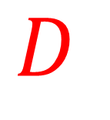
Little’s law
days of stay
$$Q$$
$$=$$
$$λ$$
$$×$$
$$D$$
average
occupancy
average
rate
average
delay
average stay:
3 days
#1
#2
#3
#4
#5
#6
#7
#8
#9
#10

Slide 22

Little’s law
average occupancy:
6 guests
$$Q$$
$$=$$
$$λ$$
$$×$$
$$D$$
average
occupancy
average
rate
average
delay
Sun
Mon
Tue
Wed
Thu

Slide 23




Little’s law in network queues
On average:
easy
easy
hard
$$D$$
$$Q=λ×D$$
$$Q$$
$$λ$$
queue size
arrival rate
queuing delay

Slide 24
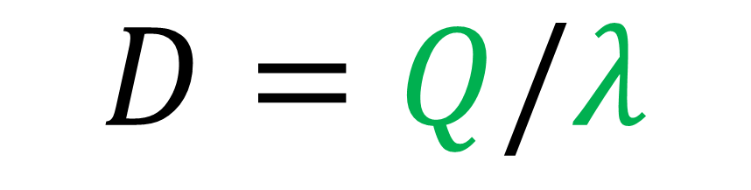
Little’s law in network queues
On average:
easy
easy
$$D=Q/λ$$
queuing delay
queue size
arrival rate

Slide 25
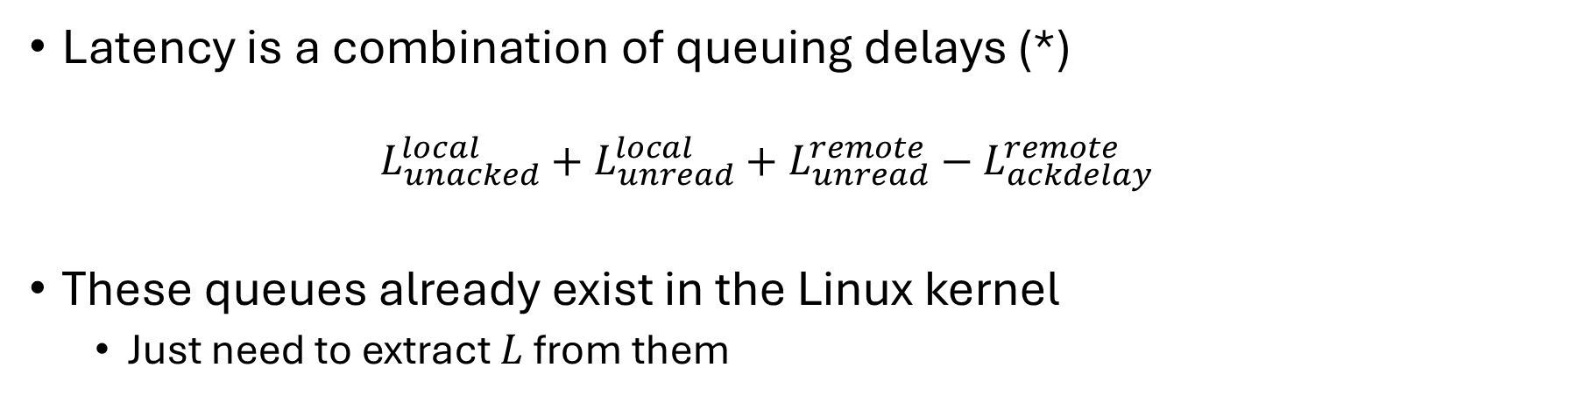
Combining delays into end-to-end latency
Latency is a combination of queuing delays (*)
  $$L_{unacked}^{local}+L_{unread}^{local}+L_{unread}^{remote}−L_{ackdelay}^{remote}$$
These queues already exist in the Linux kernel
  Just need to extract $L$ from them
unacked
unacked
unread
unread
ackdelay
ackdelay
Notes:
In the paper, we show that when messages correlate to bytes or packets, end-to-end latency can be estimated by combining queuing delays from three queues at both ends.
These queues are the "unacked" queue, [CLICK], which holds sent but unacknowledged messages;
the "unread" queue, [CLICK], which holds received but unread messages;
and the "delayed acknowledgments" queue, [CLICK], which is not typically implemented as a queue, but treating it as one and computing its delay with Little's law turns out very useful.
These queues typically exist in any TCP/IP stack, such as in Linux. We just need to extract their average queuing delays. [CLICK].

Slide 26
Queue performance tracking algorithm
Simple 4-tuple structure pluggable to any queue:
$$q_{s}=(\text{time},\text{size},\text{total},\text{integral})$$
timestamp of last state update
current #items in queue
total #items that left the queue until now
time-weighted accumulator of queue size
Simple algorithms to maintain (Track) and extract metrics (GetAvgs)
Passing this tuple to peers allows calculating remote performance

Slide 27
Bridging the semantic gap
Previous approach needs no app assistance
  Assumption – bytes/packets correlate to messages
  Not always true
Better correlation – count send() system calls
  Deals with messages fragmented by network stack
  Not always true
Most accurate – let the app tell you. How?

Slide 28
Bridging the semantic gap
Just one client-side user-space “request queue”
  Same Little’s law-based algorithms in user-space
  State shared via send() metadata
Simple API with two functions
  create(n)
  complete(n)
create()
complete()
outstanding requests
Easy adoption into libc, gRPC, etc.

Slide 29
Evaluation
Offline prototype – shows potential
  Bytes as units
  No exchange
  No dynamic toggling – workload runs twice
Nagle as batching algorithm
Redis as server app
  Hardcoded to disable Nagle
Lancet as client app
  Measures latency for varying load rates

Slide 30
Evaluation
(a) 100% SET
4
10
latency
[μs]
3
10
500μs SLO
2
10
1.93×
0
10
20
30
40
50
60
70
80
sustained throughput [kRPS]
nagle=off measured
nagle=on measured
nagle=off approximated
nagle=on approximated
approximated cutoff
measured cutoff

Slide 31
Evaluation
(a) 100% SET
(b) 95% SET
4
good
correlation
bad
correlation
10
latency
[μs]
3
10
2
10
1.93×
0
10
20
30
40
50
60
70
80
0
10
20
30
40
50
60
70
80
sustained throughput [kRPS]
nagle=off measured
nagle=on measured
nagle=off approximated
nagle=on approximated
approximated cutoff
measured cutoff

Slide 32
Future work and challenges
Dynamic toggling
  Granularity
  Policy
Metadata exchange
Better batching heuristics

Slide 33
Conclusion
The success of batching depends on end-to-end performance
Approximating this information can improve batching

