Slide 1

Tolerate It if You Cannot Reduce It: Handling Latency in Tiered Memory
Musa Unal, Vishal Gupta, Yueyang Pan, Yujie Ren, Sanidhya Kashyap

Slide 2
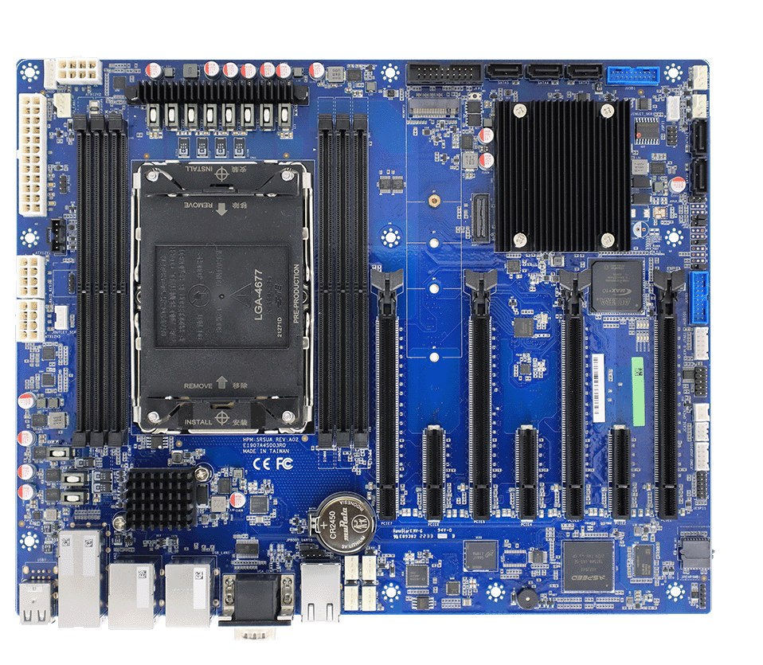
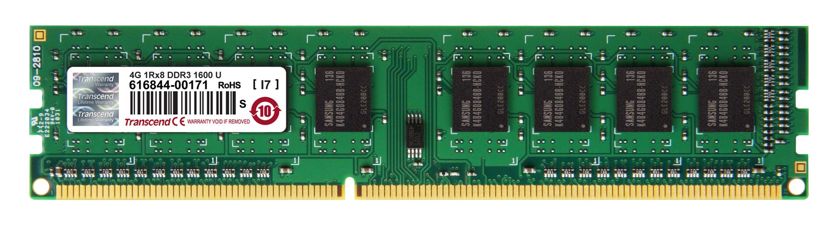




Tiered memory
Why ?
Applications demand for memory.
We want to expand main memory.
We can not add more DRAMs.
How ?
Memory
DRAM
?
DISK
PMEM
Far Memory
CXL

Slide 3
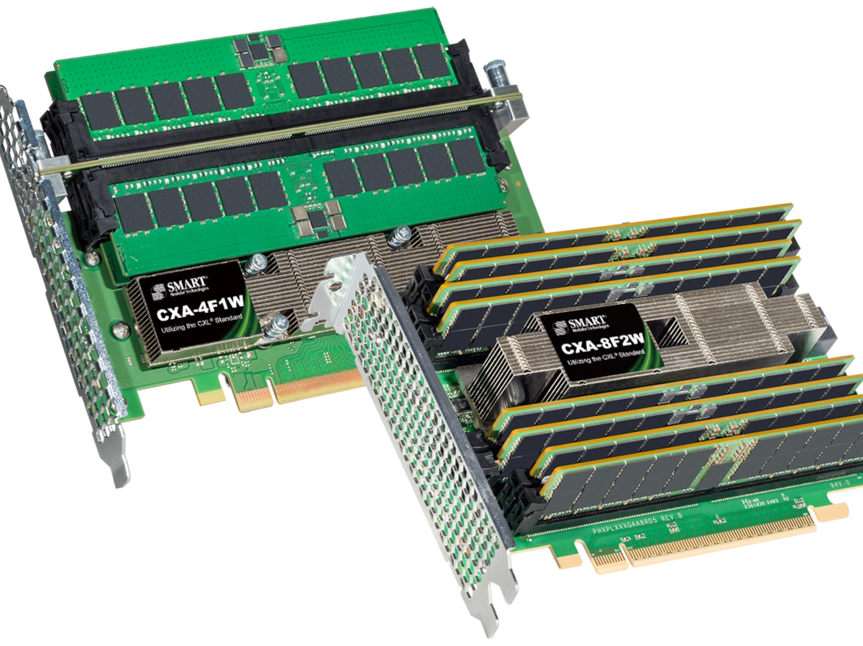
CXL expands main memory
CXL Attached Memory
Memory
DRAM
CXL
100ns
Protocol for fast memory access over PCIe
Latency is 2x higher (or higher with different topologies)
200ns
How can we handle the latency in tiered memory?

Slide 4
Conventional approach to handle latency
Promote
DRAM
CXL
Reduce
Demote
Load
CPU

Slide 5
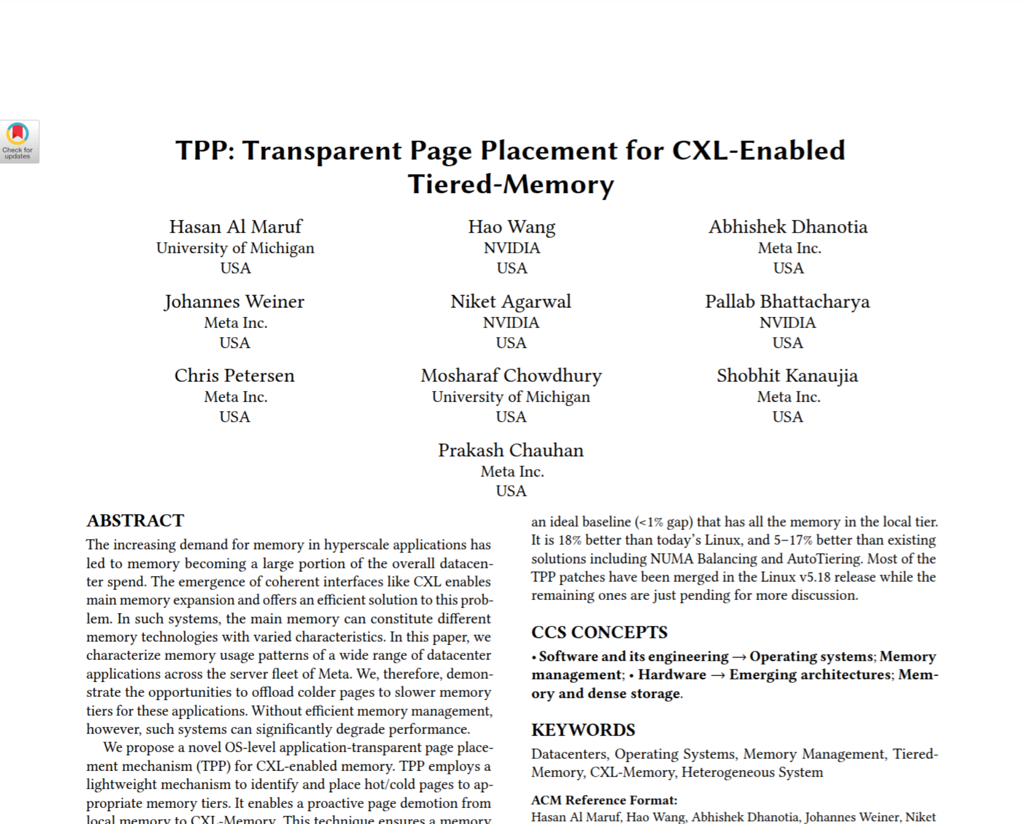

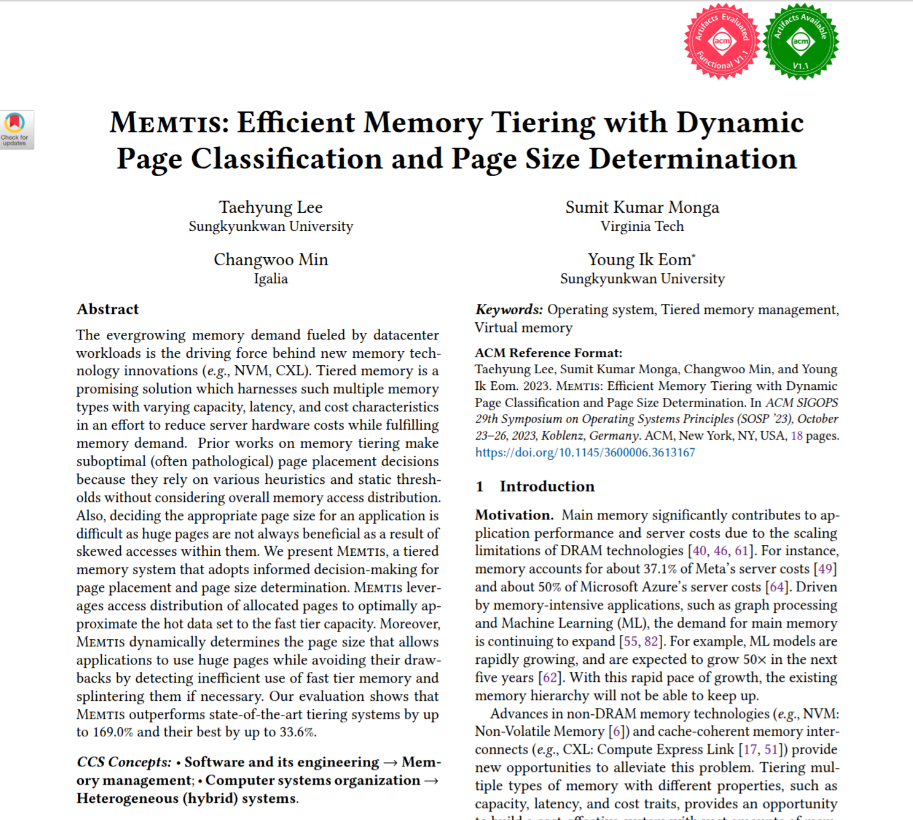
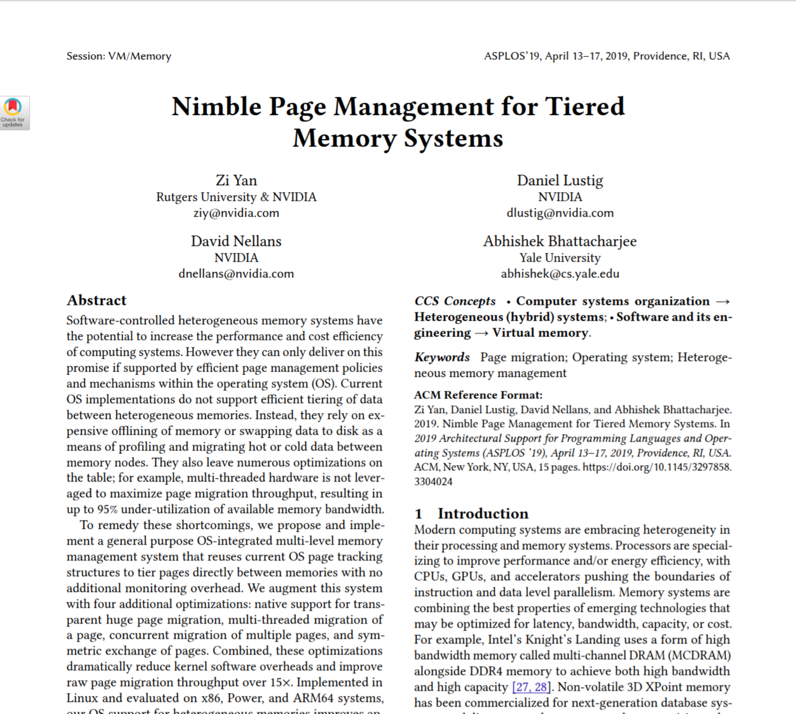
Page migration can reduce the latency
Tiering systems monitor pages hotness information.
DRAM
1
0
1
1
1
2
3
4
5
6
Promote hot pages
Demote cold pages
2
CXL
Increase locality, and reduce the latency
5
6
6
6
3
7
8
App
Monitor
9

Slide 6
Missing aspect to handle latency
Promote
DRAM
CXL
Reduce
Demote
Load
Tolerate
Prefetch

Slide 7
Hardware prefetchers can tolerate latency
Sequential Pointer Chase
i + 2
PF
$
i + 1
Stride Size | CXL Lat / DRAM Lat
4096 | ~2.01
128 | ~1.79
64 | ~1.55
i + 3
i
i + 4
CXL
i + 5
Hardware prefetchers can help to hide CXL’s latency.

Slide 8
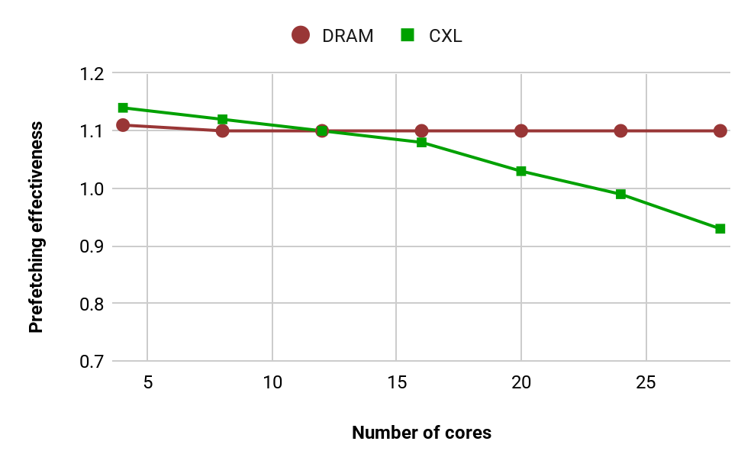
Hardware prefetchers can be harmful
Prefetching can degrade the performance under high loads.

Slide 9
Software prefetching can help as well
r[x[i]]
for i in range(1M):
e = records[x[i]]
work(e)
PF
$
r[x[i+1]]
CXL
for i in range(1M):
e = records[x[i]]
prefetch(records[x[i+1]])
work(e)
Timeliness is important!
for i in range(1M):
e = records[x[i]]
prefetch(records[x[i+k]])
work(e)
Early prefetches can be evicted.
Late prefetches are not helpful.
Prefetch distance

Slide 10
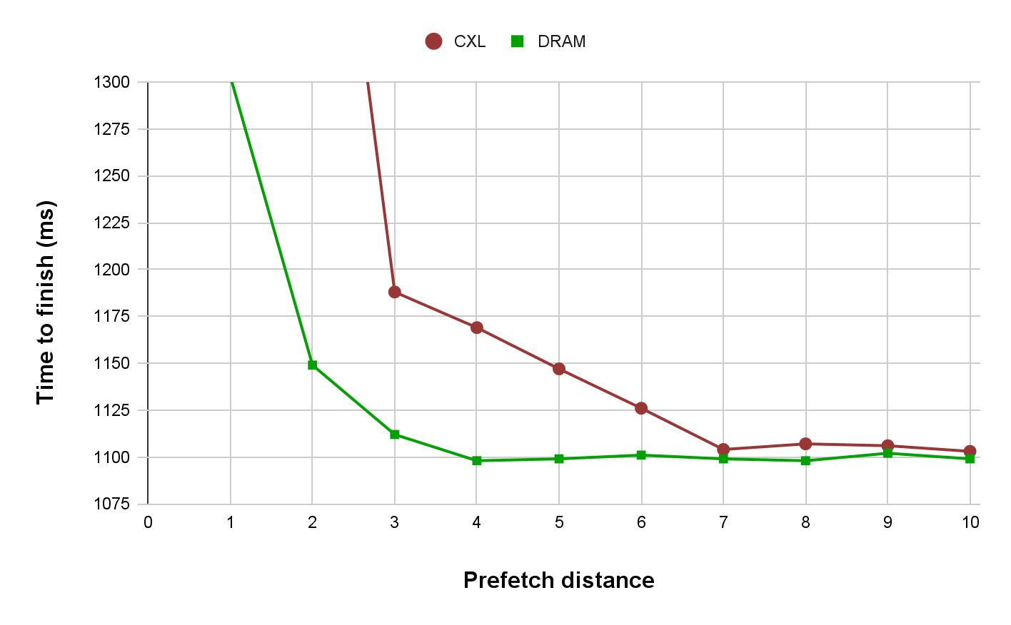
Prefetch distance matters
Scan microbenchmark
Prefetch distance should differ across tiers
Prefetching can effectively hide the latency

Slide 11
Linden: Combining reduce and tolerate
Promote
Reduce
Hotness
DRAM
CXL
Demote
Load
Prefetch
Tolerate
Prefetchability

Slide 12
Prefetchability as a tolerate metric
Can we identify memory regions that will get benefit from prefetching ?
Prefetchability:
Percentage of the loads to particular region that can be hidden by prefetching.
Number of loads hidden with prefetching
Issued loads
Thread | Region | Access Pattern | Prefetchability Ratio
T_1 | arr | Sequential | 1
T_2 | arr_2 | Random | 0

Slide 13
Combining hotness and prefetchability
// seq access
arr = [...]
for j in range(10):
for i in range(1000):
sum += arr[i]
// rand access
arr = [...]
for j in range(10):
for i in range(1000):
sum += arr[rand]
H = 1
P = 1
P = 0
H = 1
P = 1
P = 0
arr
H = 1
P = 1
P = 0
H = 1
P = 1
H=0-1
Hotness
P = 0
P=0-1
Prefetchability
Memory Pages

Slide 14
Linden’s objectives and workflow
Prefetching can hide CXL’s latency.
Compiler
Identify prefetchable access patterns
Insert software prefetch hints.
Under high contentions prefetching can be harmful
Runtime
Prefetch distances matter in different tiers
Observe dynamic behaviours
Adapts to the current state

Slide 15
Linden compiler
Compiler
Instrumented Program
Unmodified Program
arr = [...]
register_region(arr, pf_rat);
for i in range(1000):
prefetch(arr[i+pf_dist])
sum += arr[i]
arr = [...]
for i in range(1000):
sum += arr[i]
Classify Access Patterns
Calculate Prefetchability
Instrument
1
2
3

Slide 16
Linden’s runtime responsibilities
Metrics
Decisions
Hotness
Page Migration
Prefetchability
Policy Enforcer
Software Adaptation
Hardware Monitoring
Hardware Adaptation

Slide 17
Page migration
What happens if all regions are “hot” ?
Hotness + Prefetchability
Find memory regions that can tolerate the latency.
Then migrate these pages to the CXL.
DRAM
CXL

Slide 18
Software adaptation
What if a region with prefetch migrated?
Prefetch distance should be updated!
Dynamically adjust the prefetch distances with considering the tier information.
DRAM
CXL
pf distance: 4
pf distance: 8

Slide 19


Hardware adaptation
What happens under high contention.
Disable hardware prefetching!
Check which threads are accessing the CXL memory.
DRAM
CXL
Accessing
DRAM
Accessing
CXL

Slide 20
Linden: Tolerate It if You Cannot Reduce It
Two techniques for tiered memory management:
  Reduce understands the hotness.
  Tolerate understands the prefetchability.
Why toleration matters ?
  Can help to hide CXL’s latency
  Careful monitoring is essential
  Hardware and software adaptations needed
Thanks

