Slide 1
Breaking Up is Hard to Do
Security and Functionality in a Commodity Hypervisor
Patrick Colp†, Mihir Nanavati†, Jun Zhu‡
William Aiello†, George Coker*, Tim Deegan‡, Peter Loscocco*, Andrew Warfield†
† Department of Computer Science, University of British Columbia
‡ Citrix Systems R&D
* National Security Agency
Notes:
Xoar, modified version of Xen
With Xen maintainers at Citrix and George and Pete, Xen MAC guys

Slide 2


Notes:
- What I’m going to talk to you about today are *hosted virtualization platforms*

Slide 3













































































































































































































































Companies in the Cloud
(all these run in EC2 or Rackspace)
Notes:
Tonnes of services are running in the cloud
But are the virtualization platforms they run on really trustworthy?

Slide 4



Hypervisors are Secure
Small
codebase
Narrow
interface
x86
x86
x86
Hypervisor
Xen: 280 KLOC (based on the current version)
Nova: 9 KLOC (microvisor) + 20 KLOC (VMM) [EuroSys’10]
SecVisor: 2 KLOC [SOSP’07]
Flicker: 250 LOC [EuroSys’08]
Notes:
As a user of these systems, you don’t know who you’re going to be running along side. It could be a competing service
Why are users willing to put so much trust in the hypervisor?
One reason we’ve been given is that they have a small code base. For eg, Xen has only 280K LoC
There’s been a wealth of research on making them even smaller
But the more important observation is that they offer a narrow interface to guests: one very similar to that of the hardware. This makes it considerably easier to check and validate the correctness of the hypervisor
Is this trust well-placed? How have hypervisor fared in the wild?

Slide 5
CERT Vulnerabilities
38 Xen CERT vulnerabilities
23 originate in guest VMs
2 are against the hypervisor
What the heck are the other 90%?
Notes:
We decided to see what CERT had to say about this
Turns out, the hypervisor is pretty secure!
Only 2! reported vulnerabilities
Which leaves us with a very important question: what the heck are all the others?

Slide 6

“We are the 90%”
Control VM (Dom0)
IPC
Management
Device Emulation
User A’s VM
Platform
Device Drivers
User B’s VM
Manage devices
Create and destroy VMs
Arbitrarily access memory
Hypervisor
Notes:
Additional interfaces on top of hypervisor
Lots of complexity because of the many different services being hosted
All run in monolithic domain of trust
What does the hypervisor do? (isolation, scheduling, memory)
But commodity VMs need more to work
Devices, management, communication
Complex set of interdependent interfaces between all of these components
Typically, these are services are in a single monolithic domain of trust (control VM, dom0)
The implication is that an exploited in a service component affects not only the other guests that reply on that service, but the attack could break outside that service into the control VM, and compromise every other service
Even more concerning, the control VM has a single privileged interface to the hypervisor
This interface allows managing device, creating and destroying VMs, and arbitrarily accessing the memory of any VM on the system
So really what this means, is that a compromise of *any* one of these components could result in a compromise of the *entire* system
How much of a concern is this?
It turns out that the other 90% of the CERT vulnerabilities are against these components
Given the number of vulnerabilities against services in the control VM, we felt that it was time to address the elephant in the room that has been largely ignored
We addressed this problem by
Isolating guests from unrequired services. A service that a guest does not rely on should not be able to compromise its security
Containing the scope of exploits to only that service which contains the vulnerability
In order to make our work more attractive to real deployments, we gave ourselves a strict constraint: we cannot sacrifice the functionality, performance, or maintainability of the system
What this work is really about is understanding and managing exposure to risk in a real world system

Slide 7
Exposure to Risk
Isolate services into
least-privileged service VMs
Make sharing between components explicit
Contain scope of exploits in both space and time
Constraint:
Don’t reduce functionality, performance, or maintainability of the system
Notes:
Additional interfaces on top of hypervisor
Lots of complexity because of the many different services being hosted
All run in monolithic domain of trust
What does the hypervisor do? (isolation, scheduling, memory)
But commodity VMs need more to work
Devices, management, communication
Complex set of interdependent interfaces between all of these components
Typically, these are services are in a single monolithic domain of trust (control VM, dom0)
The implication is that an exploited in a service component affects not only the other guests that reply on that service, but the attack could break outside that service into the control VM, and compromise every other service
Even more concerning, the control VM has a single privileged interface to the hypervisor
This interface allows managing device, creating and destroying VMs, and arbitrarily accessing the memory of any VM on the system
So really what this means, is that a compromise of *any* one of these components could result in a compromise of the *entire* system
How much of a concern is this?
It turns out that the other 90% of the CERT vulnerabilities are against these components
Given the number of vulnerabilities against services in the control VM, we felt that it was time to address the elephant in the room that has been largely ignored
We addressed this problem by
Isolating guests from unrequired services. A service that a guest does not rely on should not be able to compromise its security
Containing the scope of exploits to only that service which contains the vulnerability
In order to make our work more attractive to real deployments, we gave ourselves a strict constraint: we cannot sacrifice the functionality, performance, or maintainability of the system
What this work is really about is understanding and managing exposure to risk in a real world system

Slide 8
SPACE

Slide 9
Space
Time
Control VM
IPC
IPC
IPC
XenStore
XenStore
Platform
Management
Platform
Management
User A’s VM
Management
Device
Emulation
Device Emulation
Device Emulation
PCI Config
Builder
Tools
Qemu
PCI Config
Builder
Tools
Qemu
Platform
Device Drivers
Device Drivers
User B’s VM
Device Drivers
System Boot
System Boot
Network
Network
Block
Block
Hypervisor
Notes:
Currently all these services exist in the same trust domain or space
A lot of the problems we talked about stem from the colocation of these services
How can we go about isolating them from each other?

Slide 10
Isolation
Space
Time
Control VM
IPC
IPC
IPC
XenStore
XenStore
Platform
Management
Platform
Management
User A’s VM
Management
Device
Emulation
Device Emulation
Device Emulation
PCI Config
Builder
Tools
Emulator
PCI Config
Builder
Tools
Emulator
Platform
Device Drivers
Device Drivers
User B’s VM
Device Drivers
System Boot
System Boot
Network
Network
Block
Block
Hypervisor
Notes:
Hypervisors already offer a light-weight isolation mechanism: the VM
Additionally, the hypervisor manages privileges on a per VM basis
Since components are already processes or kernel modules, they are easy to extract
Therefore, it is a natural fit to place each of these components in a VM
Now we no longer have a single monolithic domain trust and the privilege of each of these service VMs is managed by the MAC module in Xen
But it’s a bit more complicated than this diagram suggests – many of these components execute more than one task, potentially requiring different privileges
For example, most of the management tools require the same level of privilege, however the build must be able to map guest memory in order to setup the initial page tables
We therefore further subdivide these tasks into their own VMs based on the Principle of Least Privilege

Slide 11
Space
Time
Isolation
Control VM
IPC
IPC
IPC
XenStore
XenStore
Platform
Management
Platform
Management
User A’s VM
Management
Device
Emulation
Device Emulation
Device Emulation
PCI Config
Builder
Tools
Qemu
PCI Config
Builder
Tools
Emulator
Platform
Device Drivers
Device Drivers
User B’s VM
Device Drivers
System Boot
System Boot
Network
Network
Block
Block
Hypervisor
Notes:
Each guest gets its own emulation component, which is privileged *only* for the guest it is assigned to
Now that we have this strong isolation, we can start to reason about the sharing in the system

Slide 12
Configurable Sharing
User A’s Network
User A’s VM
User A’s Tools
User A’s Block
User B’s Network
User B’s VM
User B’s Tools
User B’s Block
Notes:
We can now completely guests from each other
Given enough hardware, each guest could have its own set of components, like devices
Why would we want to reduce the amount of sharing we have with other VMs?

Slide 13
Configurable Sharing
User A’s VM
Network
Tools
Block
User B’s VM
Notes:
Let’s consider a configuration in which devices are shared by two guests
If a VM gets exploited, it could launch an attack on one of these components, for example the block device
The attacker can now use this position to interpose on the interface the block device shares with user A’s VM. For example, they could snoop traffic, perform a DoS, or even corrupt data, potentially in an attempt to exploit the other user’s VM

Slide 14
Configurable Sharing
User A’s Network
User A’s VM
User A’s Tools
User A’s Block
User B’s Network
User B’s VM
User B’s Tools
User B’s Block
Notes:
Now let’s examine this same attack in an environment with no sharing
The guest gets exploited and launches its attack on the block device
However, this is as far as it gets. Since User A’s VM doesn’t share the block device – or even any component here – with User B, the attack is contained

Slide 15
Space
Isolation
Time
Configurable Sharing
Control VM
IPC
IPC
IPC
XenStore
XenStore
Platform
Management
Platform
Management
User A’s VM
Management
Device
Emulation
Device Emulation
Device Emulation
PCI Config
Builder
Tools
Qemu
PCI Config
Builder
Tools
Emulator
Platform
Device Drivers
Device Drivers
User B’s VM
Device Drivers
System Boot
System Boot
Network
Network
Block
Block
Hypervisor
Notes:
While it is nice to have completely isolated VMs, one of the great advantages of virtualization is that it allows the provider to maximize utilization by multiplexing resources
Therefore, it may instead be desirable to offer users willing to pay more an isolation environment, while having other users share
However, we can now reason about what we’re sharing and with whom – our exposure becomes explicit

Slide 16
Auditing
Which VMs were relying on the Block component while it was compromise?
User A’s VM
Which VMs were relying on the Block component while it was compromise?
Network
User B’s VM
Block
Network
Block
Create
User C’s VM
VM B and VM C
Notes:
Because have the explicit dependencies, we can have the hypervisor write entries into the log before making changes
Write configuration changes out to temporal database over secure channel (for our implementation, we use the temporal extensions for Postgres)
Every time we change the configuration of the system, we write an entry into the log
For example, if we want to create a VM, we first write the create message, then instantiate the VM
To hook the VM up to services, we first write the log message, then create the connection
Now, if a component is exploited, like the block device, the provider query the database with meaningful questions, like “Which VMs were relying on the Block component while it was compromised?”
In this case, it’s VM’s B and C, while A remains unaffected as it didn’t share the compromised component

Slide 17
Auditing
Time
Space
Isolation
Configurable Sharing
Control VM
IPC
IPC
IPC
XenStore
XenStore
Platform
Management
Platform
Management
User A’s VM
Management
Device
Emulation
Device Emulation
Device Emulation
PCI Config
Builder
Tools
Qemu
PCI Config
Builder
Tools
Emulator
Platform
Device Drivers
Device Drivers
User B’s VM
Device Drivers
System Boot
System Boot
Network
Network
Block
Block
Hypervisor
Notes:
- A nice property that falls out of this isolation is that it now lets us reason about the length of time each of these components run

Slide 18
TIME
Time

Slide 19
Space
Containment
Configurable Sharing
Auditing
Time
Control VM
IPC
IPC
IPC
XenStore
XenStore
Platform
Management
Platform
Management
User A’s VM
Management
Device
Emulation
Device Emulation
Device Emulation
PCI Config
Builder
Tools
Qemu
PCI Config
Builder
Tools
Emulator
Platform
Device Drivers
Device Drivers
User B’s VM
Device Drivers
System Boot
System Boot
Network
Network
Block
Block
Hypervisor
Notes:
It turns out that similar components have similar temporal properties
First, let’s consider the platform components

Slide 20


Disposable
PCI Config
Services
System Boot
Hypervisor
Notes:
What is involved in booting the system?
First, the hypervisor comes up
It then launches services to bring up and configure the platform hardware and devices
Finally, the rest of the services are started
However, this platform bring up code is no longer needed once the system is running
Keeping it around is dangerous – if it can bring your system up, it can also bring it down
Since we have these components isolated in VMs, it’s easy for us to shut them down, removing them – and their privileges – from the running system

Slide 21
Disposable
Space
Isolation
Configurable Sharing
Auditing
Time
Control VM
IPC
IPC
IPC
XenStore
XenStore
Platform
Management
Platform
Management
User A’s VM
Management
Device
Emulation
Device Emulation
Device Emulation
PCI Config
Builder
Tools
Qemu
PCI Config
Builder
Tools
Emulator
Platform
Device Drivers
Device Drivers
User B’s VM
Device Drivers
System Boot
System Boot
Network
Network
Block
Block
Hypervisor
Notes:
While considering the device driver components of the system, we observed that we might be able to apply the technique of microreboots
Microreboots were designed for high-availability systems in order to restore components to a pristine, known-good state in order to prevent failures
So why can’t we use this same technique from a security context? We can continually restore components to a known-good state
Since we have to perform these restarts frequently, a few seconds of downtime on restart is now an unacceptable performance impact

Slide 22
Snapshots
4-25 ms
VM
VM
Notes:
To address this problem, we implemented a VM snapshot facility for Xen
The way this works is that the VM boots and initialises, just before its ready to start processing user requests, we take a snapshot
This is a very light-weight snapshot – effective we only save the current CPU state of the VM
Instead of taking a complete snapshot of its memory – which is costly both in terms of time and memory – we instead leverage the log-dirty mechanism of Xen, which is used by things like live migration
As the guest runs, we copy out the original contents of pages that are dirtied to the snapshot
When we perform the rollback, we restore the contents of memory, and reset the CPU state
The VM is now ready to continue running, processing more requests
This mechanism is extremely efficient and allows us to rollback even heavily-loaded full Linux VMs in as little as 4-25ms
Despite these quick restarts, the network device proved particularly problematic – we observed network outages of 4-5 seconds
It turns out that gigabit over copper requires the link state to be renegotiated after each restart
To address this issue, we borrow another technique from HA – the recovery box
We store link state information in the recovery box so that on restart we can just pull this state and avoid the link renegotiation
With this issue sorted, we can now take full advantage of our snapshot mechanism and restart driver VMs as frequently as once a second

Slide 23
Timed Restarts
Space
Isolation
Configurable Sharing
Auditing
Time
Disposable
Control VM
IPC
IPC
IPC
XenStore
XenStore
Platform
Management
Platform
Management
User A’s VM
Management
Device
Emulation
Device Emulation
Device Emulation
PCI Config
Builder
Tools
Qemu
PCI Config
Builder
Tools
Emulator
Platform
Device Drivers
Device Drivers
User B’s VM
Device Drivers
System Boot
System Boot
Network
Network
Block
Block
Hypervisor
Notes:
The management components have a nice property. When they process a request, all the state generated is temporary, needed only for that request
So why don’t we apply our snapshots here to restore these components to a fresh state after each request?

Slide 24
Stateless VMs
rollback
Builder
Builder
Builder
Newly Created VM
Snapshot Image
Copy-on-Write
boot and
initialization
process
request
User B’s VM
User A’s VM
Notes:
Let’s consider the Builder as an example
First we boot and initialise it and snapshot it just before it’s ready to process a build request.
When we want to build a VM, we instantiate a builder. We then process the build request, loading the image from disk. Once done, we can just blow the instance away, restoring it to the snapshotted state
When we want to build another VM, we do the same thing, loading the image from disk and blowing away the builder when we’re done
These components are time-division mulitplexed – they only process requests from one guest at a time. By doing restarts after each request, we’ve effectively turned these shared components into dedicated resources

Slide 25
Stateless
Space
Isolation
Configurable Sharing
Auditing
Time
Disposable
Timed Restarts
Control VM
IPC
IPC
IPC
XenStore
XenStore
Platform
Management
Platform
Management
User A’s VM
Management
Device
Emulation
Device Emulation
Device Emulation
PCI Config
Builder
Tools
Qemu
PCI Config
Builder
Tools
Emulator
Platform
Device Drivers
Device Drivers
User B’s VM
Device Drivers
System Boot
System Boot
Network
Network
Block
Block
Hypervisor
Notes:
This leaves us with just one component: IPC
This component proves to be particularly tricky, and to deal with it, we need to compose techniques from both space and time isolation

Slide 26
Space + Time

Slide 27
Space + Time
Space
Isolation
Configurable Sharing
Auditing
Time
Disposable
Timed Restarts
Stateless
Control VM
IPC
IPC
IPC
XenStore
XenStore
Platform
Management
Platform
Management
User A’s VM
Management
Device
Emulation
Device Emulation
Device Emulation
PCI Config
Builder
Tools
Qemu
PCI Config
Builder
Tools
Emulator
Platform
Device Drivers
Device Drivers
User B’s VM
Device Drivers
System Boot
System Boot
Network
Network
Block
Block
Hypervisor
Notes:
What makes this component so difficult? It’s a highly shared and necessarily long-lived component
In Xen, XenStore acts as a central configuration repository. This contains things like the name of VMs and how much memory they use, as well as configuration details about how components are connected

Slide 28
Composition
User A’s VM
OK
XenStore
XenStore-State
XenStore-Logic
User B’s VM
B: Network can map 0xDEADBEEF
I’ve enabled the network driver to map page 0xDEADBEEF
I’ve enabled 0xPWND
Hypervisor
Notes:
Before I talk about what we did, let’s first understand how XenStore works
Guests use XenStore to communication information with other guests. For example, B’s VM has set a page so that the Network device can map it, but it needs to tell the network device that it’s done this and which page it is
XenStore processes the request, puts an entry into it’s store, and sends a reply
In order for VMs and XenStore to know when there are packets waiting, they use an event channel – Xen’s version of a virtual interrupt. When a message is delivered, the interrupt is fired, informing the other end of the new packet
Now let’s consider an attack. A guest writes a malicious packet to XenStore and gains control. It can now modify the configuration entries of other VM
Worse yet: since XenStore is long-lived, the attacker now has control of it forever
We’d like to be able to restart it, but can’t because of the long-lived configuration state

Slide 29
Composition
User A’s VM
OK
XenStore
XenStore-State
XenStore-Logic
User B’s VM
B: Network can map 0xDEADBEEF
A: Please shut me down
A: Please shut me down
I’ve enabled the network driver to map page 0xDEADBEEF
I’ve enabled 0xPWND
Hypervisor
Notes:
Why don’t we just separate out the long-lived state and put it in it’s own VM, XenStore-State?
XenStore-Logic contains all of actual logic, like processing requests, handling transactions, and performing access control
When a packet is sent, XenStore-Logic now forwards the packet on to XenStore-State, which writes the entry into the repository
Now that we have these components separated, we can apply restarts to XenStore-Logic after each request. The hypervisor monitors the event channel between XenStore and other VMs, and triggers a restart when a request/response pair has completed
Let’s consider our attack again. The guest takes over XenStore, but after the request, the hypervisor restarts it. The attacker might be able to prevent the reply message, so the hypervisor maintains a watchdog timer for each request and forces a restart if it’s triggered
It may still be possible for an attacker to compromise XenStore, and use its toe-hold to launch an attack on XenStore-State within the request

Slide 30
Composition
Monitor
User A’s VM
rollback
OK
Newly Created VM
Snapshot Image
Copy-on-Write
XenStore
XenStore-State
XenStore-Logic
B
process
request
boot and
initialization
User B’s VM
B: Network can map 0xDEADBEEF
A: Please shut me down
limit access
A: Please shut me down
I’ve enabled the network driver to map page 0xDEADBEEF
I’ve enabled 0xPWND
Hypervisor
Notes:
To solve this problem, we introduce a monitor component to XenStore
We can use the property that before each request, XenStore is in a known good state. Before it processes a request, it first informs the monitor which VM it’s about to process. The ID of this VM is locked into the monitor and can no longer be changed by XenStore
When XenStore processes the request, it passes it through as before. The monitor now enforces an additional, external access control check on the incoming packet. In this case, the packet is from B, so it lets it through
Now when we go to restart XenStore, the hypervisor also tells the monitor that XenStore-Logic has been restored to a pristine state. The monitor clears its locked-in value and is ready to accept a new request from XenStore
Let’s revisit the stepping stone attack. XenStore sees a message is waiting from B and tells the monitor. It then processes the request, which results in XenStore being compromised
When the attacker attempts to forge a message from A to the store, the monitor sees that the message doesn’t match the VM it was expecting, and denies the request. The monitor informs the hypervisor that something bad happened, and XenStore is restarted
What this lets us do is drop privilege of XenStore to the guest that it’s processing. This effectively makes XenStore, and it’s long-lived, shared state, a dedicated resource per VM
The reason this works is because of that green area on this figure. When we’re in the green bit, we known XenStore is in a good state, since we just restarted it and haven’t processed any user data. Once we tell the monitor which guest we’re about to process, the limit access bar, then we no longer trust XenStore – it could be compromised

Slide 31
Space + Time
Composition
Space
Isolation
Configurable Sharing
Auditing
Time
Disposable
Timed Restarts
Stateless
Control VM
IPC
IPC
IPC
XenStore
XenStore
Platform
Management
Platform
Management
User A’s VM
Management
Device
Emulation
Device Emulation
Device Emulation
PCI Config
Builder
Tools
Qemu
PCI Config
Builder
Tools
Emulator
Platform
Device Drivers
Device Drivers
User B’s VM
Device Drivers
System Boot
System Boot
Network
Network
Block
Block
Hypervisor
Notes:
Each service is now isolated to its own VM and exploits are contained within that VM
We offer the ability to provide shared-nothing configurations
In situations where there is sharing, we provide a secure audit facility to reason about the exposure to risk
This isolation allows us to consider the temporal properties of the components and restrict the time they run to the minimum necessary
A motivating reason for this isolation was the single privileged domain of trust. What do these privileges look like now?

Slide 32
EVALUATION
Notes:
Intuitively, it seems like our architecture is more secure, but how well does it fare against the vulnerabilities identified earlier?
What is the performance impact of this security?

Slide 33
Evaluation
What do privileges look like now?
What is the impact on the security of the system?
What are the overheads?
What impact does isolation have on performance?
What impact do restarts have on performance?
Notes:
To understand the performance impacts and overheads, we ask several questions:
What do privileges look like now?
What is the impact on the security of the system?
What are the overheads?
What impact does isolation have on performance?
What impact do restarts have on performance?

Slide 34
Privileges
Privilege | System Boot | PCI Config | Builder | Tools | Block | Network | XenStore
Arbitrarily Access Memory | X |  | X
Access and Virtualize PCI devices |  | X
Create VMs | X |  | X
Manage VMs | X |  | X | X
Manage Assigned Devices |  |  |  |  | X | X
Privilege | System Boot | PCI Config | Builder | Tools | Block | Network | XenStore
Arbitrarily Access Memory | X |  | X
Access and Virtualize PCI devices |  | X
Create VMs | X |  | X
Manage VMs | X |  | X | X
Manage Assigned Devices |  |  |  |  | X | X
Privilege | System Boot | PCI Config | Builder | Tools | Block | Network | XenStore
Arbitrarily Access Memory | X | X | X | X | X | X | X
Access and Virtualize PCI devices | X | X | X | X | X | X | X
Create VMs | X | X | X | X | X | X | X
Manage VMs | X | X | X | X | X | X | X
Manage Assigned Devices | X | X | X | X | X | X | X
Notes:
Previously all of these components effective had all of these privileges
The most highly privileged components now are the ones that can access memory
The system boot component is disposable and of no concern
For the builder, we use a tiny, custom-built OS specifically designed for only building VMs

Slide 35
Security
Of the 21 vulnerabilities against the control plane, we contain all 21
TCB is reduced from the control VM’s 7.5 million lines of code (Linux) to Builder’s 13,500 (on top of Xen)

Slide 36
Memory Overhead
Component | Memory
System Boot | 128MB
PCI Config | 128MB
XenStore-Logic | 32MB
XenStore-State | 32MB
Block | 128MB
Network | 128MB
Builder | 64MB
Tools | 128MB
Total | 512MB
Notes:
A typical configuration for Dom0 gives it 768MB of memory
The total listed here doesn’t include the System Boot and PCI Config components, as these are destroyed after boot and their memory reclaimed and reused by the system
Before you think I’m claiming we use less memory, in a traditional Dom0, adding new components results in a more or less static use of memory. However, in our system, each additional component results in a new VM and a higher memory requirement

Slide 37
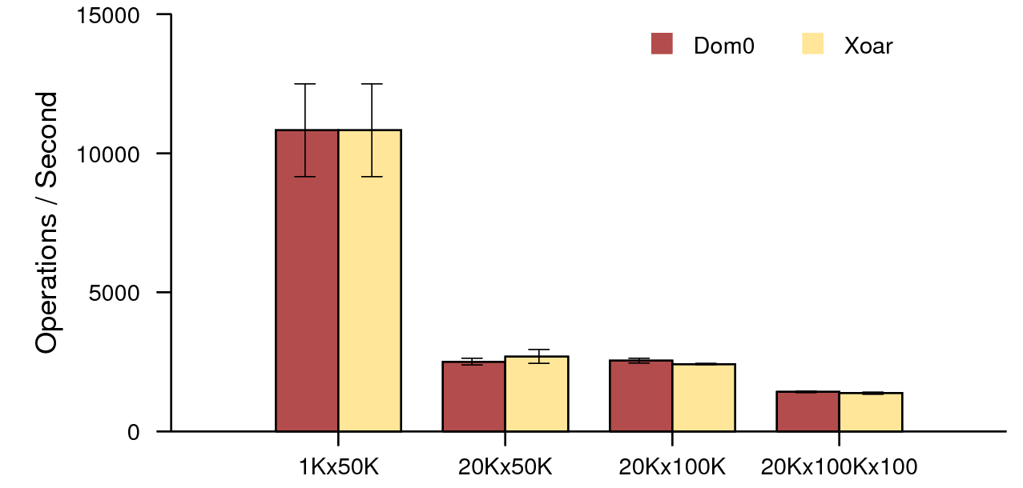
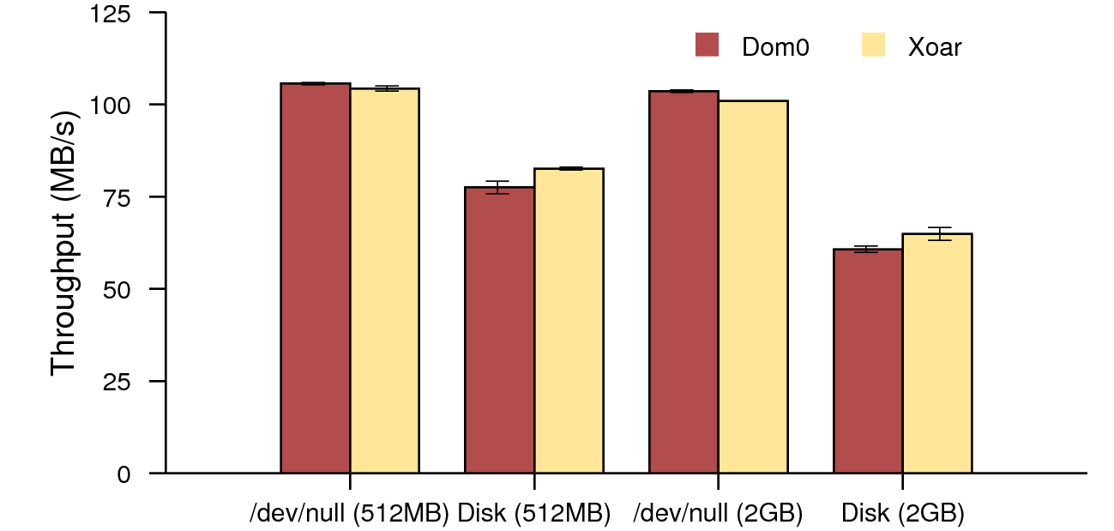
Isolation Performance
Postmark performance
wget performance
Notes:
These graphs show us the performance of isolating components
In both cases, the dark bars represent Xen with a typical Dom0 install and the light bars represent Xoar
On the left, we have results from a typical array of Postmark test configurations
On the right, we have the results of fetching two files with wget. The first two are fetching a 512MB file to /dev/null and to disk, then doing the same with a 2GB file
As we can see, Xoar’s performance is on part with a standard Xen install

Slide 38
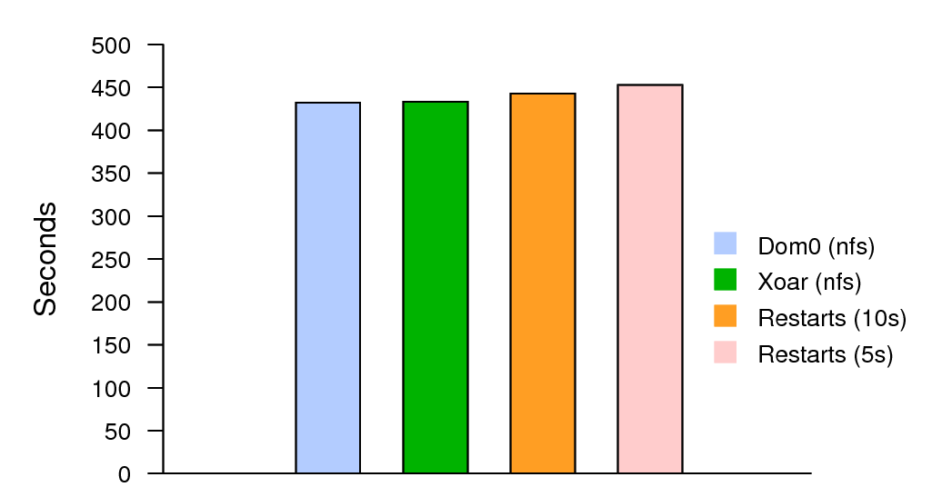
Restart Performance
Kernel build performance
Notes:
Earlier, I talked about our efficient snapshot mechanism. But how efficient is it really?
This graph shows us the results of running a kernel build over nfs
The first bar (blue) is a typical Xen/Dom0 setup, followed by Xoar with no restarts (green). We then restart the network driver every 10 (orange) and 5 (pink) seconds
As we can see, the performance impact of doing these restarts, even every 5 seconds, is low

Slide 39
CONCLUSION

Slide 40
Summing it All Up
Components of control VM a major source of risk
Xoar isolates components in space and time
  Contains exploits
  Provides explicit exposure to risk
Functionality, performance, and maintainability are not impacted
Notes:
We are currently updating our patches to release upstream to the xen-unstable tree

