Slide 1
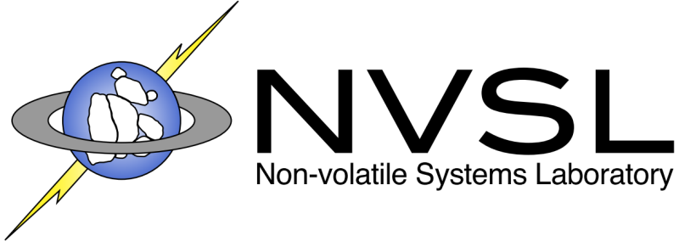


From ARIES to MARS:
Transaction Support for Next-Generation, Solid-State Drives
Joel Coburn*, Trevor Bunker*, Meir Schwarz, Rajesh Gupta, Steven Swanson
Non-volatile Systems Laboratory
Department of Computer Science and Engineering
University of California, San Diego
* Now at Google

Slide 2
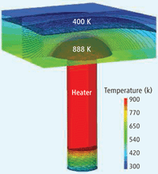
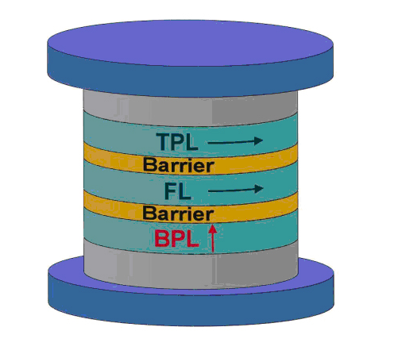
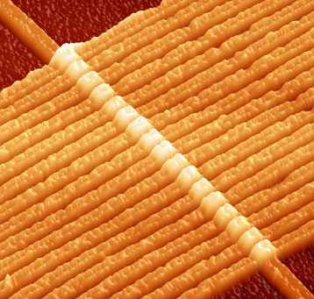
Faster than Flash
Non-volatile Memories
Flash is everywhere but has its idiosyncrasies
New device characteristics
  Nearly as fast as DRAM
  Nearly as dense as flash
  Non-volatile
  Reliable
Applications
  DRAM replacements
  Fast storage
Phase change memory
Spin-torque
MRAM
Memristor

Slide 3
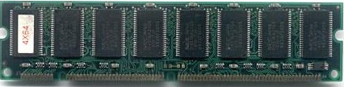
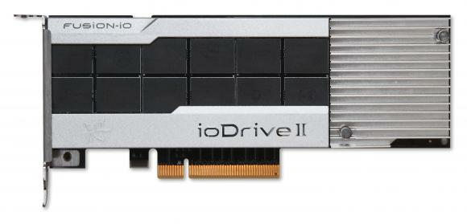
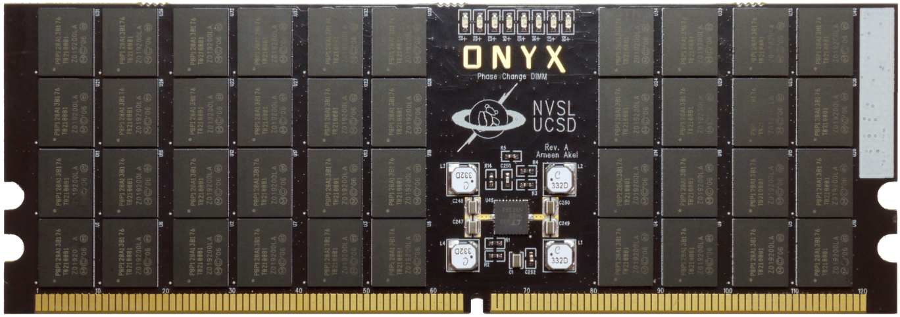
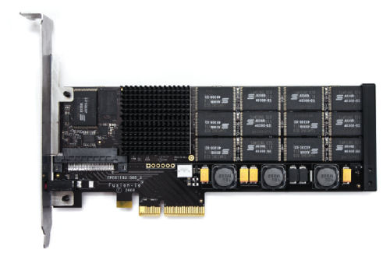
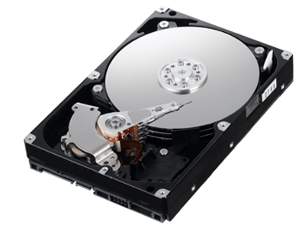
More than Moore’s Law Performance
5917x → 2.4x/yr
PCIe-Flash (2012)
DDR Fast NVM (2016?)
PCIe-PCM (2010)
PCIe-PCM (2014?)
Hard Drives (2006)
PCIe-Flash (2007)
7200x → 2.4x/yr

Slide 4
Realizing the Potential of fast NVMs
Applications
Applications
15
X
Process Isolation
Process Isolation
Low-level IO
Low-level IO
File System
File System
9
20
20
Physical Storage
3
8
29
29
Storage Controller
NV-DIMM
NV-DIMM
NV-DIMM
29
20
Log
NV-DIMM
NV-DIMM
NV-DIMM
WAL algorithms were designed for disk!

Slide 5
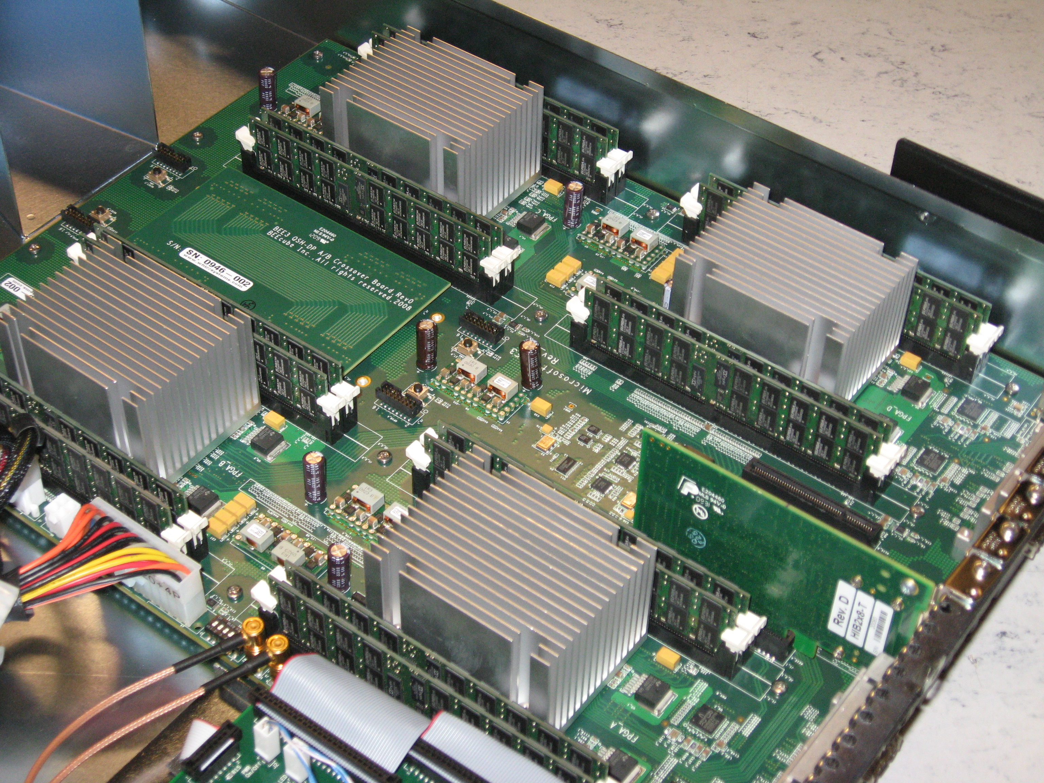
Moneta-Direct SSD for Fast NVMs
FPGA-based prototype
  DDR2 DRAM emulates PCM
  PCIe: 2GB/s, full duplex
Optimized kernel driver and device interface
  Eliminate disk-based bottlenecks in IO stack
User-space driver
  Eliminates OS and FS costs in the common case
[SC 2010, Micro 2010, ASPLOS 2012]
5µs latency,
1.8M IOPS for 512B requests

Slide 6
Characteristics of Fast SSDs
 | Disk | Moneta
Latency (4KB) | 7000µs | 7µs
Bandwidth (4KB) | 2.6MB/s | 1700MB/s
Sequential/random performance | ~100:1 | 1:1
Minimum request size/alignment | Block | Byte
Parallelism | 1 | 64
Internal/external bandwidth | 1:1 | 8:1

Slide 7
Existing Support for Transactions
Disk-based systems
  Write-ahead logging approaches: ARIES [TODS 92], Stasis [OSDI 06], Segment-based recovery [VLDB 09], Aether [VLDB 10]
  Device/HW support: Logical Disk [SOSP 93], Atomic Recovery Units [ICDCS 96], Mime [HPL-TR 92]
  Shadow paging in file systems: ZFS, WAFL
Non-volatile main memory
  Persistent regions: RVM [TOCS 94], Rio Vista [SOSP 97]
  Programming support: Mnemosyne, NV-heaps [ASPLOS 11]
Flash-based SSDs
  Transactional Flash [OSDI 08]
  FusionIO’s AtomicWrite [HPCA 11]

Slide 8
ARIES: Write-Ahead Logging Recovery Algorithm for Databases
Fast, flexible, and scalable ACID transactions
Feature | Benefit(s)
Flexible storage management | Supports varying length data and high concurrency
Fine-grained locking | High concurrency
Partial rollbacks via savepoints | Robust and efficient transactions
Recovery independence | Simple and robust recovery
Operation logging | High concurrency lock modes

Slide 9
ARIES Disk-Centric Design
Design Decision | Advantages | How?
No-force | Eliminate synchronous random writes | Flush redo log entries to storage on commit
Steal | Reclaim buffer space (scalability) Eliminate random writes Avoid false conflicts on pages | Write undo log entries before writing back dirty pages
Pages | Simplify recovery and buffer management Match the semantics of disk | All updates are to pages Page writes are atomic
Log Sequence Numbers (LSNs) | Simplify recovery Enable features like operation logging | LSNs provide an ordering on updates
Good for disk, not good for fast SSDs

Slide 10
MARS:
Modified ARIES Redesigned for SSDs
Applications
File System
Storage Manager
Simplified ARIES Replacement
+
Flexible software interface
+
Hardware support
Kernel IO
Moneta-Direct Driver
Editable Atomic Writes
Moneta-Direct SSD

Slide 11
Editable Atomic Writes (EAWs)
Storage
Atomic {
Write A
Write B
Write C
…
If(x)
Write A’
…
}
A’
Write the log
A
B
Log
C
Commit
Data
Applications can access and edit the log prior to commit.
Hardware copies data in-place.

Slide 12
Editable Atomic Write Execution
Storage
LogWrite(t1,memA,dataA,logA);
LogWrite(t1,memB,dataB,logB);
LogWrite(t1,memC,dataC,logC);
If(x) Write(memA,logA);
Commit(t1);
// WriteBack(t1);
0
63
FREE
Transaction
Table
COMMITTED
PENDING
Metadata
File
Memory
A
A
A’
A’
A
A’
A’
B
Log
File
B
B
C
C
C
Data
File

Slide 13
Designing MARS for Fast NVMs
No-force
Steal
Pages
LSNs
Perform write backs in hardware at the memory controllers
Hardware does in-place updates
Eliminate undo logging
Log always holds latest copy
Software sees contiguous objects
Hardware manages the layout of objects across memory controllers
Hardware maintains ordering with commit sequence numbers

Slide 14
MARS Features using EAWs
Feature | Provided by MARS?
Flexible storage management | ✓
Fine-grained locking | ✓
Partial rollbacks via savepoints | ✓
Recovery independence | ✓
Operation logging | N/A

Slide 15
EAW Hardware Architecture
TID Status
Ack
Commit
Write back
Ring
Control
TID
Manager
Free
8 GB
Comm
8 GB
Logger
Pend
Logger
Transfer
Buffers
Host
via
PIO
Req
Queue
Perm
Check
Score
board
8 GB
8 GB
Logger
Logger
DMA
Control
Ring (4 GB/s)
Tag
Renamer
Free
Free
Comm
Comm
8 GB
Pend
8 GB
Logger
Pend
Logger
8 GB
8 GB
Req Status
Logger
Logger
2-phase commit protocol
Host via
DMA

Slide 16
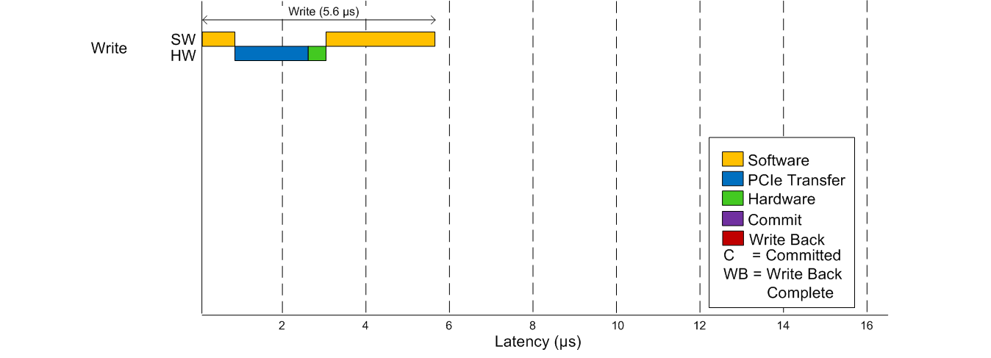
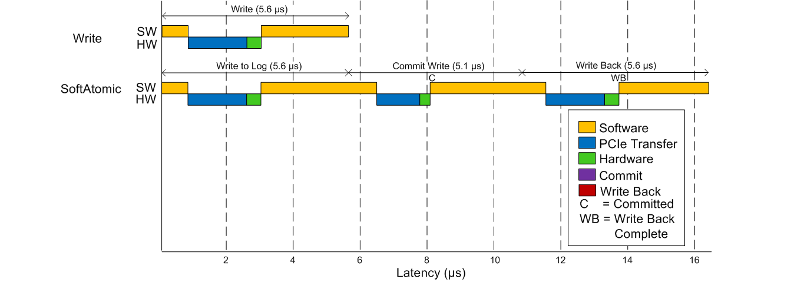
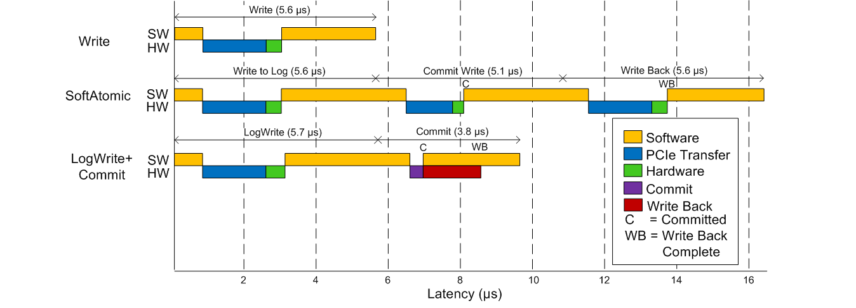
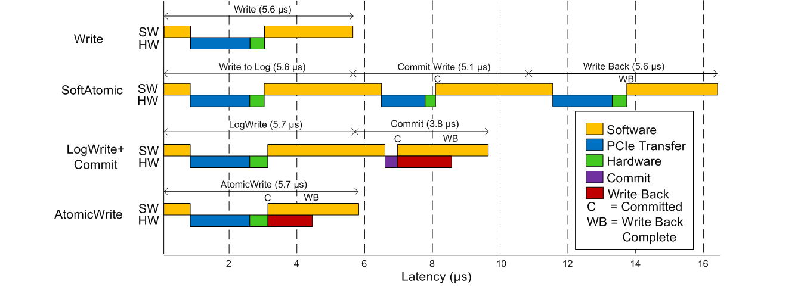
Latency Breakdown
Up to 3x faster than software only

Slide 17
Bandwidth Comparison
2 to 3.8x
improvement

Slide 18
Internal Memory Bandwidth
3x bandwidth

Slide 19
MemcacheDB:
Persistent Key Value Store
1.7x faster than SoftAtomic, 3.8x faster than BDB

Slide 20
Comparison of MARS and ARIES
4x throughput improvement and better scalability

Slide 21
Conclusions from MARS
MARS: Redesign of write-ahead logging for NVMs
  Provides the features of ARIES but none of the disk-related overheads in a database storage manager
Editable Atomic Writes (EAWs)
  Makes the log accessible and editable prior to commit
  Minimizes the cost of atomicity and durability
  Offloads logging, commit, and write back to hardware
MARS achieves 4x the performance of ARIES
  Reduces latency and required host/device bandwidth

Slide 22
Thank you!
Any questions?

