Slide 1
Timecard:
Controlling User-Perceived Delays in
Server-Based Mobile Applications
Lenin Ravindranath, Jitendra Padhye,
Ratul Mahajan, Hari Balakrishnan
MIT, Microsoft Research

Slide 2





































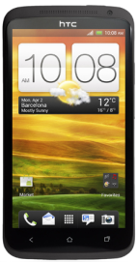
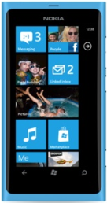

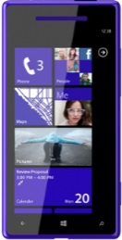
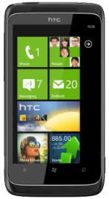
Cloud Services
Mobile Apps

Slide 3



Response Time Matters
Users are impatient

Slide 4
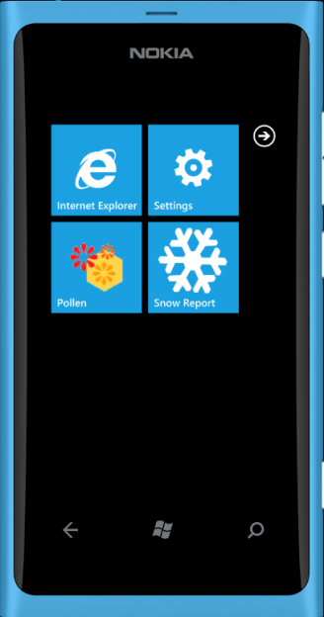
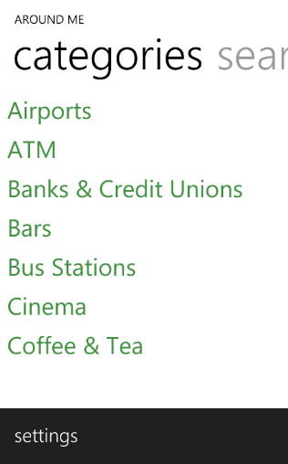

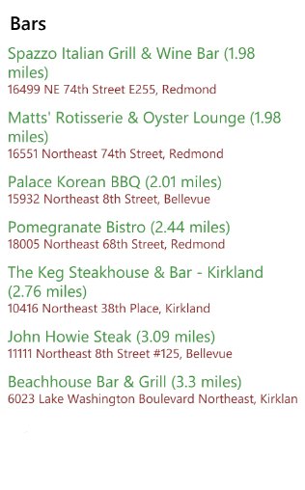


Slide 5


User interaction
Rendering
Tightly control
User-perceived delay

Slide 6

Server processing delay
Server
Uplink
Downlink
App
processing delay
App
processing delay
Request
transfer delay
Response
transfer delay
App
App
User interaction
Rendering
Tightly control
User-perceived delay

Slide 7
Control Server Delay
Server processing delay
Server
Uplink
Downlink
Control
Server delay
App
App
User interaction
Rendering
Tightly control
User-perceived delay

Slide 8
Controlling the Server Delay
Server processing
Request
Response
Server
Deadline
Trade-off quality of result for processing time
  More time to process, better quality results

Slide 9
Controlling the Server Delay
Worker
Worker
Worker
Worker
Worker
Request
Response
Server
Deadline

Slide 10
Controlling the Server Delay
Worker
Worker
Worker
Worker
Worker
Request
Response
Server
Better result
Deadline

Slide 11
Controlling the Server Delay
Assumed
external delay
Assumed
external delay
Server processing
Server
Deadline
Servers keep fixed deadlines
  No consideration about external delays
  Assume constant external delays

Slide 12
Significant Variability in External Delays
Server processing
TCP state
Server
TCP state
Device type
Data size
Network
(3G, WiFi, LTE, ..)
RTT, tput
Reading sensors
Device type
App
App
User interaction
Radio state
Rendering
Highly variable
[AppInsight – OSDI ’12]

Slide 13
Significant Variability in External Delays
Server
Deadline
Client with high external delays
  Poor end-to-end response time
Client with low external delays
  Do not produce the best quality result

Slide 14
Significant Variability in External Delays
Server
Servers should adapt to external delays
to control the user-perceived delay

Slide 15
Significant Variability in External Delays
Server
Deadline

Slide 16
Significant Variability in External Delays
Server
Adapt

Slide 17
Significant Variability in External Delays
Server
Adapt
App
App
User interaction
Rendering
End-to-end deadline

Slide 18
Timecard
Server
App
App

Slide 19
Timecard
GetElapsedTime();
PredictRemainingTime(responseSize);
Adapt
Server
App
App
Time elapsed since
user interaction
Predicted downlink &
app processing delay

Slide 20
Timecard
GetElapsedTime();
PredictRemainingTime(responseSize);
Adapt Processing Time
Server
App
App
Desired end-to-end delay

Slide 21
Timecard
GetElapsedTime();
PredictRemainingTime(responseSize);
Adapt Processing Time
Server
Trade-off on
quality of the result
App
App
Desired end-to-end delay

Slide 22
Timecard
GetElapsedTime();
PredictRemainingTime(responseSize);
Server
Adapt Response
App
App
Desired end-to-end delay

Slide 23
Timecard
GetElapsedTime();
PredictRemainingTime(responseSize);
Server
Adapt Response
App
App
Desired end-to-end delay

Slide 24
Timecard
GetElapsedTime();
PredictRemainingTime(responseSize);
Server
Better
quality result
App
App
Desired end-to-end delay

Slide 25
Timecard
GetElapsedTime();
PredictRemainingTime(responseSize);
Server
App
App
Time elapsed since
user interaction
Predicted downlink &
app processing delay

Slide 26
Challenges
Server
App
App

Slide 27
Challenges
Server
Highly asynchronous
App
App
Background Thread
GPS callback
Web request
Web callback
Background Thread
UI dispatcher
Event
handler
GPS start
UI Thread
Thread start

Slide 28
Challenges
Server Threads
Send response
Spawn workers
Server
Request
handler
Highly asynchronous
App
App
Background Thread
GPS callback
Web request
Web callback
Background Thread
UI dispatcher
Event
handler
GPS start
UI Thread
Thread start
Transaction

Slide 29


Challenges
GetElapsedTime();
PredictRemainingTime(responseSize);
No single reference
clock
Variable network delays
and processing delays
Server
Highly asynchronous
App
App
Transaction

Slide 30
Timecard
GetElapsedTime();
PredictRemainingTime(responseSize);
TimeSync
Delay Predictors
Server
Transaction Tracking
App
App
Transaction

Slide 31





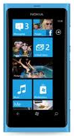

Timecard
Developer
App
Service
Timecard.dll
config
GetElapsedTime();
PredictRemainingTime
(responseSize);
App Instrumenter
Desired end-to-end delay
Instrumented
App
App Store

Slide 32
Timecard
GetElapsedTime();
PredictRemainingTime(responseSize);
TimeSync
Delay Predictors
Server
Transaction Tracking
App
App
Transaction

Slide 33
Timecard
GetElapsedTime();
PredictRemainingTime(responseSize);
TimeSync
Delay Predictors
Server
Transaction Tracking
App
App
Transaction

Slide 34
Transaction Tracking
Server Threads
Send response
Spawn workers
Server
Request
handler
App
App
Background Thread
GPS callback
Web request
Web callback
Background Thread
UI dispatcher
Event
handler
GPS start
UI Thread
Thread start
Transaction

Slide 35
Transaction Tracking
Server Threads
Send response
Spawn workers
Track across thread boundaries
  at the app and at the server
Background Thread
GPS callback
Web request
Web callback
Background Thread
UI dispatcher
Event
handler
GPS start
UI Thread
Thread start

Slide 36
Transaction Tracking
Server Threads
Track between app and server
Send response
Spawn workers
Server
Request
handler
App
App
Background Thread
GPS callback
Web request
Web callback
Background Thread
UI dispatcher
Event
handler
GPS start
UI Thread
Thread start

Slide 37
Transaction Tracking
Server Threads
Send response
Spawn workers
Server
Request
handler
App
App
Background Thread
GPS callback
Web request
Web callback
Background Thread
UI dispatcher
Event
handler
GPS start
UI Thread
Thread start
Transaction

Slide 38
Transaction Tracking
TC
Server Threads
TC
TC
Send response
TC
Spawn workers
Server
Request
handler
App
App
TC
Background Thread
TC
GPS callback
Web request
Web callback
TC
Background Thread
UI dispatcher
Event
handler
GPS start
TC
UI Thread
TC
Thread start
TC
Transaction context (TC) attached to every thread
  Carry along timestamps, transaction information

Slide 39
Transaction Tracking
Server Threads
Event handler – create new Transaction context (TC)
  Timestamp and attach to thread
Asynchronous call – Pass TC from current thread to callback thread
  Pass TC by detouring callbacks [AppInsight – OSDI ‘12]
Send response
Spawn workers
Server
Request
handler
App
App
TC
Background Thread
GPS callback
Web request
Web callback
TC
Background Thread
UI dispatcher
Event
handler
GPS start
TC
UI Thread
Thread start
TC

Slide 40
Transaction Tracking
Server Threads
Send response
Spawn workers
Server
Request
handler
App
App
TC
Background Thread
GPS callback
Web request
Web callback
TC
Background Thread
UI dispatcher
Event
handler
GPS start
TC
UI Thread
Thread start
TC

Slide 41
Transaction Tracking
Server Threads
Send response
TC
Spawn workers
Server
Request
handler
TC
HTTP[“x-Timecard-Request”]
App
App
TC
Background Thread
GPS callback
Web request
Web callback
TC
Background Thread
UI dispatcher
Web Request – pass TC from current thread to server
  Encode TC in a special HTTP header
Request handler at server – Parse TC and attach to server thread
Event
handler
GPS start
TC
UI Thread
Thread start
TC

Slide 42
Transaction Tracking
Server Threads
Send response
TC
Spawn workers
Server
Request
handler
TC
App
App
TC
Background Thread
GPS callback
Web request
Web callback
TC
Background Thread
UI dispatcher
Event
handler
GPS start
TC
UI Thread
Thread start
TC

Slide 43
Transaction Tracking
GetElapsedTime();
TC
Server Threads
TC
TC
Send response
TC
Spawn workers
Server
Request
handler
TC
App
App
TC
Background Thread
TC
GPS callback
Web request
Web callback
TC
Background Thread
UI dispatcher
Event
handler
GPS start
TC
UI Thread
TC
Thread start
TC

Slide 44
Timecard
GetElapsedTime();
PredictRemainingTime(responseSize);
TimeSync
Delay Predictors
Server
Transaction Tracking
App
App
Transaction

Slide 45

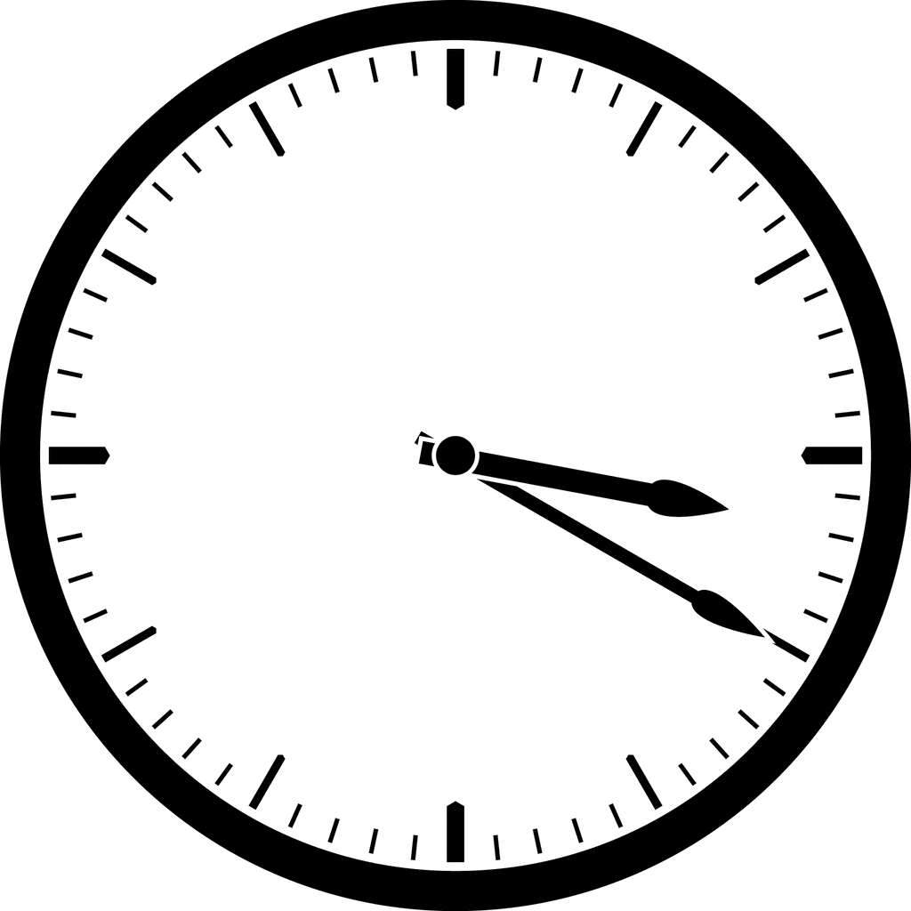
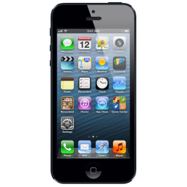
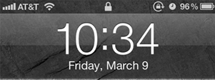
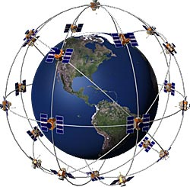
TimeSync
Sync with Cell Tower
  Off my several seconds to minutes
GPS
  Does not work indoors
Probing
Probe
GPS

Slide 46
TimeSync
Symmetric
Asymmetric
Probe
Instrument app to automatically send probes
Smartphone clock
Clock offset
Server clock
Clock drift

Slide 47
TimeSync
Idle
Idle
Radio wakeup
delay
Probe
Active
with large extra delay
Network Radio States

Slide 48

TimeSync
Network traffic
Queuing delay
Idle
Probe
Active
Active
with large extra delay

Slide 49
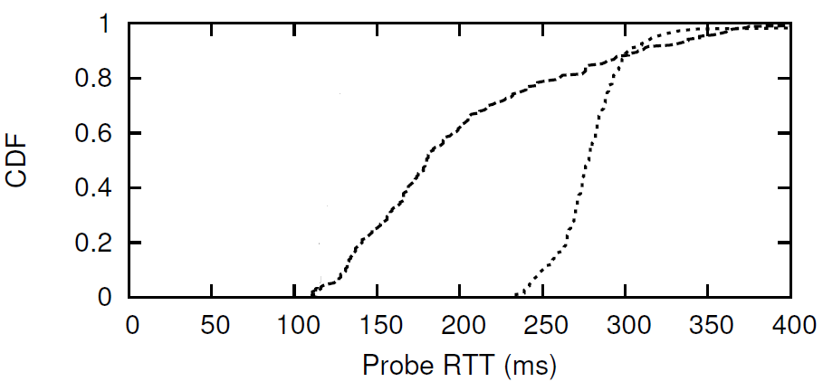
TimeSync
Network busy
min RTT
Radio idle
> 100ms error

Slide 50
TimeSync
Probe
Need to be radio-aware and network-aware
Optimal time to send the probes
  Radio is active
  No network traffic from the phone

Slide 51
TimeSync
Server
App
App

Slide 52
TimeSync
Probe
App
Background Thread
GPS callback
Web request
Background Thread
Event
handler
GPS start
UI Thread
Thread start

Slide 53
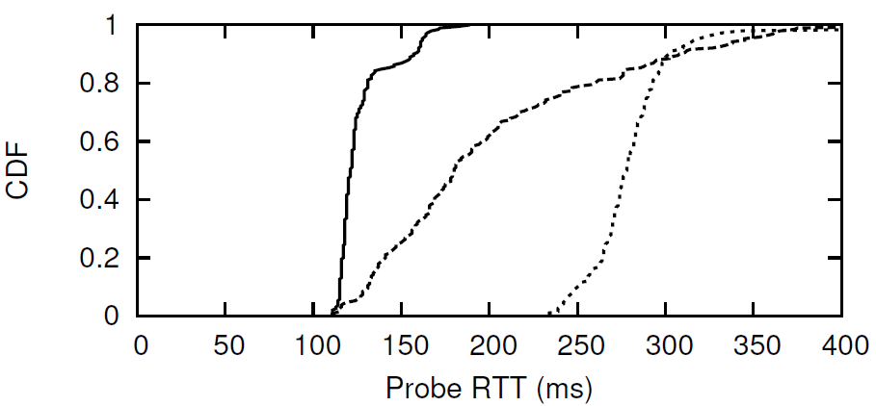
TimeSync
Network busy
min RTT
Timecard
Radio idle
~5ms error

Slide 54
Timecard
GetElapsedTime();
Server
App
App
Time elapsed since
user interaction

Slide 55
Predicting Remaining Time
PredictRemainingTime(responseSize);
Server
App
App
Downlink delay
App processing delay

Slide 56
Predicting Downlink Delay
Analysis of 4000 apps
Most transfers are short
  Median – 3KB
  90% percentile – 37KB
TCP window state
Response size
Latency
Cellular networks
  High-bandwidth, rare-loss,
  high-latency,
Throughput
Loss rate
99% transfers over HTTP
  TCP window state matters -> multiple RTTs

Slide 57
Predicting Downlink Delay
TCP Window
1 extra RTT

Slide 58
Predicting Downlink Delay
TCP parameters
Response size
Determined by
RTT
Number of round trips
Latency

Slide 59
Predicting Downlink Delay
RTT
Use recent estimate of RTT
  Use time sync probes
Read TCP window state
Number of round trips
Middlebox
TCP window
state
Read TCP window state at server
Do not work with middleboxes
  Split-TCP connection
TCP window state at the middlebox matters
  No easy way to estimate
Build an empirical data-driven model

Slide 60
Predicting Downlink Delay
PredictRemainingTime(responseSize);
Decision tree model
  Response size
  Recent RTT
  Network provider
  Bytes already transferred in
  the TCP connection
    Proxy for TCP window state at the middlebox
Downlink Delay Predictor
Middlebox
Learn

Slide 61
Predicting Downlink Delay
20 users + controlled experiments
  1 month, two cities
250,000 downloads
  1 KB to 500KB
AT&T, T-Mobile, Sprint, Verizon, Wi-Fi
  3G, 4G (HSPA+), LTE
Indoors, outdoors, static, walking, driving
Split the data into training and testing
Wi-Fi
Median error - 12 ms, 90th percentile - 31ms
Cellular
Median error - 17 ms, 90th percentile - 86 ms

Slide 62
Predicting App Processing Delay
PredictRemainingTime(responseSize);
Server
App
App

Slide 63
Predicting Remaining Time
PredictRemainingTime(responseSize);
Downlink Delay Predictor
Server
Processing Delay Predictor
App
App

Slide 64
Timecard
GetElapsedTime();
PredictRemainingTime(responseSize);
e
d = D – e – r
r
Server
App
App
D
Desired end-to-end delay

Slide 65
Deployment
Mobile ads service
Twitter analysis service

Slide 66

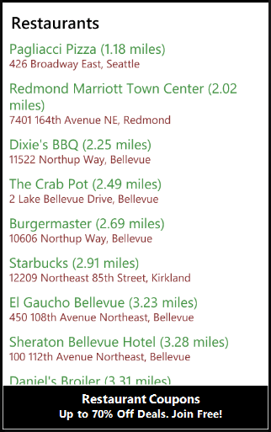
Mobile Ads Service
Contextual ads to mobile apps [Mobisys ’13]

Slide 67

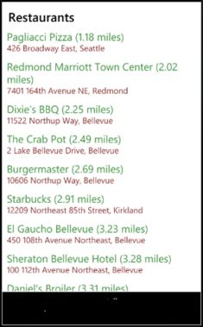
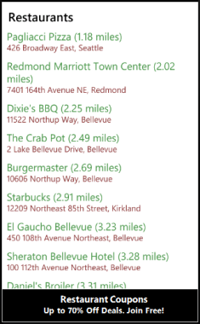
Mobile Ads Service
Fetch and process ads for keywords
Send keywords
Extract keywords
Render ad
Best Ad

Slide 68
Mobile Ads Service
Ad provider
Ad provider
Keywords
Ad provider
Ad provider
Ad provider
A
Send keywords
Extract keywords
Render ad
Ad

Slide 69
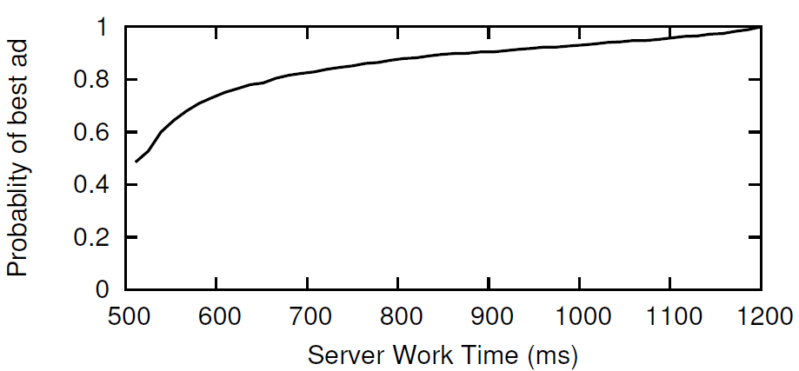
Mobile Ads Service
Send keywords
Extract keywords
Render ad
Ad

Slide 70
Mobile Ads Service
GetElapsedTime();
PredictRemainingTime(responseSize);
Adapt Processing Time
Send keywords
Extract keywords
Render ad
Ad

Slide 71
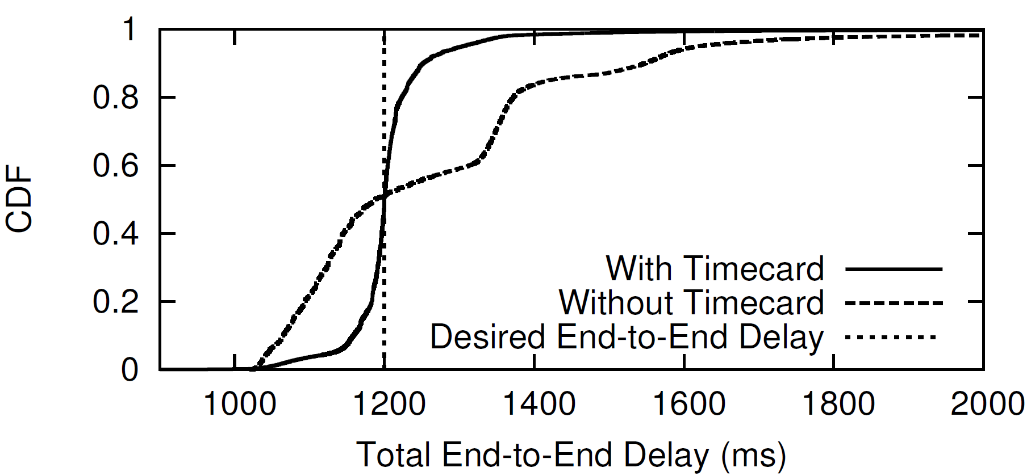
Mobile Ads Service
~200,000 transactions
Significant variability in external delay
With Timecard
Target
delay
Without Timecard
Within 50ms of the target delay 90% of the time

Slide 72
Deployment
Mobile ads service
Twitter analysis service

Slide 73

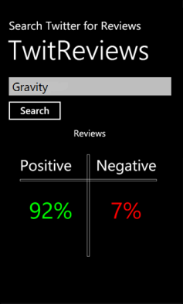
Twitter Analysis Service
Fetch from Twitter and analyze
Send keyword
Get keyword
Parse and render
Score and tweets

Slide 74
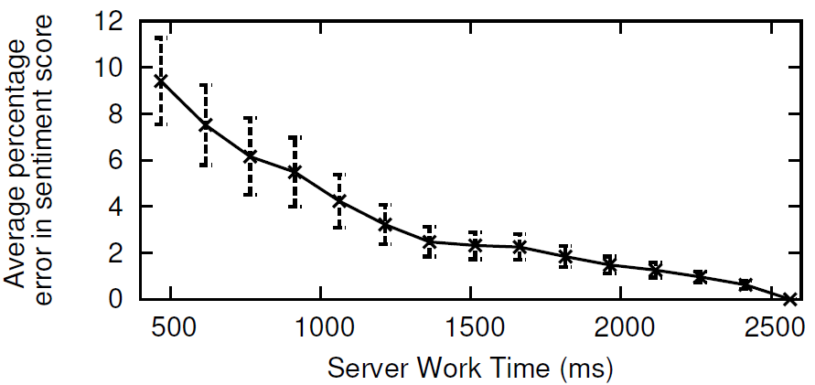
Twitter Analysis Service
Fetch from Twitter and analyze
Send keyword
Get keyword
Parse and render
Score and tweets

Slide 75
Twitter Analysis Service
GetElapsedTime();
PredictRemainingTime(responseSize);
Adapt Processing Time
10KB to 50 KB
Adapt Response
Send keyword
Get keyword
Parse and render
Score and tweets

Slide 76
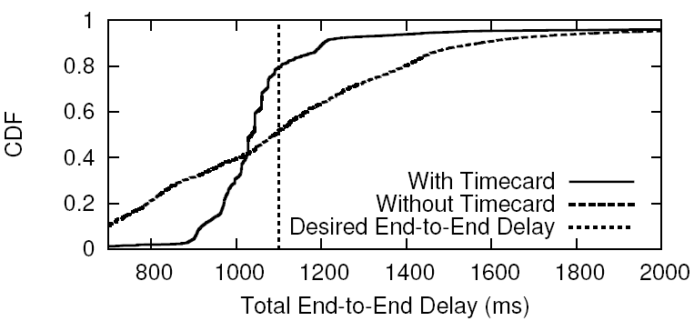
Twitter Analysis Service
~150,000 transactions
Adapt server processing time in steps of 150ms
With Timecard
Target
delay
Without Timecard
Tightly control end-to-end delay with Timecard

Slide 77
Timecard Overhead
0.1% runtime overhead
Less than 1% memory overhead
Less than 1% network overhead
Negligible battery overhead

Slide 78
Limitations
Bootstrapping
  Training the downlink and app processing delay predictors
  Learn app processing delay for every transaction type
  Turn off adaptation till enough data is collected
Complex transactions
  Multiple parallel or serial requests
  Elapsed time will work!
  Need to model complex interactions or need developer help

Slide 79
Timecard
GetElapsedTime();
PredictRemainingTime(responseSize);
Adapt Processing Time
Server
Adapt Response
App
App
End-to-end deadline

Slide 80
Timecard
GetElapsedTime();
PredictRemainingTime(responseSize);
Adapt Resources Used
Server
App
App
End-to-end deadline

Slide 81
Timecard
GetElapsedTime();
PredictRemainingTime(responseSize);
Request Prioritization
Server
App
App
End-to-end deadline

Slide 82
Timecard
Scheduler
Deadlines
GetElapsedTime();
PredictRemainingTime(responseSize);

Slide 83
Take-Away
Controlling end-to-end delays
  Elapsed time
  Prediction on remaining time
Can be applied in several context
PredictRemainingTime(paper);
GetElapsedTime();
Adapt quality of the paper
SOSP Deadline

Slide 84
Timecard
GetElapsedTime();
PredictRemainingTime(responseSize);
Server
App
App
Time elapsed since
user interaction
Predicted downlink &
app processing delay

Slide 85
Backup

Slide 86
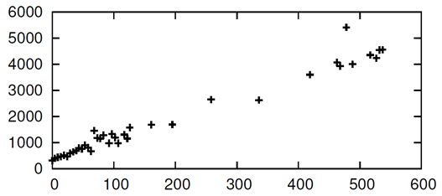
Predicting App Processing Delay
Analysis of AppInsight data
1653 types of transactions
Correlated with response size
Response size
Processing delay (ms)
App
Response size (KB)

Slide 87
Predicting App Processing Delay
Analysis of AppInsight data
1653 types of transactions
Correlated with response size
Parsing delay
  Correlated with data size
Rendering delay
  Correlated with data size
Response size
App
Dependent on device type
  Processing speed

Slide 88
Predicting App Processing Delay
PredictRemainingTime(responseSize);
Decision tree model
  Response size
  Device type
Processing Delay Predictor
Learn
App
Analysis of AppInsight data
1653 types of transactions
Median error - 8ms
90th percentile error - 100ms

