Slide 1
X-Stream: Edge-Centric Graph Processing using Streaming Partitions
Amitabha Roy
Ivo Mihailovic
Willy Zwaenepoel

Slide 2




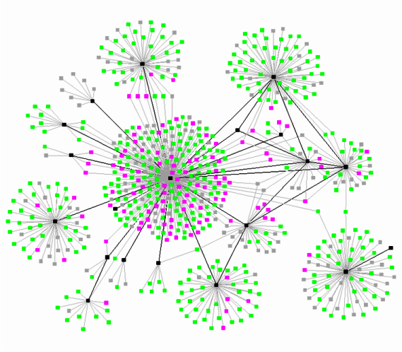
Graphs
Interesting information is encoded as graphs
HyperANF
Pagerank
ALS
….
+

Slide 3
Big Graphs
Large graphs are a subset of the big data problem
Billions of vertices and edges, hundreds of gigabytes
Normally tackled on large clusters
  Pregel, Giraph, Graphlab …
  Complexity, Power consumption …
Can we do large graphs on a single machine ?

Slide 4
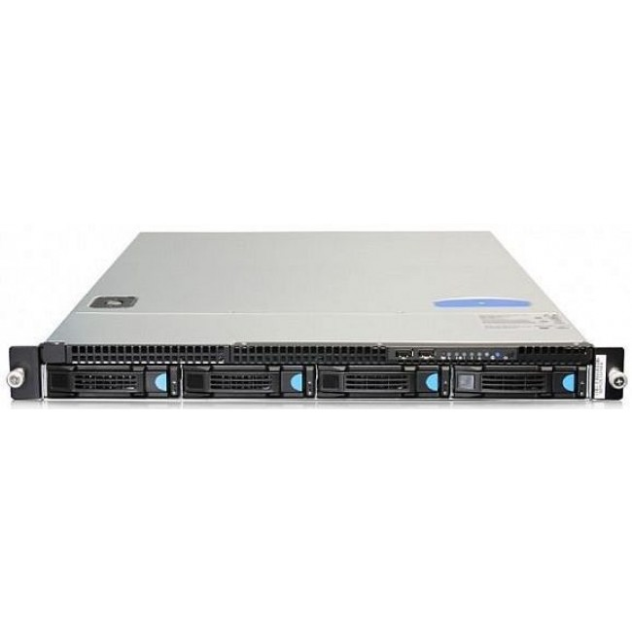
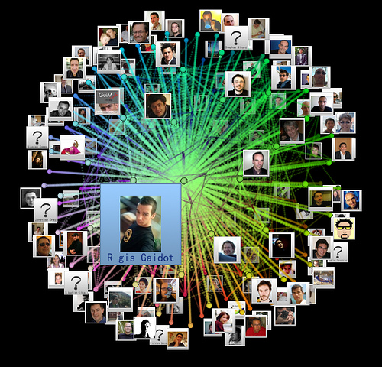
X-Stream
Process large graphs on a single machine
  1U server = 64 GB RAM + 2 x 200 GB SSD + 3 x 3TB drive
Notes:
Throw away why build X-Stream.

Slide 5
Approach
Problem: Graph traversal = random access
Random access is inefficient for storage
  Disk (500X slower)
  SSD (20X slower)
  RAM (2X slower)
Solution: X-Stream makes graph accesses sequential
Notes:
Move first point to previous slide. Consider uncovering points. Add backup slide on bandwidth numbers.

Slide 6
Contributions
Edge-centric scatter gather model
Streaming partitions
Notes:
Too much stuff. Headings are too general.

Slide 7
Standard Scatter Gather
Edge-centric scatter gather based on Standard Scatter gather
Popular graph processing model
Pregel [Google, SIGMOD 2010]
…
Powergraph [OSDI 2012]
Notes:
Need a picture for scatter gather.

Slide 8
Standard Scatter Gather
State stored in vertices
Vertex operations
  Scatter updates along outgoing edges
  Gather updates from incoming edges
V
V
Scatter
Gather
Notes:
Need a picture for scatter gather.

Slide 9
Standard Scatter Gather
1
6
3
7
2
5
8
4
BFS
Notes:
Green should not be sharp.

Slide 10
Vertex-Centric Scatter Gather
Iterates over vertices
for each vertex v
if v has update
for each edge e from v
scatter update along e
Scatter
Standard scatter gather is vertex-centric
Does not work well with storage

Slide 11
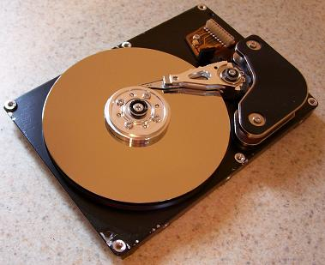
Vertex-Centric Scatter Gather
SOURCE | DEST
1 | 3
1 | 5
2 | 7
2 | 4
3 | 2
3 | 8
4 | 3
4 | 7
4 | 8
5 | 6
6 | 1
8 | 5
8 | 6
Lookup Index
1
6
3
V
1
2
3
4
5
6
7
8
7
2
5
8
4
BFS

Slide 12
Transformation
for each vertex v
if v has update
for each edge e from v
scatter update along e
for each edge e
If e.src has update
scatter update along e
Scatter
Scatter
Vertex-Centric
Edge-Centric

Slide 13
Edge-Centric Scatter Gather
SOURCE | DEST
1 | 3
1 | 5
2 | 7
2 | 4
3 | 2
3 | 8
4 | 3
4 | 7
4 | 8
5 | 6
6 | 1
8 | 5
8 | 6
1
6
3
V
1
2
3
4
5
6
7
8
7
2
5
8
4
BFS

Slide 14
SOURCE | DEST
1 | 3
1 | 5
2 | 7
2 | 4
3 | 2
3 | 8
4 | 3
4 | 7
4 | 8
5 | 6
6 | 1
8 | 5
8 | 6
SOURCE | DEST
1 | 3
8 | 6
5 | 6
2 | 4
3 | 2
4 | 7
4 | 3
3 | 8
4 | 8
2 | 7
6 | 1
8 | 5
1 | 5
=
No index
No clustering
No sorting

Slide 15
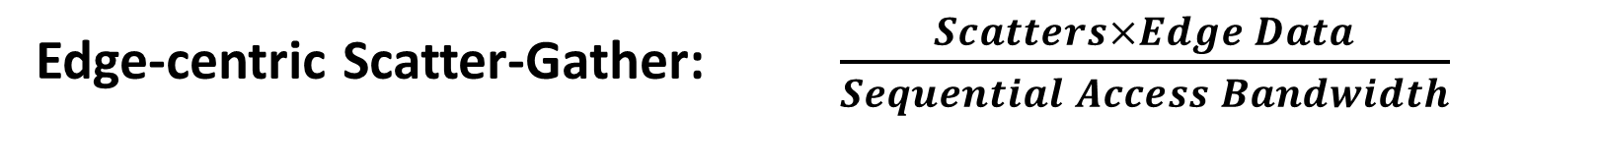
Tradeoff
Vertex-centric Scatter-Gather: $\frac{Edge Data}{Random Access Bandwidth}$
Edge-centric Scatter-Gather: $\frac{Scatters×Edge Data}{Sequential Access Bandwidth}$
Sequential Access Bandwidth >> Random Access Bandwidth
Few scatter gather iterations for real world graphs
  Well connected, variety of datasets covered in the paper

Slide 16
Contributions
Edge-centric scatter gather model
Streaming partitions
Notes:
Too much stuff. Headings are too general.

Slide 17
Streaming Partitions
Problem: still have random access to vertex set
V
1
2
3
4
5
6
7
8
Solution: partition the graph into streaming partitions

Slide 18
Streaming Partitions
A streaming partition is
  A subset of the vertices that fits in RAM
  All edges whose source vertex is in that subset
  No requirement on quality of the partition

Slide 19
Partitioning the Graph
SOURCE | DEST
1 | 5
4 | 7
2 | 7
4 | 3
4 | 8
3 | 8
2 | 4
1 | 3
3 | 2
Subset of vertices
V1
1
2
3
4
V2
5
6
7
8
SOURCE | DEST
5 | 6
8 | 6
8 | 5
6 | 1

Slide 20
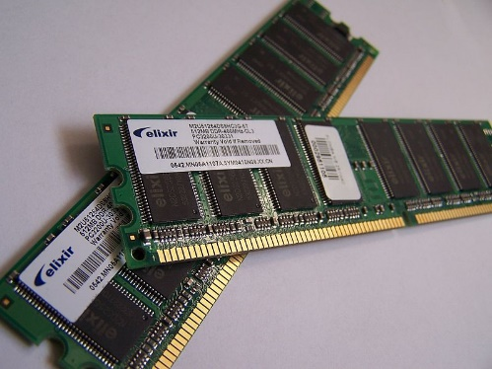
Random Accesses for Free
SOURCE | DEST
1 | 5
4 | 7
2 | 7
4 | 3
4 | 8
3 | 8
2 | 4
1 | 3
3 | 2
V1
1
2
3
4

Slide 21
Generalization
SOURCE | DEST
1 | 5
4 | 7
2 | 7
4 | 3
4 | 8
3 | 8
2 | 4
1 | 3
3 | 2
V1
1
2
3
4
Fast storage
Slow storage
Applies to any two level memory hierarchy

Slide 22
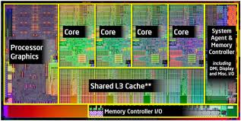

Generally Applicable
RAM
RAM
CPU Cache
OR
OR
Disk
SSD
RAM

Slide 23
Parallelism
Simple Parallelism
State is stored in vertex
Streaming partitions have disjoint vertices
Can process streaming partitions in parallel

Slide 24
Gathering Updates
Partition 1
Edges
Vertices
Partition 100
X
Y
X
Vertices
Y
Shuffler
Minimize random access for large number of partitions
Multi-round copying akin to merge sort but cheaper

Slide 25
Performance
Focus on SSD results in this talk
  Similar results with in-memory graphs
Notes:
Switch to on disk for talk.

Slide 26
Baseline
Graphchi [OSDI 2012]
First to show that graph processing on a single machine
  Is viable
  Is competitive
Also targets larger sequential bandwidth of SSD and Disk
Notes:
Consider putting in a table of differences

Slide 27
Different Approaches
  Fundamentally different approaches to same goal
Graphchi uses “shards”
  Partitions edges into sorted shards
X-Stream uses sequential scans
  Partitions edges into unsorted streaming partitions
Notes:
Consider putting in a table of differences

Slide 28
Baseline to Graphchi
Replicated OSDI 2012 experiments on our SSD
Create shards
Run Algorithm
Graphchi
Input
Shards
Answer
X-Stream
Run Algorithm
Input
Answer
Notes:
Consider putting in a table of differences

Slide 29
X-Stream Speedup over Graphchi
Mean Speedup = 2.3

Slide 30
Baseline to Graphchi
Replicated OSDI 2012 experiments on our SSD
Create shards
Run Algorithm
Graphchi
Input
Shards
Answer
X-Stream
Run Algorithm
Input
Answer
Notes:
Consider putting in a table of differences

Slide 31
X-Stream Speedup over Graphchi ( + sharding)
Mean Speedup
Prev = 2.3
Now = 3.7

Slide 32
Preprocessing Impact
X-Stream returns answers before Graphchi finishes sharding
Notes:
Put fourth benchmark back in.

Slide 33
Sequential Access Bandwidth
Graphchi shard
  All vertices and edges must fit in memory
X-Stream partition
  Only vertices must fit in memory
More Graphchi shards than X-Stream partitions
Makes access more random for Graphchi

Slide 34
SSD Read Bandwidth (Pagerank on Twitter)

Slide 35
SSD Write Bandwidth (Pagerank on Twitter)

Slide 36
Disk Transfers (Pagerank on Twitter)
Metric | X-Stream | Graphchi
Data moved | 224 GB | 322 GB
Time taken | 398 seconds | 2613 seconds
Transfer rate | 578 MB/s | 126 MB/s
SSD can sustain reads = 667 MB/s, writes = 576 MB/s
X-Stream uses all available bandwidth from the storage device
Notes:
Add a line of explanation.

Slide 37
Scaling up
256 Million V, 4 Billion E, 33 mins
4 Billion V, 64 Billion E,
26 hours
8 Million V, 128 Million E, 8 sec
6 TB Disk
400 GB SSD
16 GB RAM

Slide 38
Conclusion
X-Stream
Edge-centric processing
+
Streaming Partitions
=
Sequential Access
Good Performance
RAM, SSD, Disk
Big graphs
Download from http://labos.epfl.ch/xstream
Notes:
Too many words.

Slide 39
BACKUP

Slide 40
API Restrictions
Updates must be commutative
Cannot access all edges from a vertex in single step
Notes:
Remove.

Slide 41
Applications
X-Stream can solve a variety of problems
BFS, SSSP, Weakly connected components, Strongly connected components, Maximal independent sets, Minimum cost spanning trees, Belief propagation, Alternating least squares, Pagerank, Betweenness centrality, Triangle counting, Approximate neighborhood function, Conductance, K-Cores
Q. Average distance between people on a social network ?
A. Use approximate neighborhood function.
Notes:
Remove.

Slide 42
Edge-centric Scatter Gather
Real world graphs have low diameter
1
6
1
8
3
D=7, BFS in 7 steps
2
7
7
2
5
8
4
3
4
5
6
D=3, BFS in 3 steps, Most real-world graphs

Slide 43
X-Stream Main Memory Performance

Slide 44
Runtime impact of Graphchi Sharding

Slide 45
Pre-processing Overhead
Low overhead for producing streaming partition
Strictly cheaper than sorting edges by source vertex

