Slide 1
Silo: Speedy Transactions in Multicore In-Memory Databases
Stephen Tu, Wenting Zheng, Eddie Kohler†, Barbara Liskov, Samuel Madden
MIT CSAIL, †Harvard University
Notes:
Need an agenda

Slide 2
Goal
Extremely high throughput in-memory relational database.
  Fully serializable transactions.
  Can recover from crashes.

Slide 3

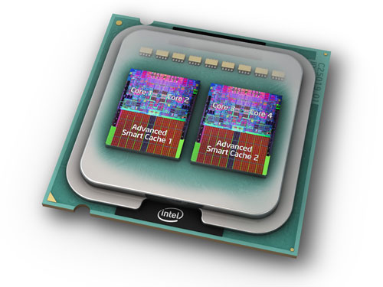


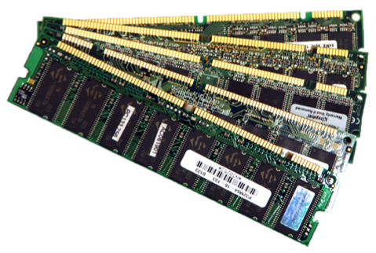
Multicores to the rescue?
txn_commit()
{
// prepare commit
// […]
commit_tid = atomic_fetch_and_add(&global_tid);
// quickly serialize transactions a la Hekaton
}
Notes:
Just say at 1 thread, performance is good
Better than other systems on the hardware
Talk about global TIDs. Can we remove? No– this is the serialization point.
Which serializability??
We started w/ this system– we optimized it, but this one thing ended up limiting scalability

Slide 4
Why have global TIDs?
Notes:
What is “this”?

Slide 5


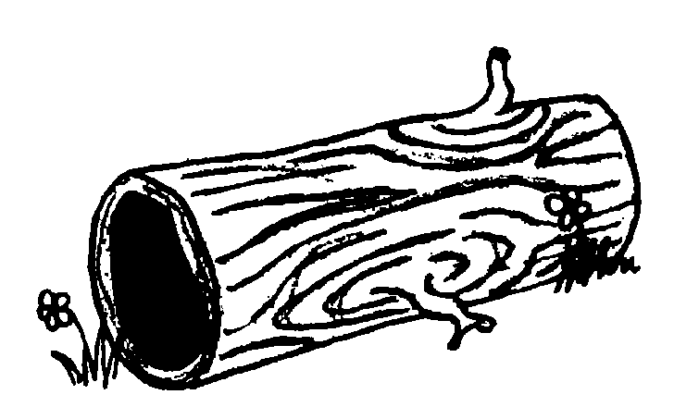

Recovery with global TIDs
State:
T1:
tmp = Read(A); // tmp = 1
Write(B, tmp);
Commit();
{ A:1, B:0 }
Global TID
T2:
Write(A, 2);
Commit();
{ A:2, B:1 }
Time
How do we properly recover the DB?
Record: [A:2]
Record: [B:1]
TID: 2, Rec: [A:2]
TID: 1, Rec: [B:1]
…
…
…
…
…
…
…
…
Notes:
Pose the question of how to force recovery of T2 to also recover T1 w/o global TID?
Can we take slide 12/13 and put in here somehow? “we solve this problem w/ use of epochs”

Slide 6


Slide 7
Silo: transactions for multicores
Near linear scalability on popular database benchmarks.
Raw numbers several factors higher than those reported by existing state-of-the-art transactional systems.
Notes:
Think about how to emphasis this more
(put some graph there?)
Can we just say awesome raw throughput numbers w/o making a reference to existing literature?

Slide 8
Secret sauce
A scalable and serializable transaction commit protocol.
  Shared memory contention only occurs when transactions conflict.
Surprisingly hard: preserving scalability while ensuring recoverability.

Slide 9
Solution from high above
Use time-based epochs to avoid doing a serialization memory write per transaction.
  Assign each txn a sequence number and an epoch.
Seq #s provide serializability during execution.
  Insufficient for recovery.
Need both seq #s and epochs for recovery.
  Recover entire epochs (all or nothing).
Notes:
Slow down on this slide.

Slide 10
Epoch design
Notes:
What is “this”?

Slide 11
Epochs
Divide time into epochs.
  A single thread advances the current epoch.
Use epoch numbers as recovery boundaries.
Reduces non data driven shared writes to happening very infrequently.
  Serialization point is now a memory read of the epoch number!

Slide 12
Transaction Identifiers (TIDs)
Each record contains TID of its last writer.
TID is broken into three pieces:
Assign TID at commit time (after reads).
  Take the smallest number in the current epoch larger than all record TIDs observed in the transaction.
Status bits | Sequence number | Epoch number
0
63
Notes:
Be more clear that TID is assigned at *end* of TID

Slide 13
Executing/committing transactions
Notes:
Make the flow of transactions more clear?

Slide 14
Pre-commit execution
Idea: proceed as if records will not be modified – check otherwise at commit time.
To read record A, save the record’s TID in a local read-set, then use the value.
To write record A, store the write in a local write-set.
(Standard optimistic concurrency control)

Slide 15
Commit Protocol
Phase 1: Lock (in global order) all records in the write set.
  Read the current epoch.
Phase 2: Validate records in read set.
  Abort if record’s TID changed or lock is held (by another transaction).
Phase 3: Pick TID and perform writes.
  Use the epoch recorded in Phase 1 for the TID.
Notes:
Intuition of what phase 1 and phase 2 achieve– in phase 3 we ensure no conflict in RW sets

Slide 16
// Phase 1
for w, v in WriteSet {
Lock(w); // use a lock bit in TID
}
Fence(); // compiler-only on x86
e = Global_Epoch; // serialization point
Fence(); // compiler-only on x86
// Phase 2
for r, t in ReadSet {
Validate(r, t); // abort if fails
}
tid = Generate_TID(ReadSet, WriteSet, e);
// Phase 3
for w, v in WriteSet {
Write(w, v, tid);
Unlock(w);
}
Notes:
Don’t resay the previous slide

Slide 17
Returning results
Say T1 commits with a TID in epoch E.
Cannot return T1 to client until all transactions in epochs ≤ E are on disk.

Slide 18
Correctness

Slide 19
Epoch read = serialization point
One property we require is that epoch differences agree with dependencies.
  T2 reads T1’s write → T2’s epoch ≥ T1’s.
  T2 overwrites a key T1 read → T2’s epoch ≥ T1’s.
The commit protocol achieves this.
Full proof in paper.
Notes:
Want to show epochs agree w/ serial order.
Mention in english write-write conflicts?

Slide 20
Write-after-read example
Say T2 overwrites a key T1 reads.
T1:
tmp = Read(A);
WriteLocal(B, tmp);
Lock(B);
e = Global_Epoch;
Validate(A); // passes
t = GenerateTID(e);
WriteAndUnlock(B, t);
T1() {
tmp = Read(A);
Write(B, tmp);
}
T2() {
Write(A, 2);
}
T2’s epoch ≥ T1’s epoch
Time
T2:
WriteLocal(A, 2);
Lock(A);
e = Global_Epoch;
t = GenerateTID(e);
WriteAndUnlock(A, t);
B
A
A happens-before B
Notes:
Mention you can do a similar argument for RAW

Slide 21
Read-after-write example
Say T2 reads a value T1 writes.
T1:
WriteLocal(A, 2);
Lock(A);
e = Global_Epoch;
t = GenerateTID(e);
WriteAndUnlock(A, t);
T1() {
Write(A, 2);
}
T2() {
tmp = Read(A);
Write(A, tmp+1);
}
T2’s epoch ≥ T1’s epoch
T2’s TID > T1’s TID
Time
T2:
tmp = Read(A);
WriteLocal(A, tmp+1);
Lock(A);
e = Global_Epoch;
Validate(A); // passes
t = GenerateTID(e);
WriteAndUnlock(A, t);
B
A
A happens-before B
Notes:
This lets us correctly replay writes in the same epoch

Slide 22
Storing the data

Slide 23
Storing the data
A commit protocol requires a data structure to provide access to records.
We use Masstree, a fast non-transactional B-tree for multicores.
But our protocol is agnostic to data structure.
  E.g. could use hash table instead.
Notes:
Emphasize Masstree is non-transactional.

Slide 24
Masstree in Silo
Silo uses a Masstree for each primary/secondary index.
We adopt many parallel programming techniques used in Masstree and elsewhere.
  E.g. read-copy-update (RCU), version number validation, software prefetching of cachelines.

Slide 25
From Masstree to Silo
Inserts/removals/overwrites.
Range scans (phantom problem).
Garbage collection.
Read-only snapshots in the past.
Decentralized logger.
NUMA awareness and CPU affinity.
And dependencies among them!
See paper for more details.
Notes:
*crucial to getting good performance*

Slide 26
Evaluation

Slide 27
Setup
32 core machine:
  2.1 GHz, L1 32KB, L2 256KB, L3 shared 24MB
  256GB RAM
  Three Fusion IO ioDrive2 drives, six 7200RPM disks in RAID-5
  Linux 3.2.0
No networked clients.

Slide 28
Workloads
TPC-C: online retail store benchmark.
  Large transactions (e.g. delivery is ~100 reads + ~100 writes).
  Average log record length is ~1KB.
  All loggers combined writing ~1GB/sec .
YCSB-like: key/value workload.
  Small transactions.
  80/20 read/read-modify-write.
  100 byte records.
  Uniform key distribution.

Slide 29
Scalability of Silo on TPC-C
I/O
(scalability
bottleneck)
I/O slightly limits scalability, protocol does not.
Note: Numbers several times faster than a leading commercial system + numbers better than those in paper.
Notes:
Talk about IO bottleneck as a hypothesis, and how we validated it

Slide 30
Cost of transactions on YCSB
Protocol (~4%)
Global TID (~45%)
Key-Value: Masstree (no multi-key transactions).
  Transactional commits are inexpensive.
MemSilo+GlobalTID: A single compare-and-swap added to commit protocol.
Notes:
Say Key-Value has no durability.

Slide 31
Related work

Slide 32
Solution landscape
Shared database approach.
  E.g. Hekaton, Shore-MT, MySQL+
  Global critical sections limit multicore scalability.
Partitioned database approach.
  E.g. H-Store/VoltDB, DORA, PLP
  Load balancing is tricky; experiments in paper.

Slide 33
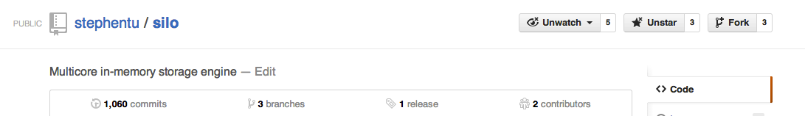
Conclusion
Silo is a new in memory database designed for transactions on modern multicores.
Key contribution: a scalable and serializable commit protocol.
Great performance on popular benchmarks.
Fork us on github: https://github.com/stephentu/silo

